Slide 1
Policy 4-001: Data Management Policy, Summary Slide
Functional Areas |  | Inputted Data Stewards
Financial Areas | Budget | Sandy Hughes | 4
 |  | Cathy Anderson | 3
 |  | Mark Winter | 2
 |  | Unknown/No Input | 4
 | General Ledger | Cathy Anderson | 2
 |  | Todd Kapos | 2
 |  | Laura Howat | 1
 |  | Lisa Zaelit | 1
 |  | Sandy Hughes | 1
 |  | Unknown/No Input | 6
HR Area | HR | Jeff Herring | 4
 |  | Josna Kotturappa | 3
 |  | Mary Anne Berzins | 1
 |  | My HR Rep | 1
 |  | Unknown/No Input | 3
Formalizing Data Accountability and Processes
Clarify role responsibilities
Who’s accountable
Centralized location for current individuals accountable for data

Slide 2
Updates 4-001, Institutional Data Management Policy

Slide 3
4-001, Definitions
Replaces employee with functional areas and adds a general sentence of excluding data from being classified as Institutional if there is policy prohibiting it
A. Institutional Data – Data that are acquired or maintained by University functional areas in the performance of official administrative job duties. Specifically excluded from the definition of Institutional Data are: personal medical, psychiatric, or psychological data for both employees and patients seen at University Hospitals or Clinics; notes and records that are the personal property of individuals in the University community; research notes, data and materials; and data otherwise restricted by institutional policy or State or Federal guidelines.

Slide 4
4-001, Definitions continued
Adding reference to new guideline which stores data stewards’ contact information.
F. Data Steward – A University official who has planning and policy-level responsibilities for access and management of Institutional Data in his or her functional areas. A Data Steward is appointed by the Vice President who is responsible for the Data Steward’s functional area. For example, the Vice President for Enrollment Management appoints the Registrar as the Data Steward over student data. Current appointments are posted to section IV.A Guideline - Data Management Roles by functional areas

Slide 5
4-001, Definitions continued
Again adding reference to new guideline, but also expands on a data custodian’s role as initial contact and subject matter expert.
G. Data Custodian - The subject matter expert that is the initial source of contact for data within their functional area. The Data Custodian implements the policy, procedures, and best practices defined by the Data Steward, and has responsibility for IT systems that create, receive, store, process or transmit Institutional Data. Data Custodians suggests prioritizations, modifications, or clarifications to Data Stewards for data within their functional area. Current appointments are posted to section IV.A Guideline - Data Management Roles by functional areas

Slide 6
4-001, Definitions continued
Addition indicates that data users should be communicating with or following procedures created by data stewards when utilizing data within a stewards functional area
I. Data Users – Individuals and organizations that access Institutional Data and Information, in coordination with data stewards and custodians, in order to perform their assigned duties or to fulfill their role in the university community.

Slide 7
4-001, Definitions continued
Adding reference to new guideline
J. Best Practices – Accepted management and access procedures that Data Custodians, Data Administrators and Data Users follow to ensure security, accessibility, and integrity of Institutional Data. The Data Steward is responsible for specifying Best Practices and identifying adequate resources that enable Data Custodians and Data Administrators to implement Best Practices. Best Practices change as technology, procedural improvements, and the nature of the data change. Because Best Practices are subject to change, they will be described in documented procedures that reference policy. Delegations given to data custodians to implement best practices will be referenced in the IV.A Guideline - Data Management Roles

Slide 8
4-001, Definitions continued
Adding reference to new guideline
K. Guideline - Data Management Roles - indicates current individuals filling the Data Steward and Data Custodian roles and the functional area they are appointed to. The guideline will be periodically updated by the CIO's office as necessary.

Slide 9
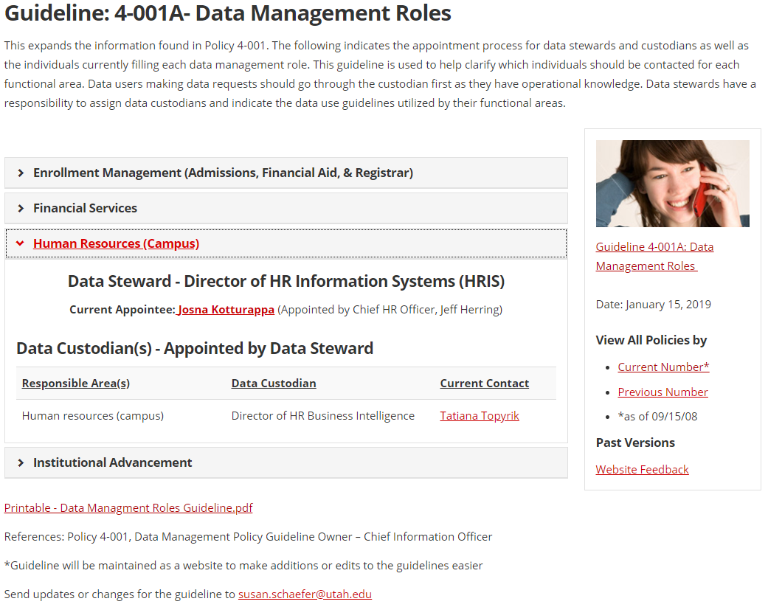

Slide 10
Reasons for the proposed changes
Decrease confusion for data users around access or use
Reduces reports mismatch by indicating current data stewards that are approving definitions and calculation standards
Better data transparency to better understand needs and uses
To protect the privacy and data of students, patients, staff, and faculty.

Slide 11
Potential Impact
Negligible for patients, students, staff and faculty
The additions added to the definition is to help clarify how and who to contact for data. No changes are made to how policy defines data usage.

Slide 12
Q & A

