Slide 1

https://dps.utah.edu/coronavirus/

Slide 3
UAC
VISION
U Extended Campus
World-Class Teaching, Learning Environment
Platform for Exploring Innovation and Scholarship
In a Unique Cultural Setting
Gateway for International Student Recruitment
Global Experience for SLC Campus Students

Slide 4
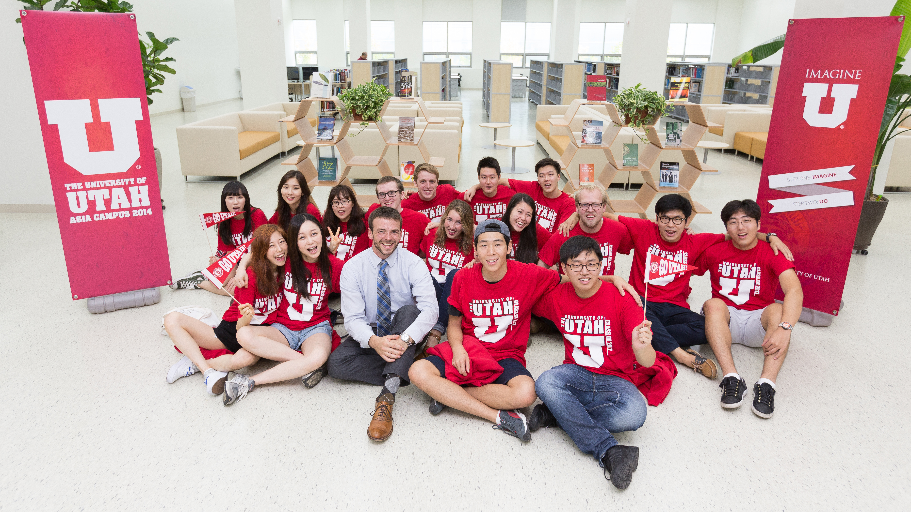
2014 INAUGURAL CLASS

Slide 5
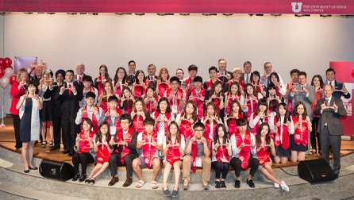
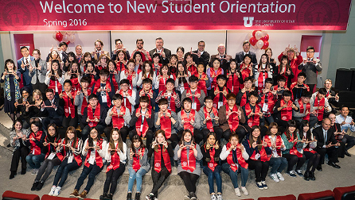
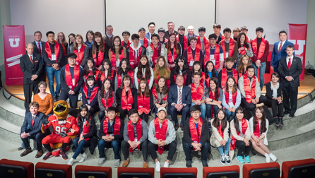
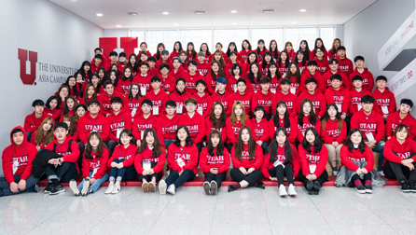
2015
2016
2017
2018

Slide 6
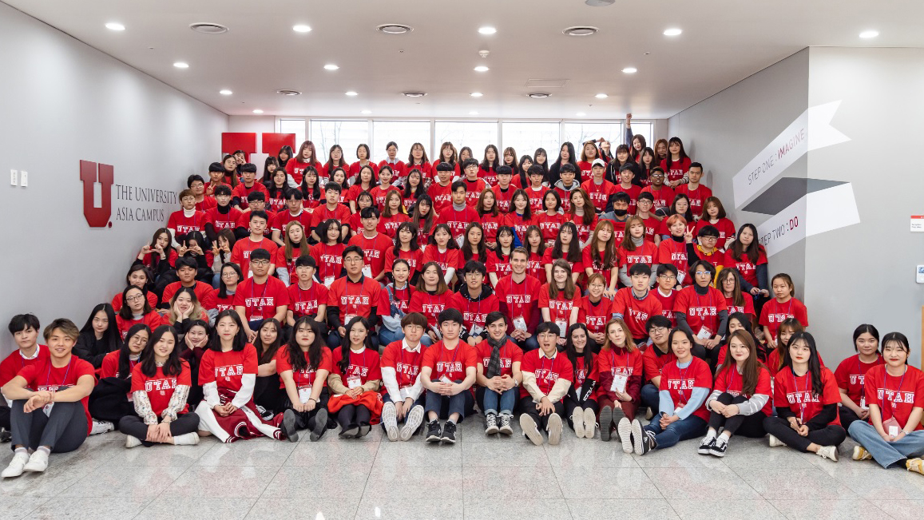
2019 SPRING CLASS

Slide 7

UAC REVENUE STREAM
176
141
100
78
85
# of new students
FY
15
16
17
18
19
Tuition (USD)
532,000
3,047,000
4,162,000
4,438,000
4,971,702
Total Revenue (USD)
2,018,000
4,407,000
5,518,000
5,939,000
5,027,952
Annual Korean Government Subsidy of $1,311,000 for first four years

Slide 8
Student Growth at the Utah Asia Campus
Semester | Students enrolled in classes in Korea | UAC students studying at the Salt Lake City Campus
 |  |  | Total Students
Fall 2014 | 13 |  | 13
Spring 2015 | 77 |  | 77
Fall 2015 | 112 |  | 112
Spring 2016 | 162 |  | 162
Fall 2016 | 194 | 4 | 198
Spring 2017 | 194 | 25 | 219
Fall 2017 | 192 | 26 | 218
Spring 2018 | 232 | 43 | 275
Fall 2018 | 268 | 43 | 311
Spring 2019 | 340 | 64 | 404
Fall 2019 | 348 | 55 | 403
Does not include students on approved LOA

Slide 9
ACADEMIC SUCCESS
  Fall 2016 (N = 3): Average GPA: 3.92 Range: 3.77 - 4.0
  Spring 2017 (N = 22): Average GPA: 3.67 Range: 2.41 - 4.
  Summer 2017 (N = 24): Average GPA: 3.68 Range: 2.67 – 4.0
  Fall 2017 (N = 23): Average GPA: 3.53 Range: 2.56 – 4.0
  Spring 2018 (N = 40): Average GPA: 3.51 Range: .23 – 4.0
  Summer 2018 (N=40): Average GPA: 3.59 Range: 2.45 – 4.0
  Fall 2018 (N = 35): Average GPA: 3.54 Range: 1.96 – 4.0
  Spring 2019 (N = 61): Average GPA: 3.62 Range: 2.7 – 4.0

Slide 10

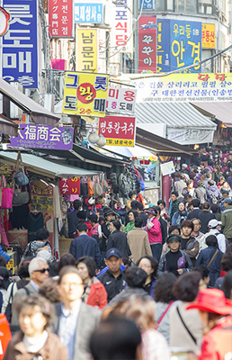
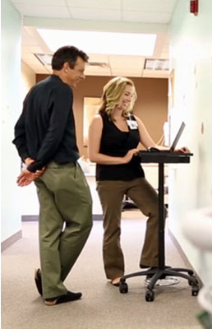

MAJORS 2014-2017
Communication
Psychology
Public Health
Social Work

Slide 11


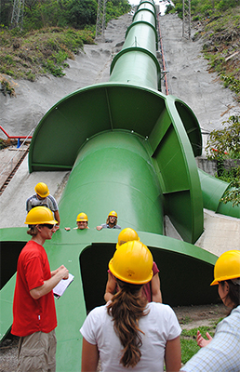
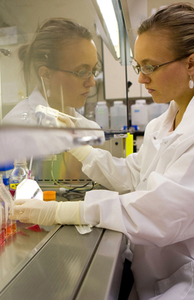
MAJORS 2017-2019
Civil and Environmental
Engineering
Film and Media Arts
Urban Ecology
Biomedical Informatics

Slide 12


WHAT’S NEXT
CELEBRATION 5th Anniv.
Marketing campaign
ADD NEW DEGREES
STEM, complement
ENROLLMENT
Domestic, International
CAMPUS RECOGNITION
Faculty, Honors
RESEARCH CAPABILITY
--------

Slide 13
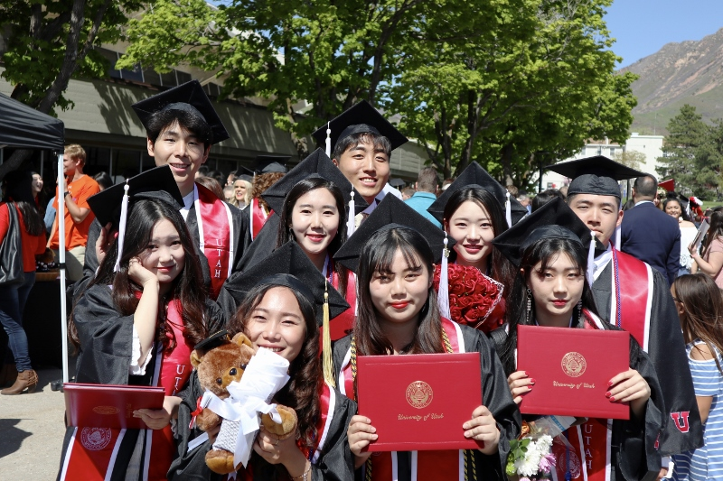
GRADUATING STUDENTS!
Graduating Students:
  Spring 2017: 1
  Summer 2017: 7
  Fall 2017: 6
  Spring 2018: 13
  Summer 2018: 15
  Fall 2018: 8
  Spring 2019: 11
  Summer 2019: 24
  53 COMM, 27 PSYC, 7 SW, 2 FMS
TOTAL GRADUATES FROM SLC CAMPUS: 85!

Slide 14
UAC Faculty Fall 2019
Daniel Wee, PhD Biology, University of Utah. Assistant Professor Lecture Track. Raised in SLC, co-founder of bio tech start-up T3S Technologies in SLC with Professor Kelly Hughes.
Hwan Yong Lee, PhD Mathematics, University of Utah. Associate Professor Lecture Track. Taught math for Engineers at Drexel University for 8 years.
Sejin Kim, PhD Communication, Colorado State University. Assistant Professor Lecture Track.
Ansuk Jeong, PhD, Community Psychology, University of Illinois, Chicago. Assistant Professor Lecture Track. Has taught at UIC and the University of Chicago. Holds the only active research grant at UAC from the Korean National Research Foundation to study families who have a cancer patient, to investigate their stress and coping mechanisms.
Younghee Lee, PhD, in Bioinformatics, Ewha Woman’s University. Postdoc in Genetic Medicine, University of Chicago, School of Medicine. Assistant Professor Tenure Track. One of two tenure track faculty at the UAC. Appointed in SLC after a national search.

