Slide 1
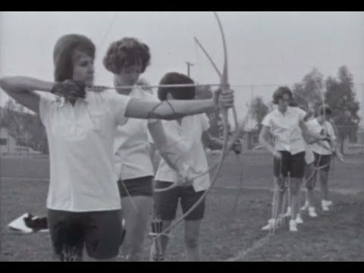
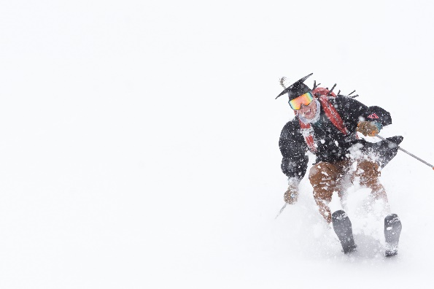
Parks, Recreation, & Tourism
Discontinuation of the Doctorate of Education, Ed.D. Degree
-The degree has not been sought for over 25 years
-The degree is left-over from our past association with the College of Education
-The degree is not sought by students in this field of study

