Slide 1
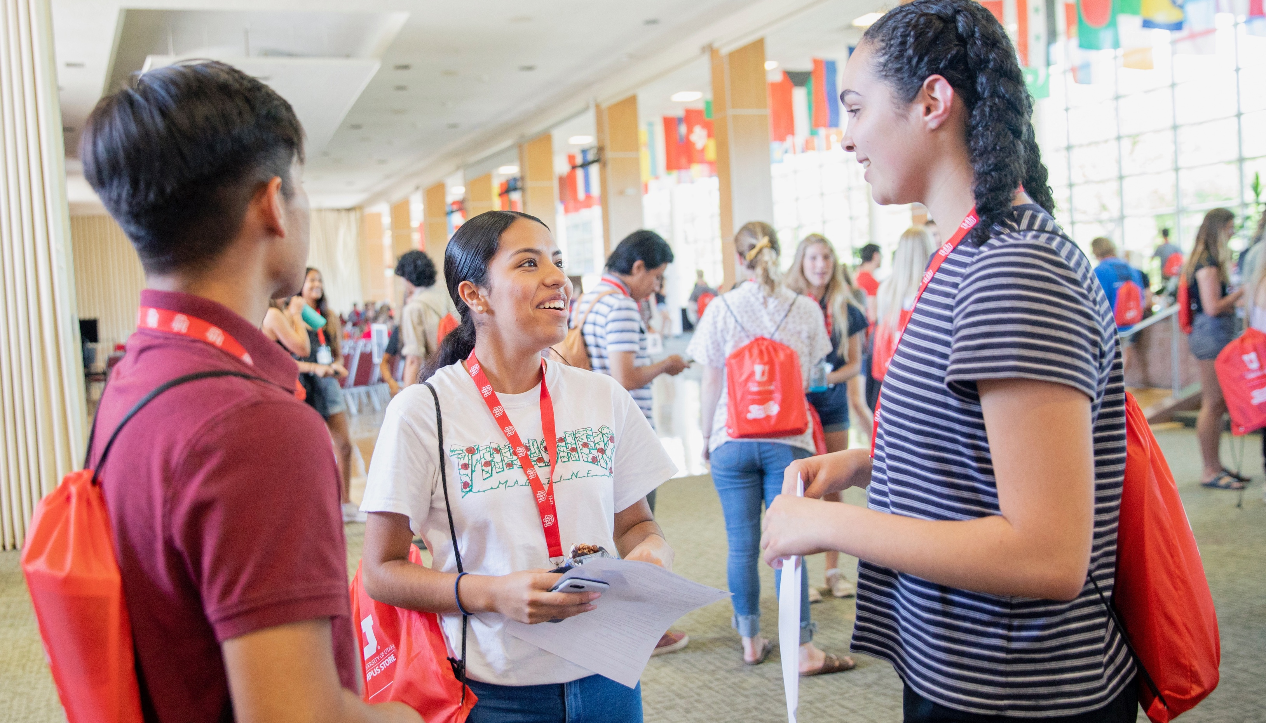

Safety is
a Culture
Fall 2019

Slide 2
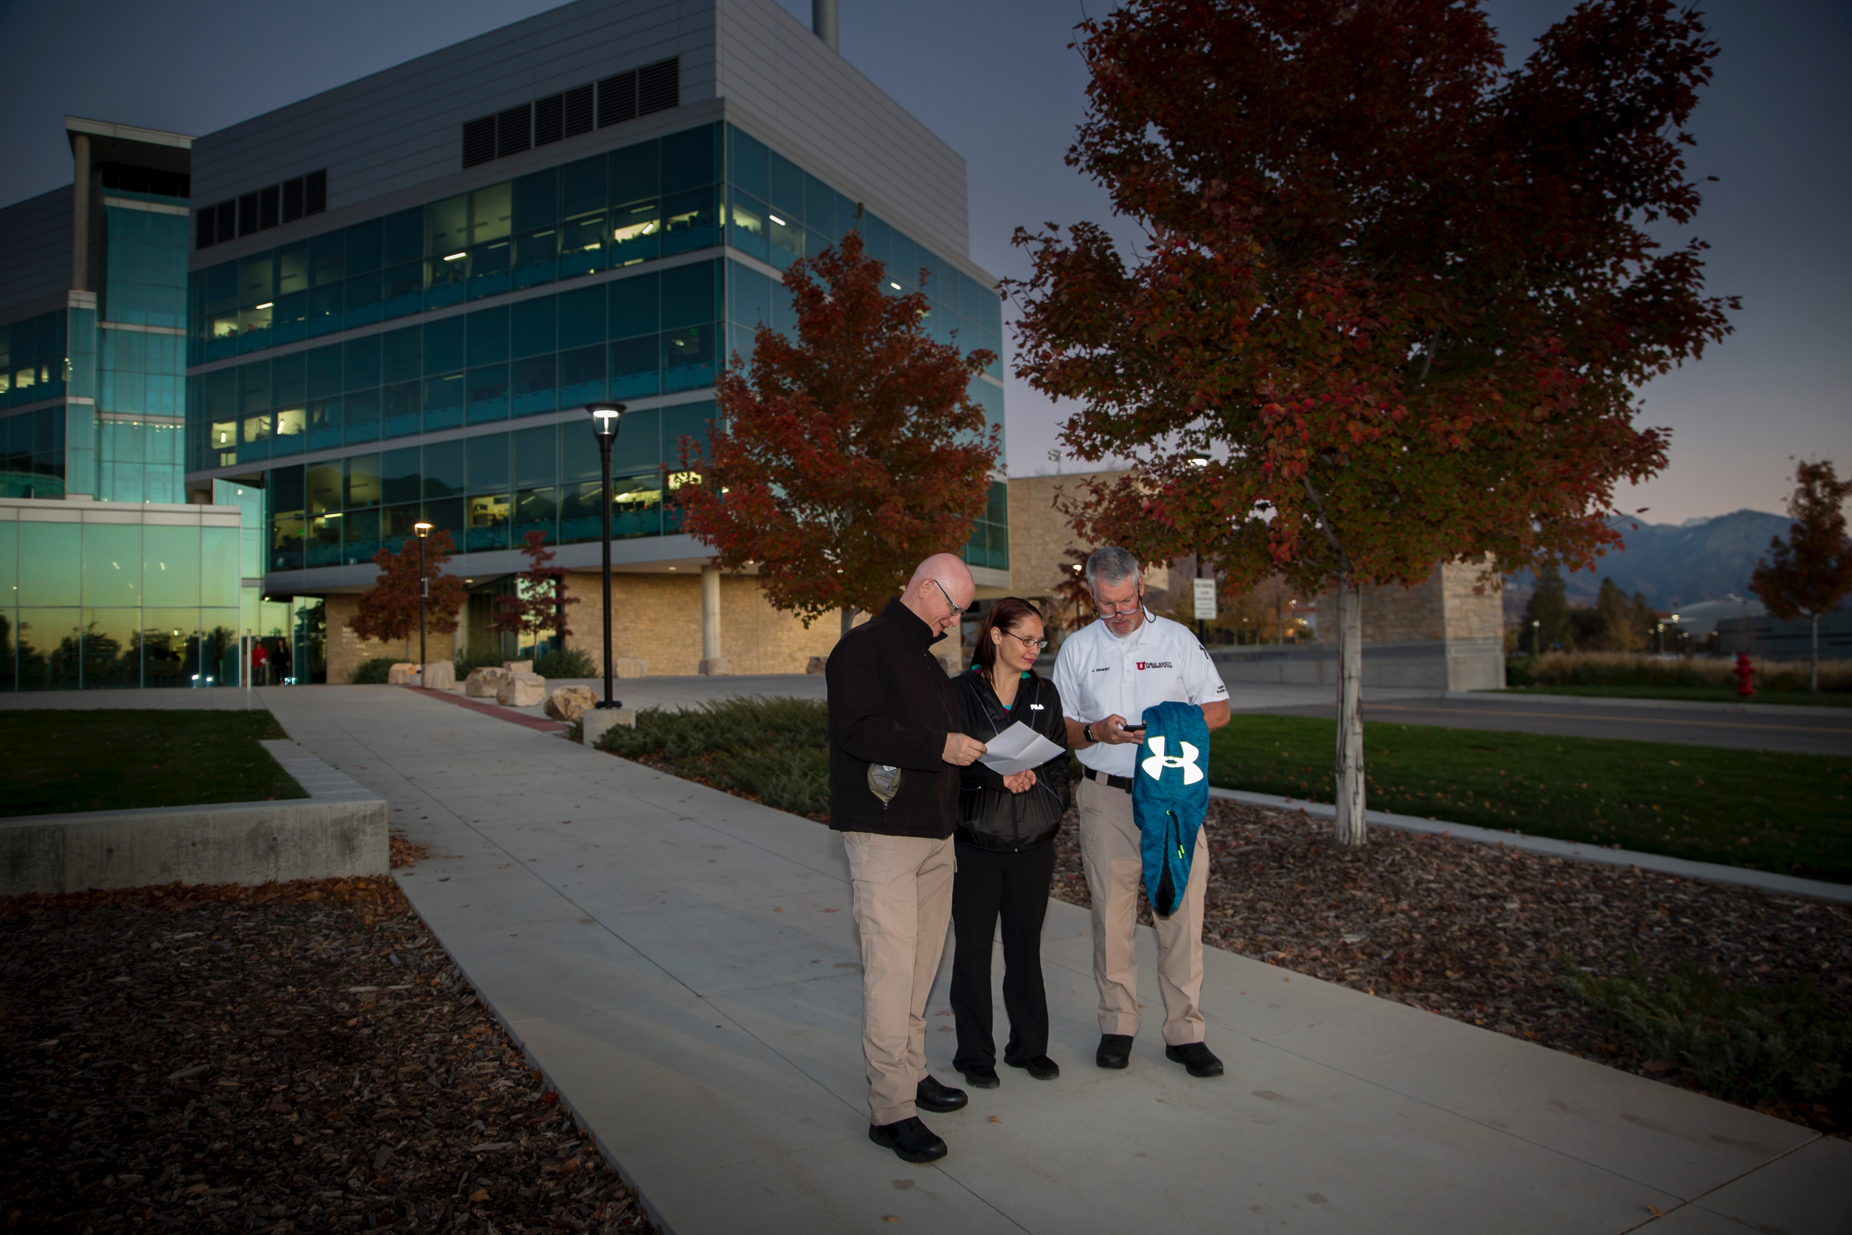
Lighting
Notes:
Each year, student, staff and faculty volunteers arm themselves with flashlights and a phone to participate in the annual Walk After Dark event that helps identify and address safety and lighting concerns across campus. The event is held in September.

Slide 3
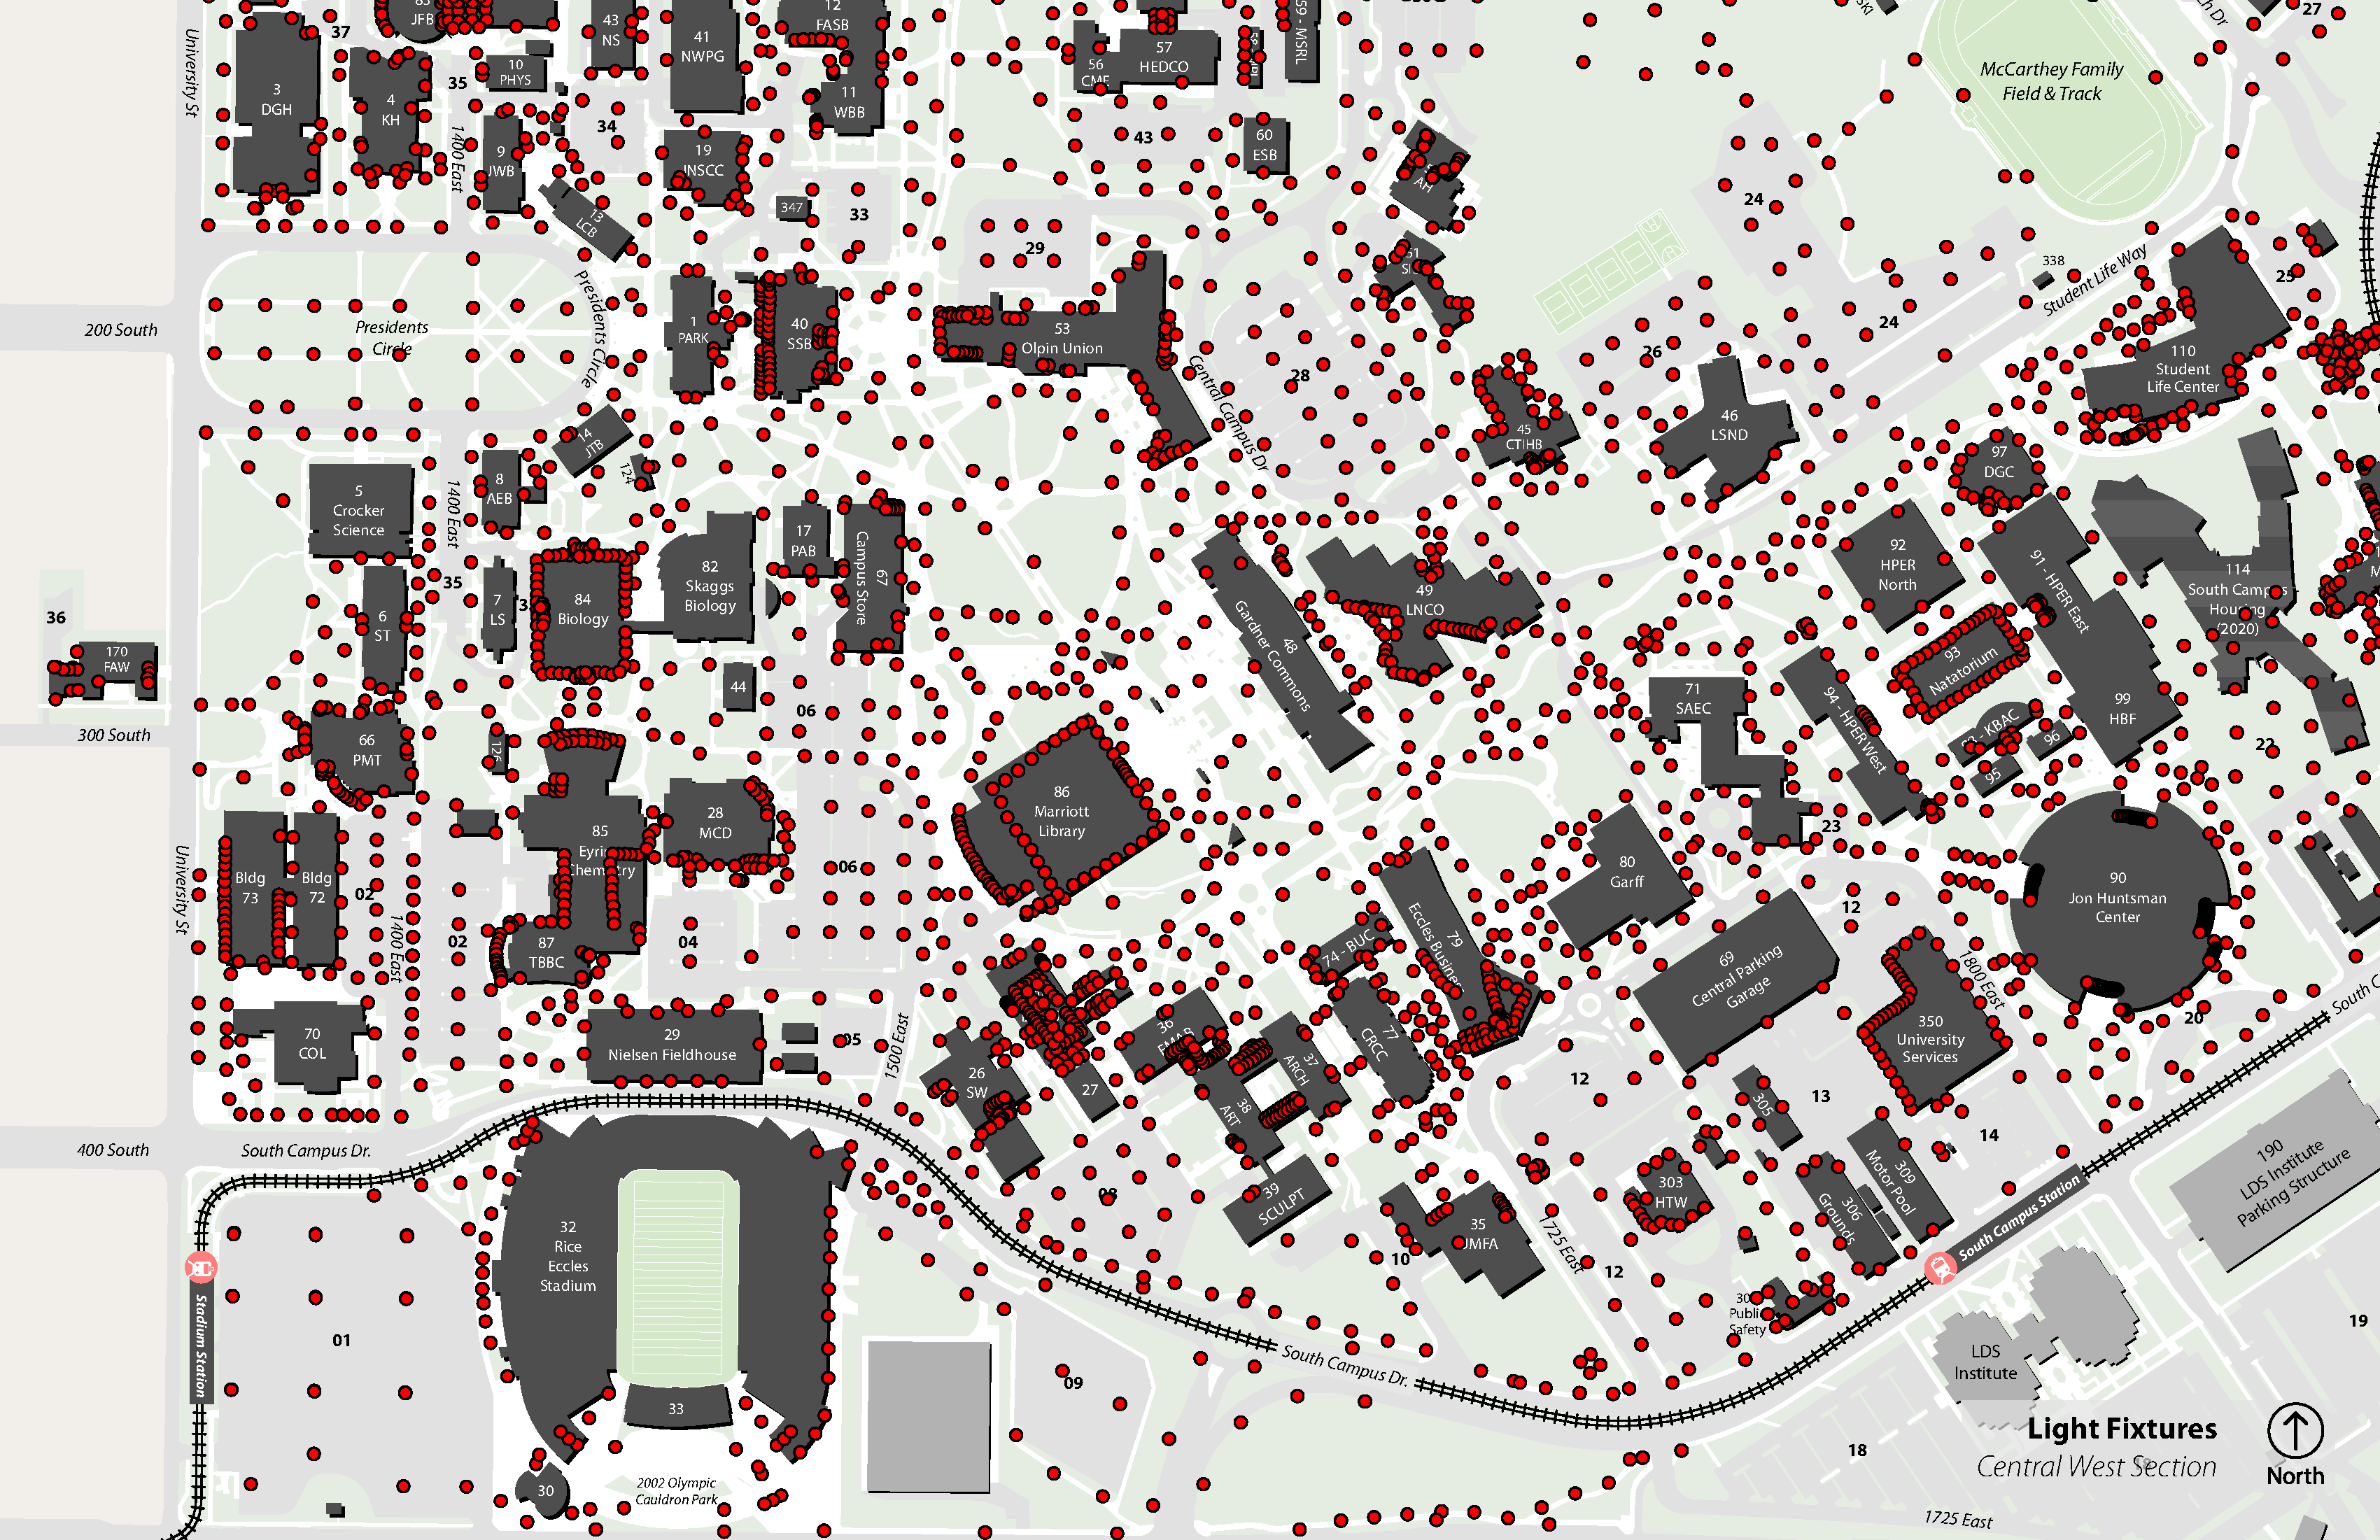
Notes:
The University of Utah has invested more than $600,000 to improve outside lighting by installing energy-efficient, long-lasting LED bulbs across campus. There are now more than 3,200 lighting fixtures on campus—including 11 lights added so far this year.

Slide 4
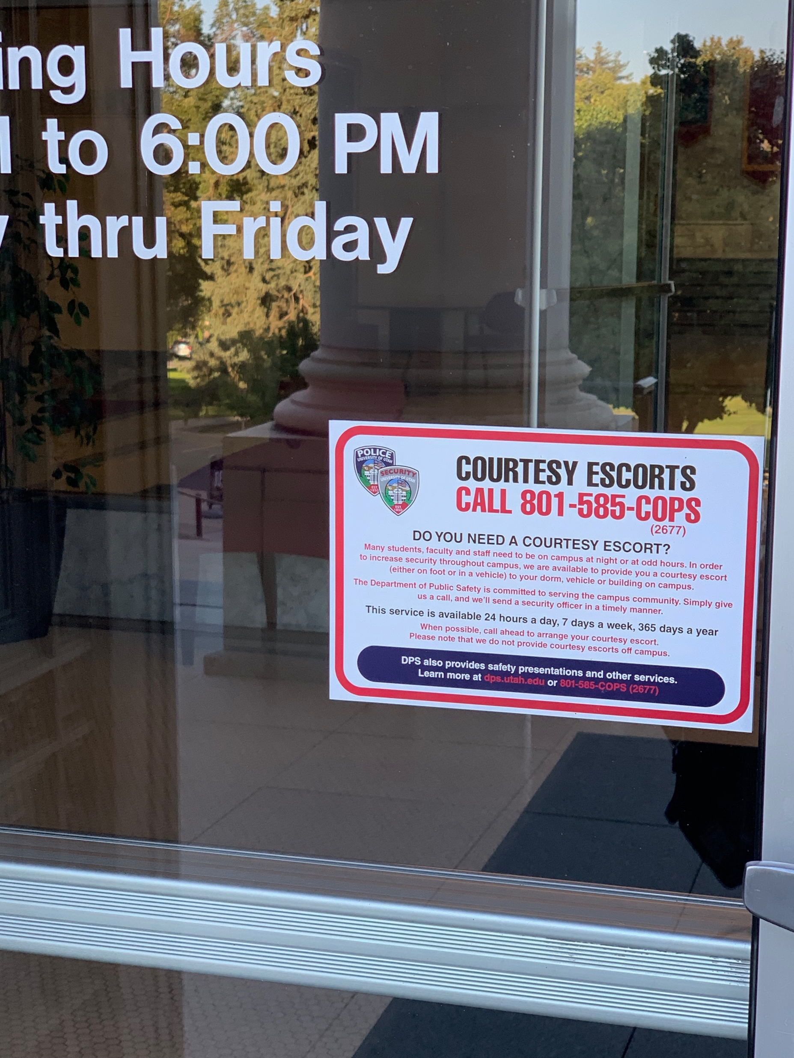
You are not alone
Notes:
We have increased our courtesy escort service so that the average wait time is now only 7 minutes. New stickers have been placed on doors throughout campus. Please note that campus community members may request this service any time, for any reason.

Slide 5
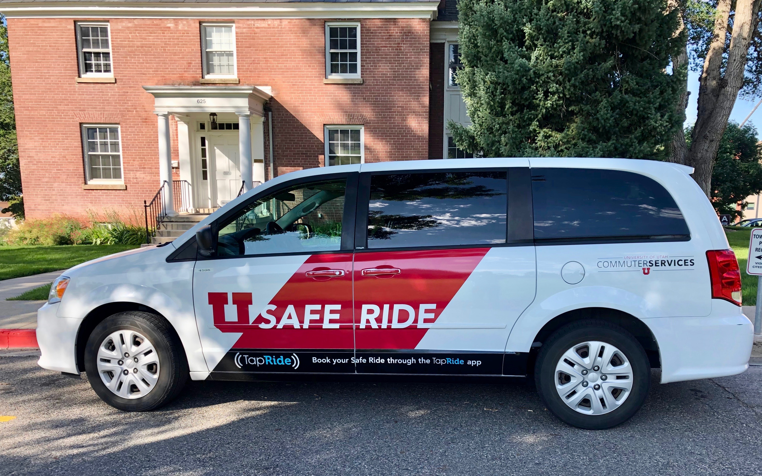
SafeRide
Notes:
In response to many requests from our students, we’ve added a new service: SafeRide. This free service is available to the university community but is especially meant to serve students on campus at night who need a ride to a parking lot, to their housing area, or to another building on campus.
Students, faculty and staff can request a SafeRide to and from any location on campus, except Research Park. Those in Research Park can request a ride though the Hospital On-Demand shuttle service.
SafeRide operates Monday – Friday from 6 p.m. – 12:30 a.m. and uses the TapRide app.

Slide 6
Parking after 3 p.m.
Notes:
We are clustering evening classes in five ”neighborhoods” and aligning transportation and security patrols in these areas. The scheduling office in the registrar’s office has moved 80 classes for fall semester.
The neighborhoods are: Business Loop; Gardner Commons; Health Sciences; Marriott Library; and University Street.
Parking: By popular demand of our students, parking is available after 3 p.m in most A lots for any U permit holder. Those areas are shown in red on this map and more are being added.

Slide 7
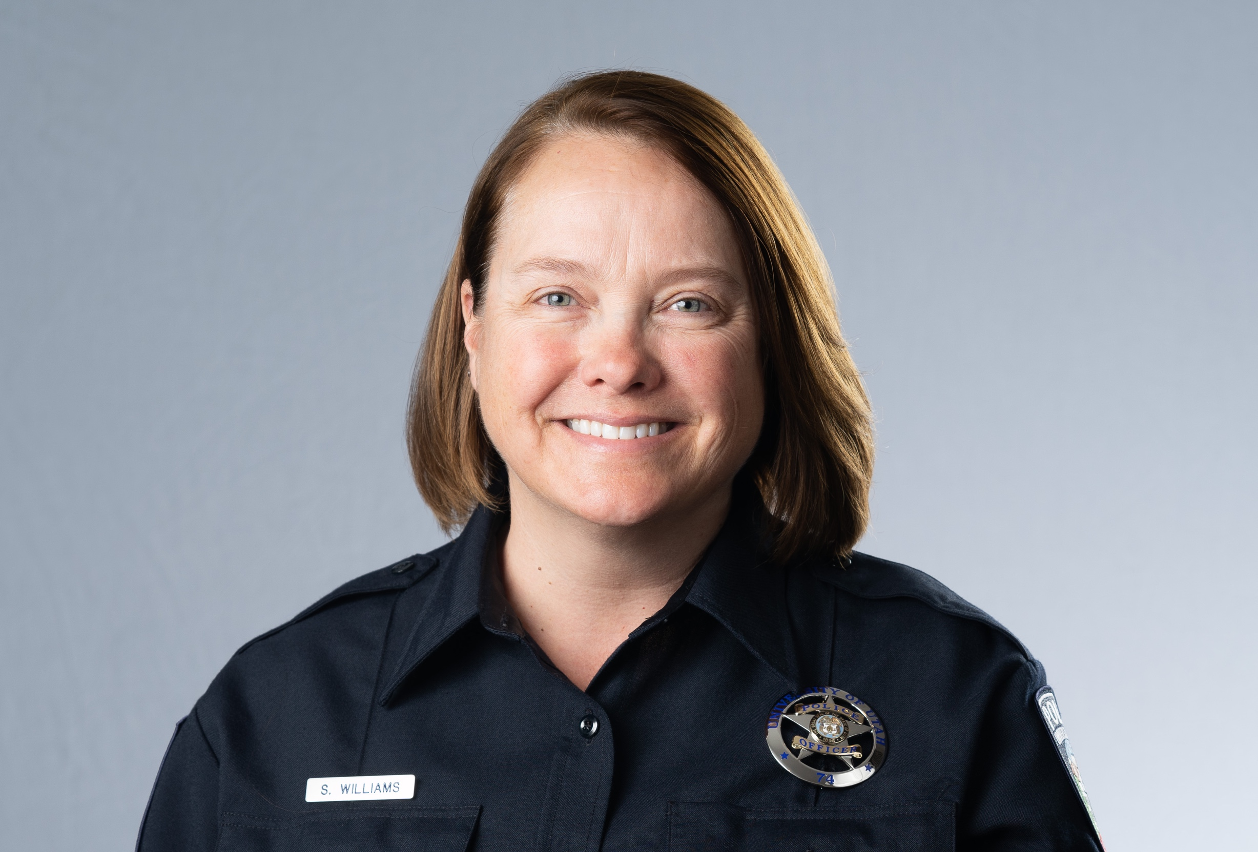
Det. Suzanne Williams
New Staff
13+
Notes:
Since 2017, we have added approximately 13+ employees specifically related to safety — a number that does not include all new or planned hires in police in DPS or Health Sciences.
UPD: Suzanne Willliams, det. Specializes in DV
UPD: Jamie Justice, victim-survivor advocate
UPD: Lt. Terry Fritz
ODOS: Tevita Hola, case manager, BIT, Office of Dean of Students
HRE: Jimmy Thren, resident outreach coordinator, and Kolay Carver, asst. director, conduct management and resident outreach

Slide 8
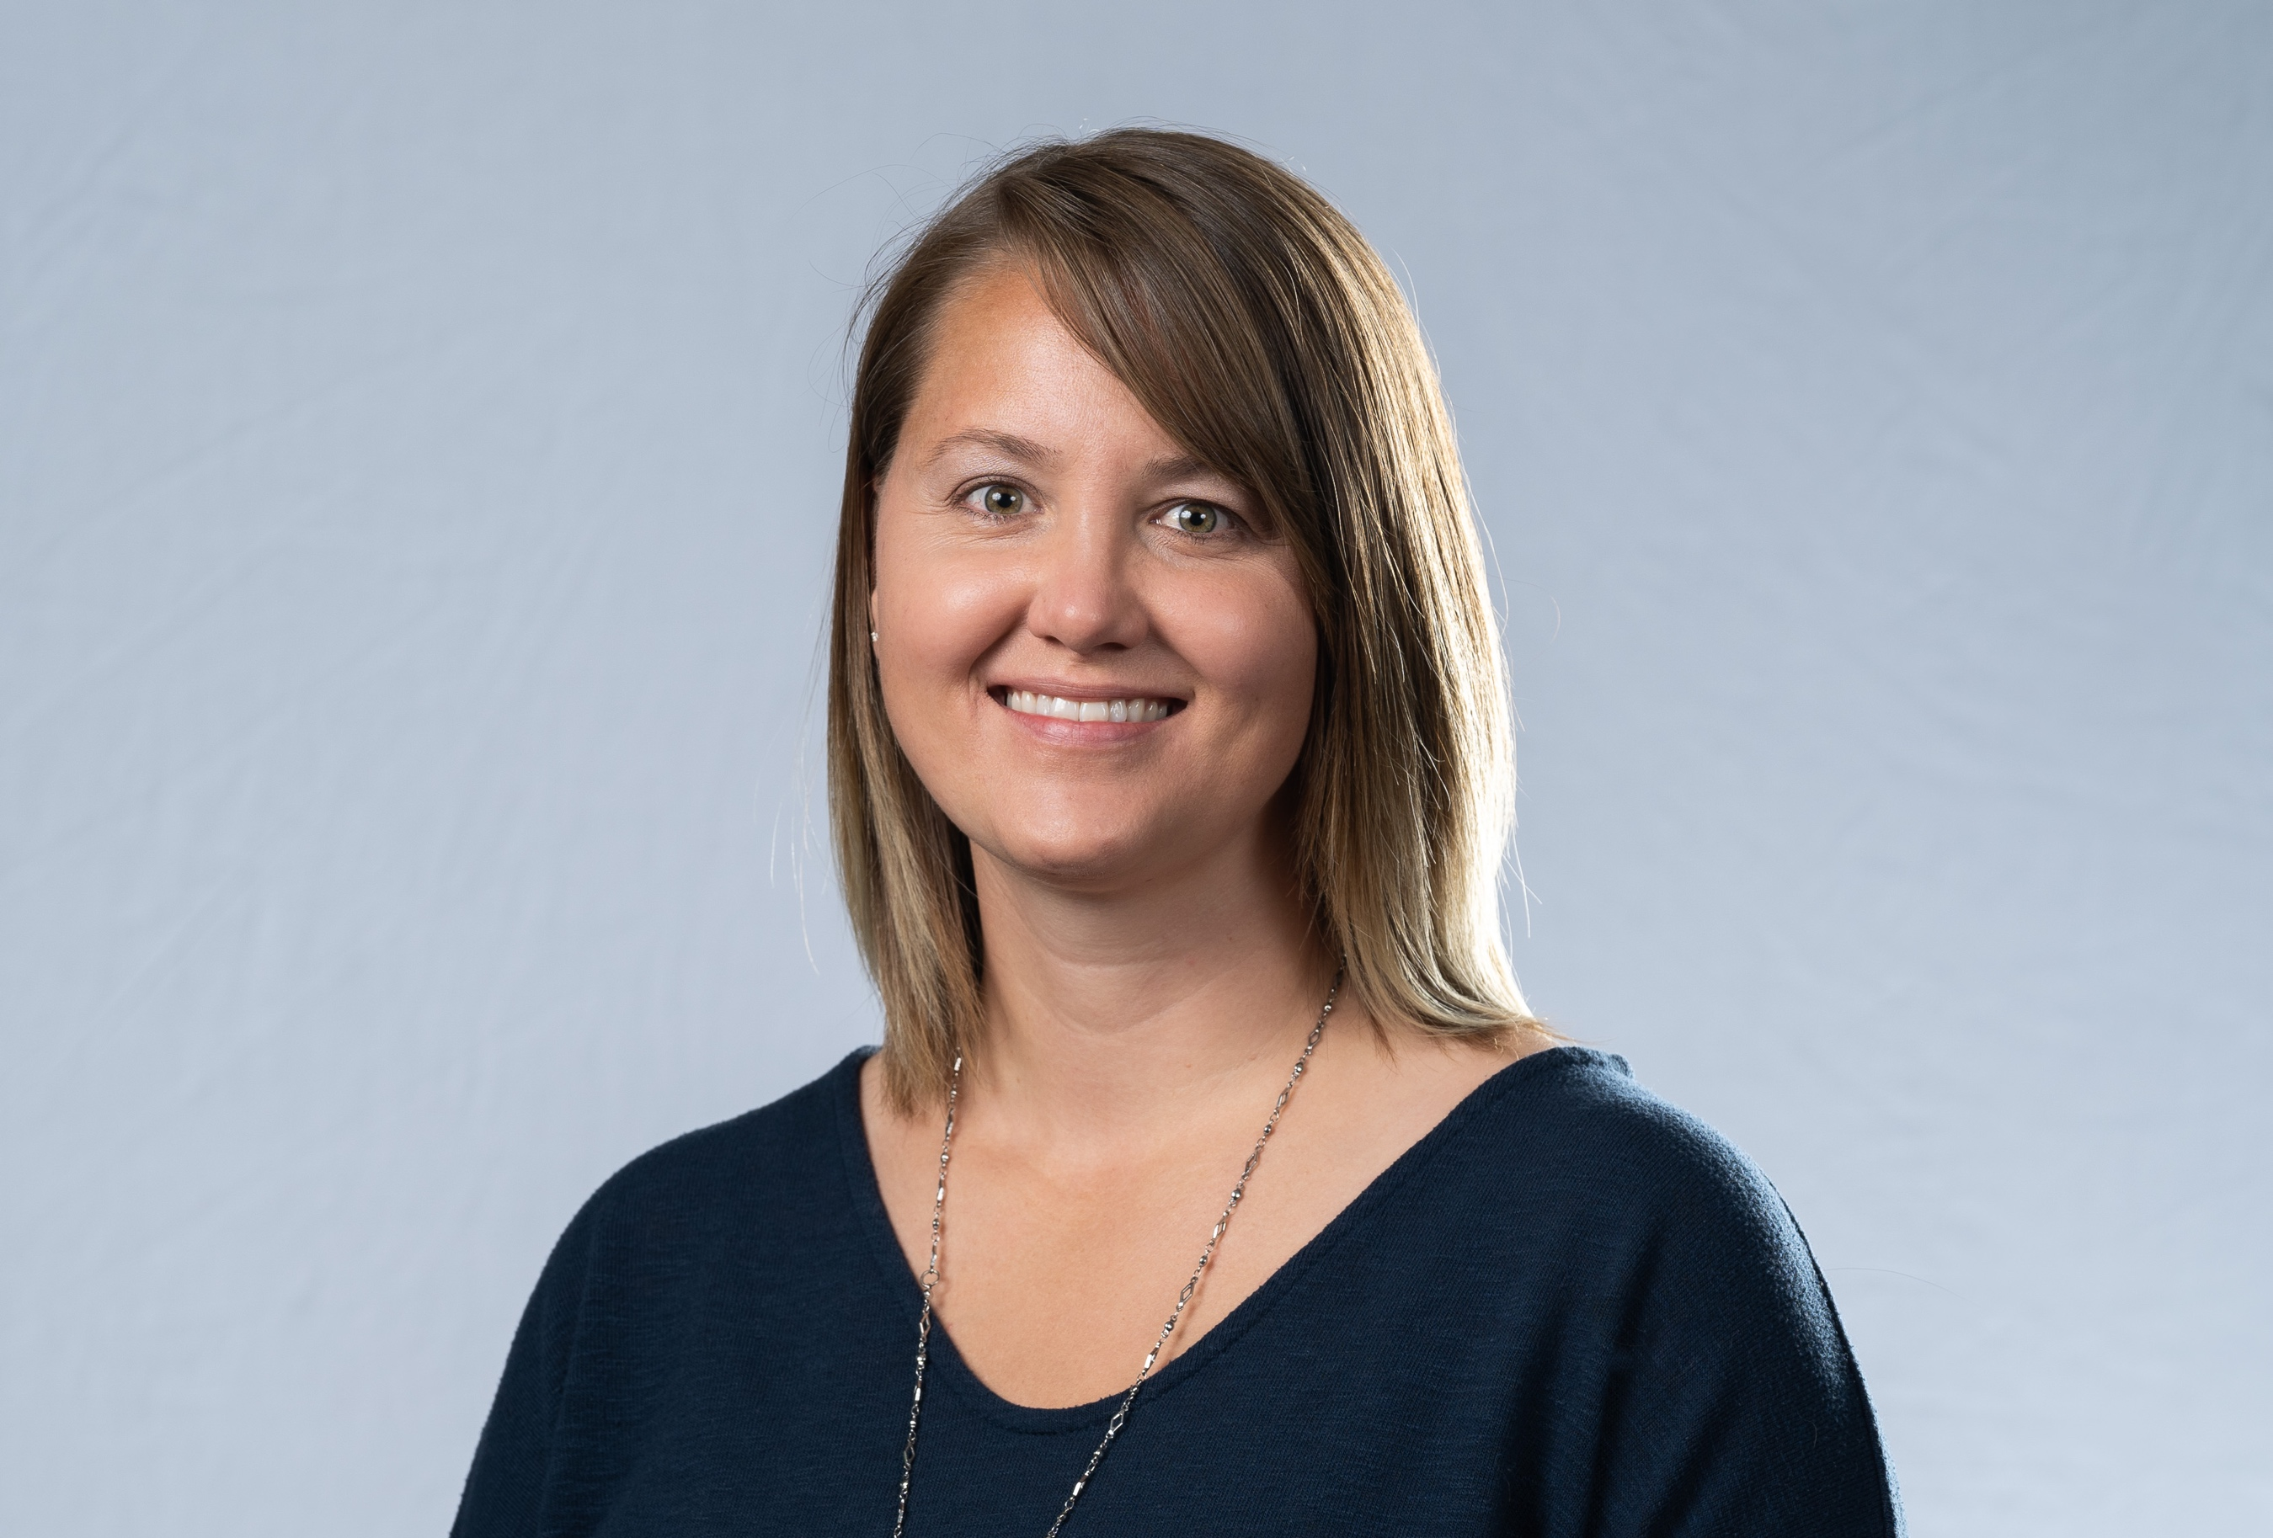
Jamie Justice,
Victim-survivor advocate
New Staff
Notes:
UPD: Terry Fritz
UPD: Jamie Justice
UPD: Suzanne Willliams
HRE: Jimmy and Kolay Carver
ODOS: Tevita Hola

Slide 9
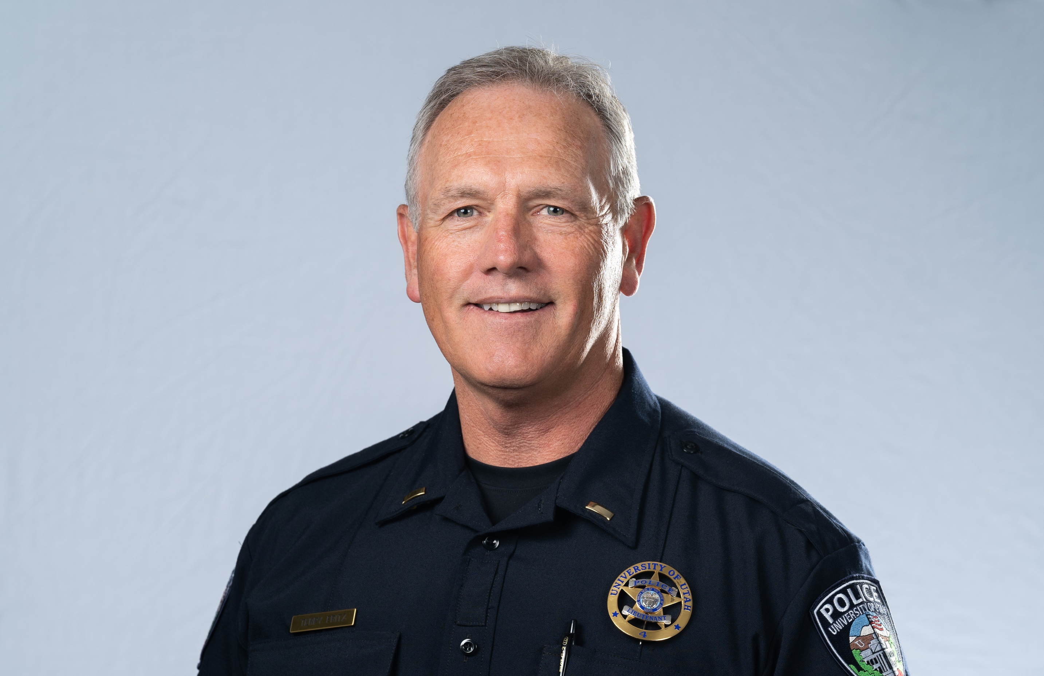
Lt. Terry Fritz
New Staff
Notes:
UPD: Terry Fritz
UPD: Jamie Justice
UPD: Suzanne Willliams
HRE: Jimmy and Kolay Carver
ODOS: Tevita Hola

Slide 10
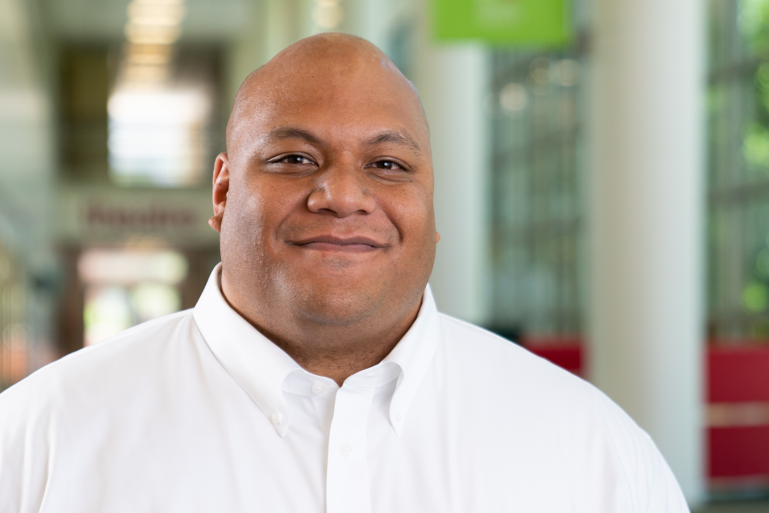
New Staff
Tevita Hola,
BIT case manager,
Dean of Students office
Notes:
UPD: Terry Fritz
UPD: Jamie Justice
UPD: Suzanne Willliams
HRE: Jimmy and Kolay Carver
ODOS: Tevita Hola

Slide 11
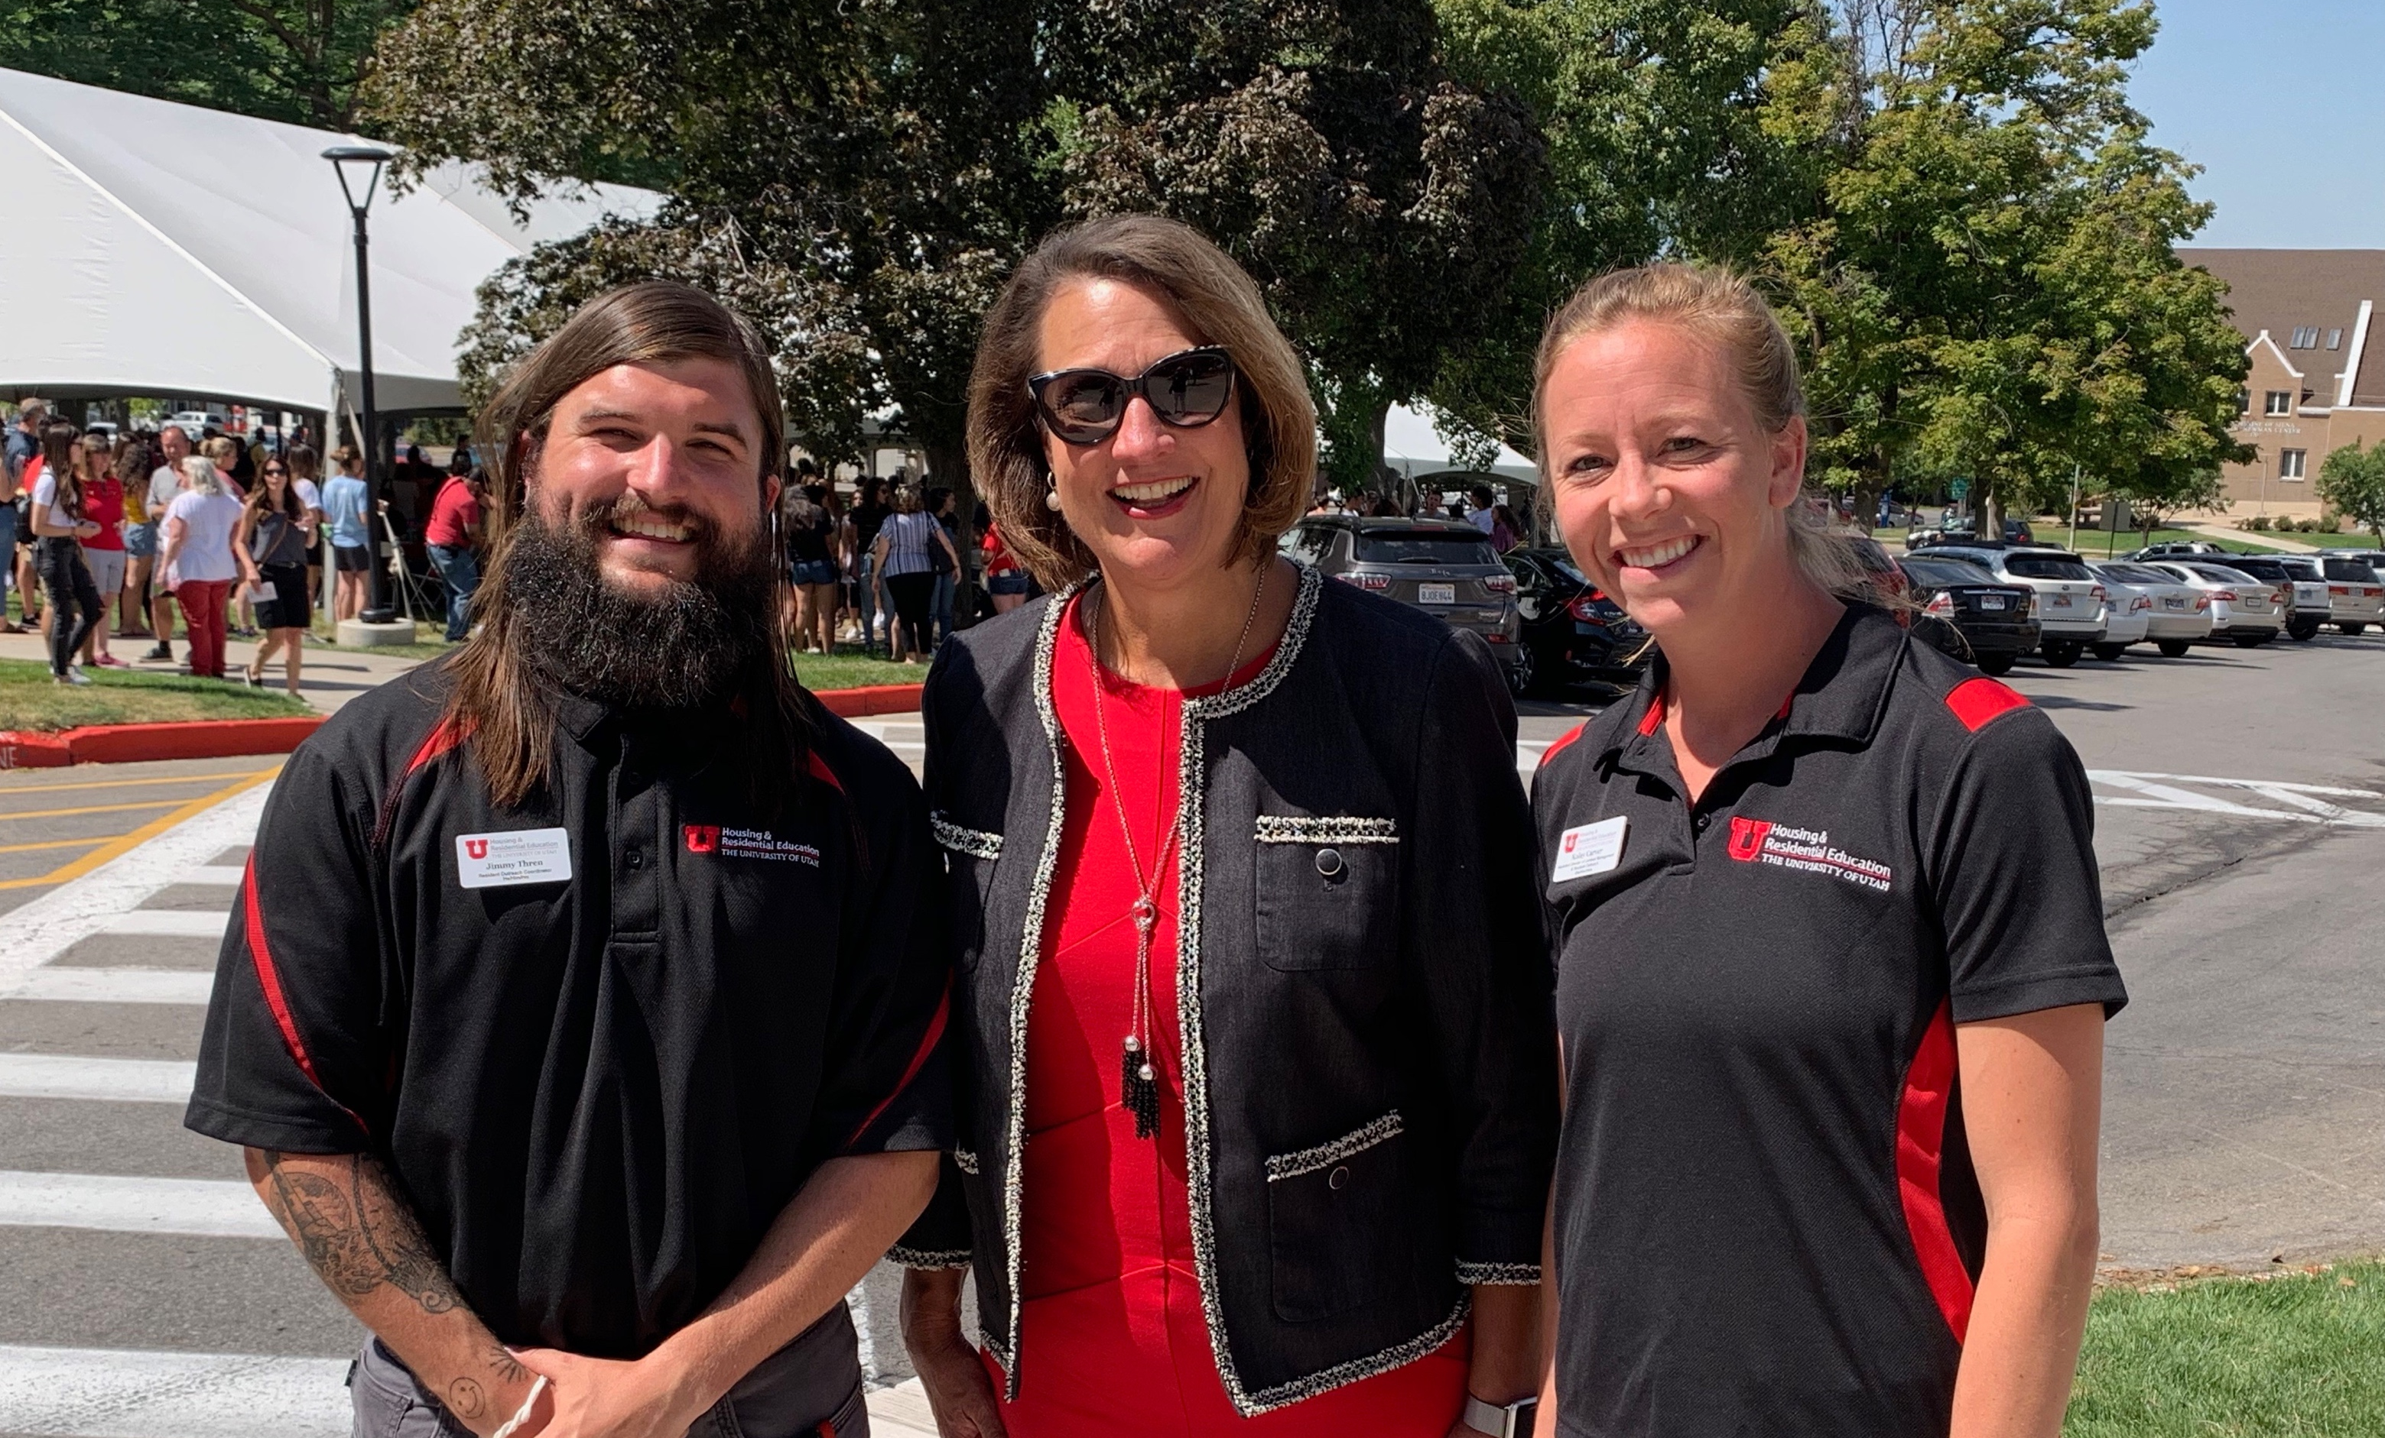
New Staff
Jimmy Thren, resident outreach coordinator, and Kolay Carver, asst. dir. conduct management and resident outreach
Notes:
UPD: Terry Fritz
UPD: Jamie Justice
UPD: Suzanne Willliams
HRE: Jimmy and Kolay Carver
ODOS: Tevita Hola

Slide 12
Housing Safety
Notes:
We have revised policies to better protect our campus community, particularly our students living on campus. There have been significant changes to the Overnight Guest Policy, including pre-registration for overnight visitors and maximum stays of no more than 10 nights a semester.

Slide 13
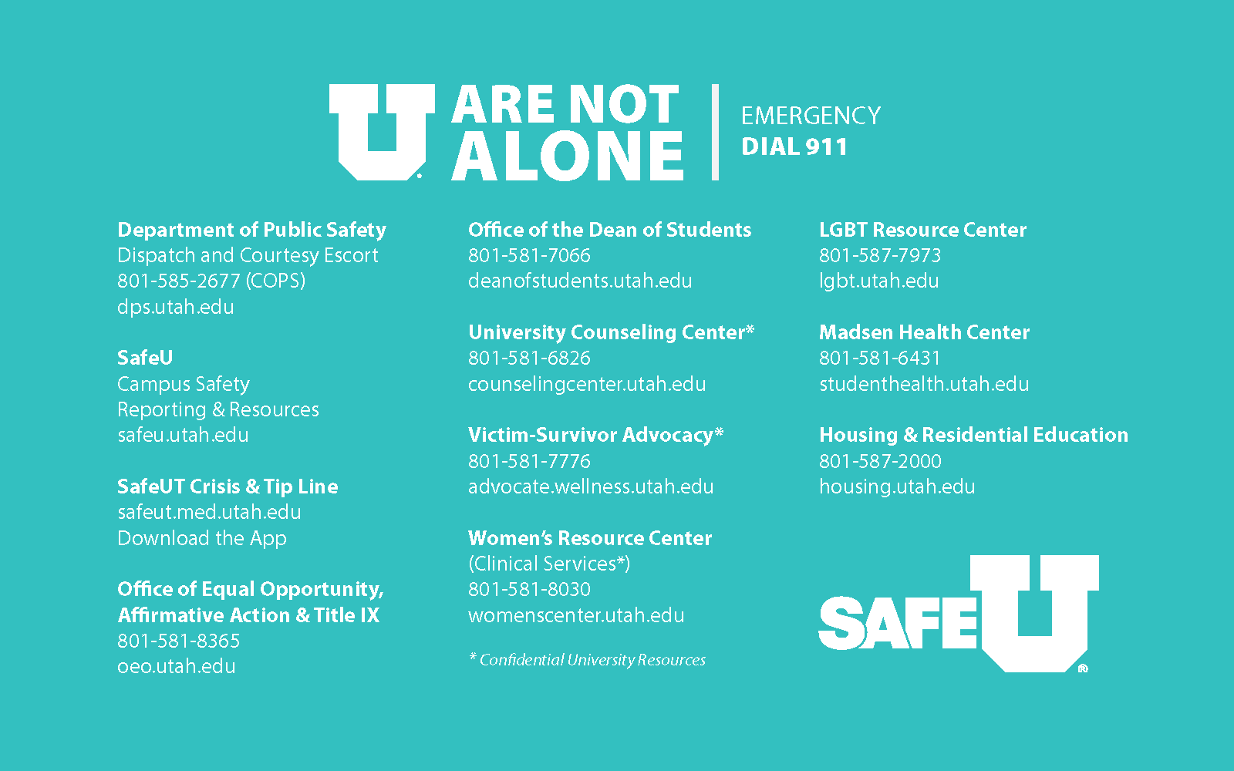
New staff
Housing Safety
Notes:
Thanks to OEO/AA, HRE and SafeU, every student who moved into campus housing last week received a large magnet listing campus safety resources.

Slide 14

Awareness Campaign
Awareness Campaign
Notes:
This fall, the campus safety awareness campaign is focused on trainings available across campus for students, for faculty and staff, and our community. Please help make sure everyone you know is aware of safeu.Utah.edu and what’s available there.

Slide 15
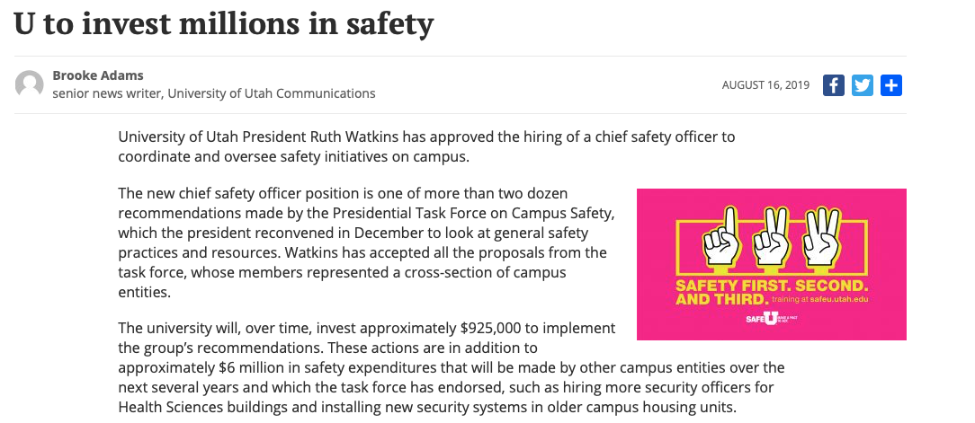
Spreading the word
SAFETY INVESTMENT HIGHLIGHTS
• Chief Safety Officer
• Student Parking Available after 3 p.m.
• Cluster Evening Classes
• Expand Emergency Mass Communication
• Add a Threat Assessment Team
• Increase Self-Defense Training
• Expand Online Training
Notes:
We received broad media coverage of the announcement of the new recommendations made by the Campus Safety Task Force, which included hiring a new chief safety officer — an emerging trend at universities across the country. The U is the first to create such a position in Utah; the chief safety officer will oversee all safety efforts on campus.
Other changes include parking, evening class consolidation, new personnel—about $1 million in investment by the U this year.
Other entities are also making changes. Health Sciences will spend $4 million over several years to add security officers in every building. HRE also is investing about $1 million to improve safety in older housing buildings.

Slide 16
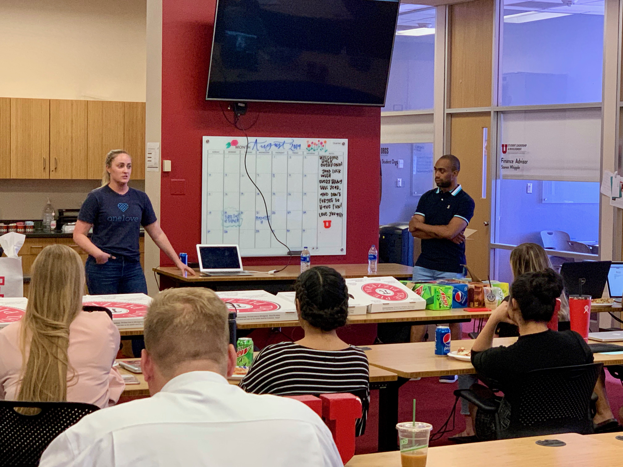
Training
Notes:
Representatives of the One Love Foundation visited campus at the start of the semester to provide healthy relationship training to three athletic teams (soccer, football, field and track) and ASUU. Our partnership is ongoing.

Slide 17

Research
Notes:
We launched a new initiative, with seed funding, to advance research on how to prevent violence against women with more than 30 faculty members from across campus participating.

Slide 18
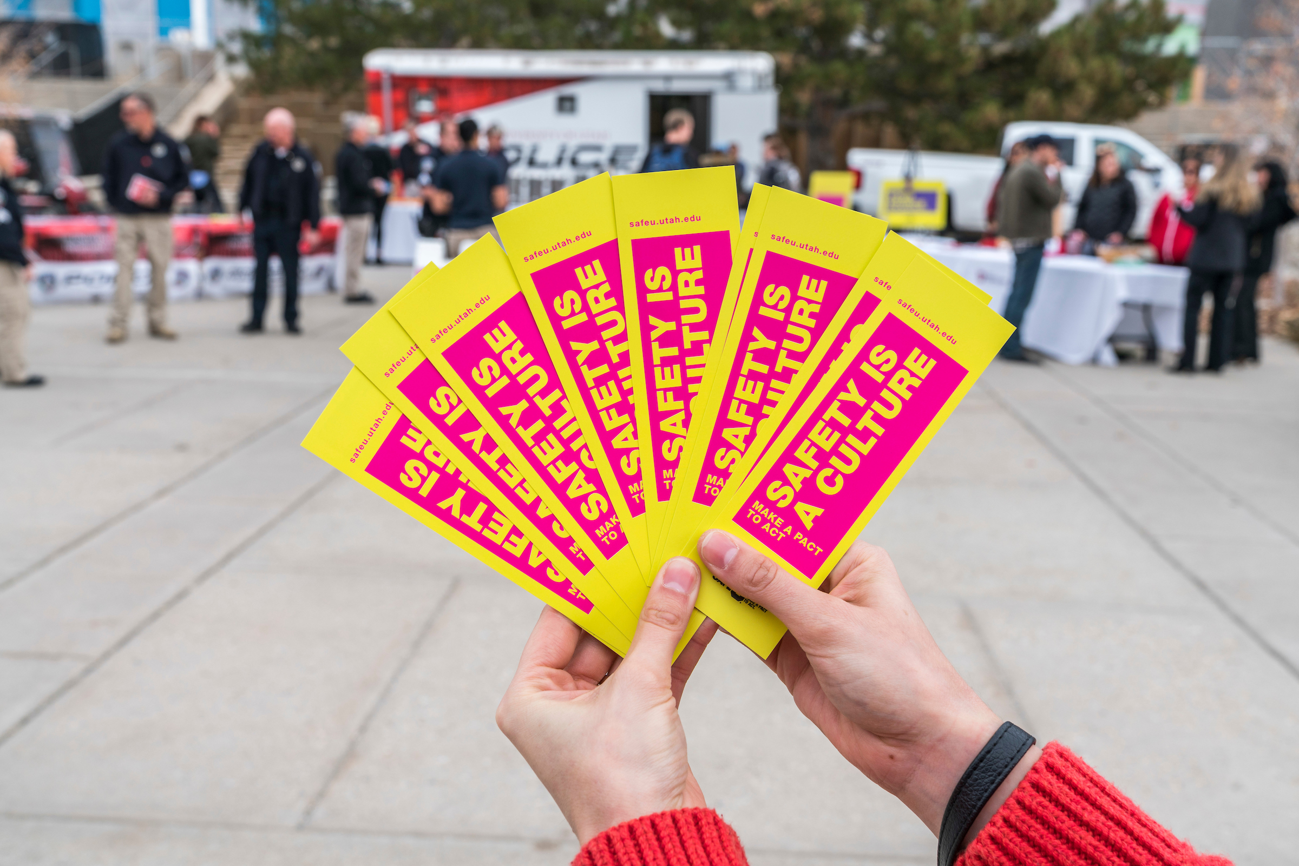
MAKE A PACT TO ACT.
Notes:
October will be SafeU Month and we are inviting all campus community members to engage in trainings, activities, etc.

Slide 19

Notes:
Your call to action:
• Share what you know and have heard today
• Learn more about ways to increase safety. Bring a training to your unit.
• Act. Make a pact to act.

Slide 20
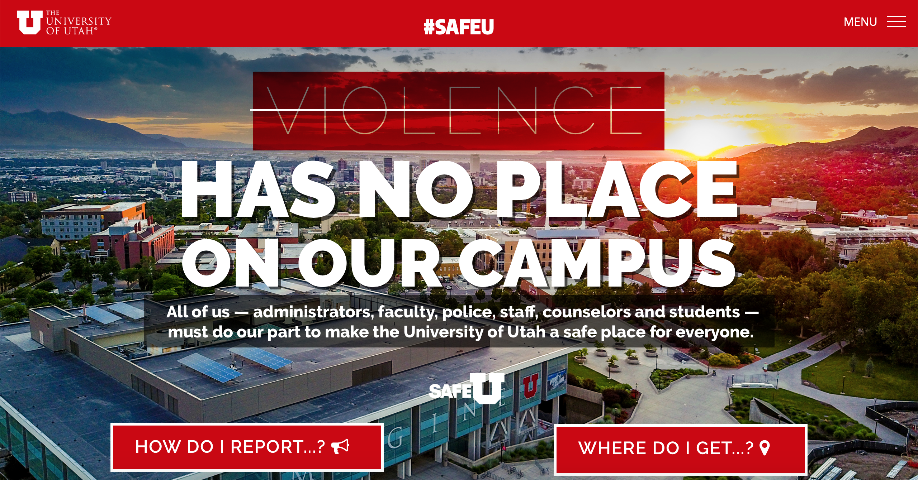
Notes:
Safeu.Utah.edu is a comprehensive source for all safety information.

