Slide 1
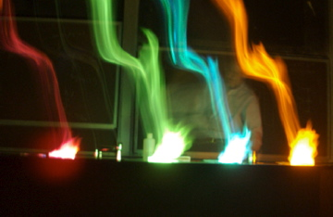
Subject to the approval of the Board of Trustees, the “university faculty shall have the authority . . . to legislate on matters of educational policy. . . .
The faculty has a right to a meaningful role in the governance of the university; . . . it has a right to participate in decisions relating to the general academic operations of the university including budget decisions and administrative appointments.”
The legislative power of the faculty is “normally. . . exercised by the faculty in conjunction with duly elected student representatives and administrators in the Academic Senate . . . .

Slide 2
Rule 5-200A Staff Paid Parental Leave Benefit
Building Access & Surveillance Policy 3-234
Revised Policy 3-030 Travel
Policy 3-041 Accountability for Non-capital Equip
Policy 6-002 III-C Eligibility of CL Faculty for Senate Presidency
Policy and Rule 4-050 Enterprise Software
Policy 5-141: Performance Management
Policy 4-003 Website Policy

Slide 3
MS in Medical Studies
MS in Recreational Therapy
HKR Restructure Health & Kinesiology BS/MS/PhD
Master of Business Creation
BFA in Film and Media Arts – Animation Production Emphasis
BFA in Graphic Design
Special Education Minor
Data Science BS
Certificate in Public Policy
Dual Degrees in (1) Master of City & Metropolitan Planning
and Master of Public Policy and (2) Master of City &
Metropolitan Planning and Master of Public Administration
Master of Athletic Training
Philosophy of Science BA/BS
Civil and Environmental Engineering BS for U Asia
Minor and emphasis in Advanced Financial Analysis
Campus Safety Syllabus Statement
SACSCF Proposed Student Feedback Instrument

Slide 4
Seven-year reviews
Art & Art History
College of Health minor in OSH
Mechanical Engineering
Philosophy
Geophysics
Psychology Department
Environmental Humanities
Distinguished Teaching Award
John R. Park Teaching Fellowship Award
Community Engaged Teaching and Scholarship Award
2019 Early Career Teaching Awards Calvin S. and JeNeal N. Hatch Prize in Teaching Distinguished Professors Appointments
Distinguished Scholarly & Creative Research Awards

Slide 5
ONGOING WORK !
Senate Task Force-Student Input in RPT (Policy 6-303)
Senate Task Force-Career-Line Faculty Parental Leave Benefit
Senate Task Force for Consideration of a Graduate Assembly
CIB2 Committee

Slide 6
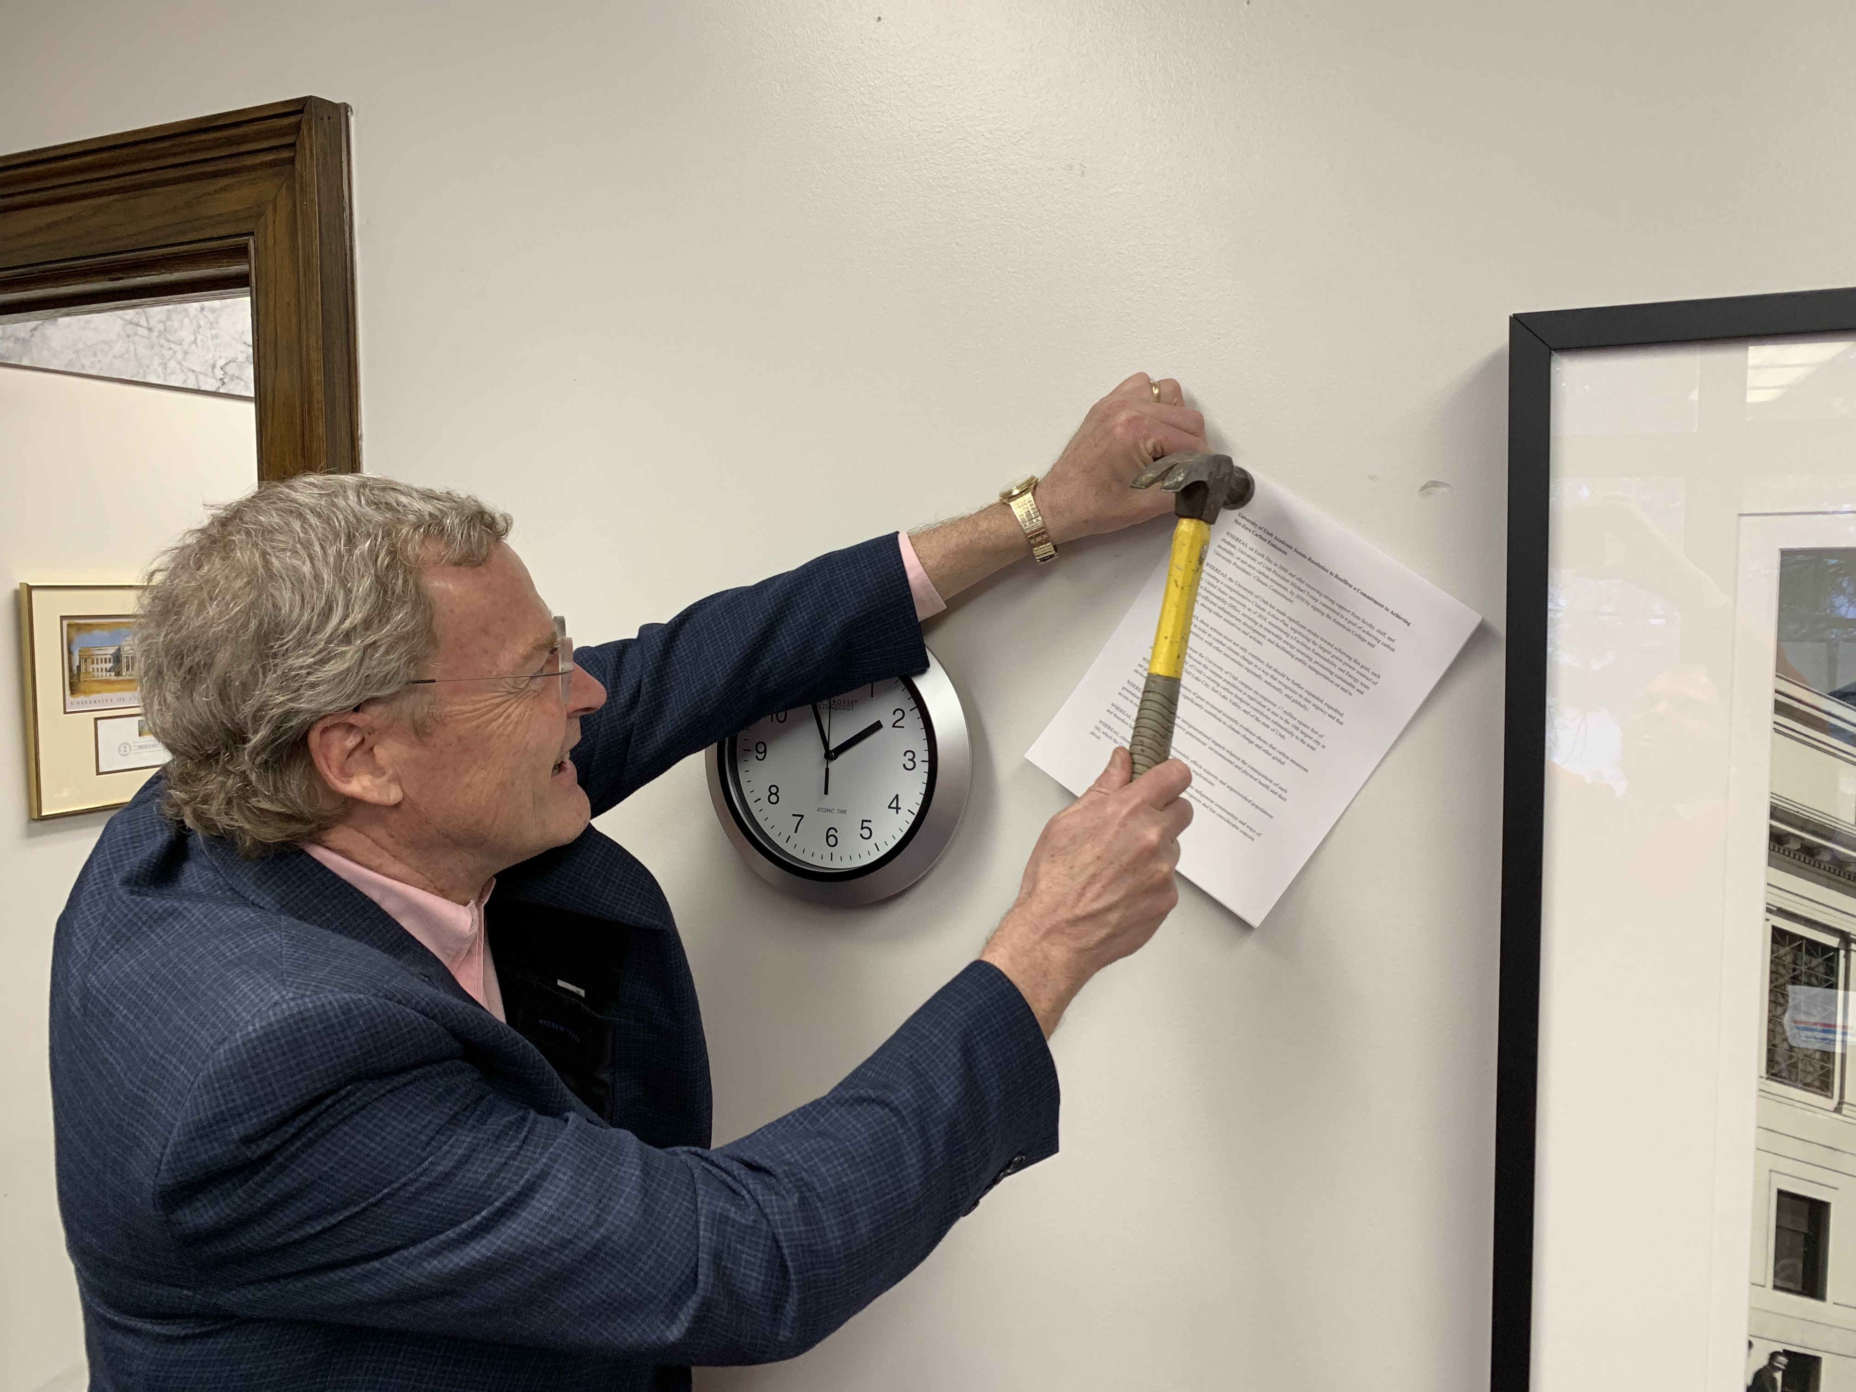
Senate Carbon Neutrality Resolution
Delivered to the Park Building

Slide 7
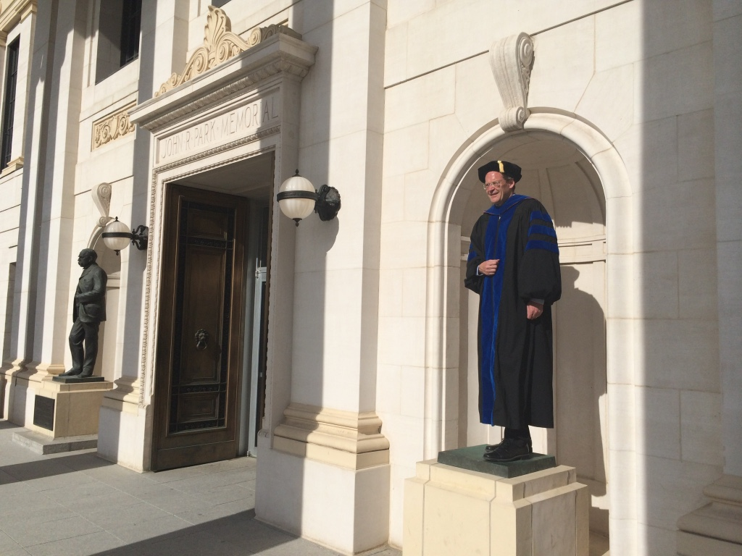

Slide 8
?

