Slide 1
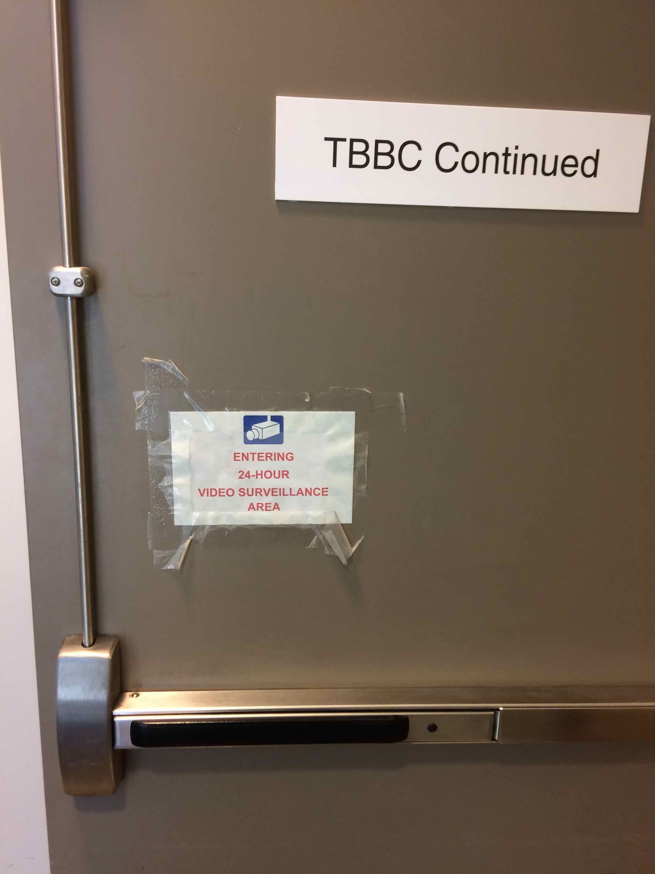
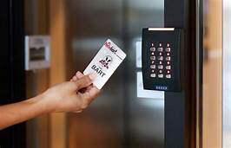
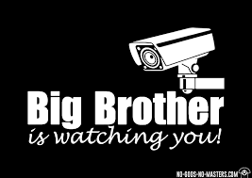
Building Access & Surveillance Systems
Policy 3-234 Revision

Slide 2
Building Access & Surveillance Systems Policy 3-234 Revision
Current Situation
20 year old policy focused on keys
Modern Electronic Access Systems & Video Recording Systems Raise Privacy Concerns
No clear regulations on who can install Surveillance Systems
Some Large Systems managed by DPS;
numerous building specific systems
Little central oversight on storage & use of data
Need for a Revised Policy and more Specific Rules

Slide 3
Guiding principles: Respect Privacy, Provide Safety & Security, Notice and Transparency.
Combination of revised basic Policy & more detailed Rules
Establish new process requiring multitude of smaller systems to be centrally registered & meet criteria. Then more effectively regulate both (i) centrally managed Public Safety direct-monitored systems, & (ii) dispersed smaller systems managed by building stewards & departments.
Clarify balancing protecting privacy, while protecting persons & property from criminal activity (physical assaults, property theft or damage).
Regulate storage & permissible use of recorded data (key-card swipe tracking, video). Track & manage physical keys & key-card permissions.

Slide 4
Legal Requirements
Must comply with federal & state laws.
Clery Act = campus safety.
FERPA = student records. HIPAA=patient privacy. GRAMA - Utah Government Records Access Management Act.
GRAMA: Utah statute specifically governs UU as a “governmental entity,” directly controls how UU responds to records requests from individuals, law enforcement agencies, news media, etc. Controls bases for withholding entire records, or redacting specific information (e.g., blur out faces in videos).

Slide 5
Timeline
Phase 1: Basic Regulations & Develop registration process.
Phase 2: Report back to Senate after experience of startup period and propose further revising Regulations then if needed.
Phase 3: Consider regulations on other topics—e.g., mobile surveillance such as drones & body cameras.
Utah Legislative Audit recently performed at all USHE institutions, criticized and requires improvements of building access systems. Important for UU response to be ready & in place well before January legislature session. UU response includes having revised Regulations fully approved (Senate & Trustees) & implementation well underway.

Slide 6
People who are Making this Happen!
Current draft Regulations developed through broad consultation--- and after input from Executive Committee, working with a sub-committee assigned by Exec Committee to further refine the draft, will bring to next Senate meeting.
Advising subcommittee appointed by Exec Committee:
Prof. Randy Dryer—Exec Committee member, former Chair of Board of Trustees, Law & Honors faculty, expertise in Privacy Law, government records law, etc.
Prof. Leslie Francis—Exec Committee member, past Senate President, Law, & Philosophy, & Medicine faculty, expertise in Privacy Law, FERPA, HIPAA.
Prof. Bob Flores—Senate Policy Liaison, past Senate President, Law faculty.
Working with:
Dale Brophy, Chief of Policy & Director of Public Safety
Cory Higgins, Director Facilities Management
Office of General Counsel
Further info & recommendations: c/o Executive Assistant Karen Janicki, Facilities Management (801) 581-7389 karen.janicki@fm.utah.edu

