Slide 1
Imagine … the future
Notes:
Flammarion engraving

Slide 2
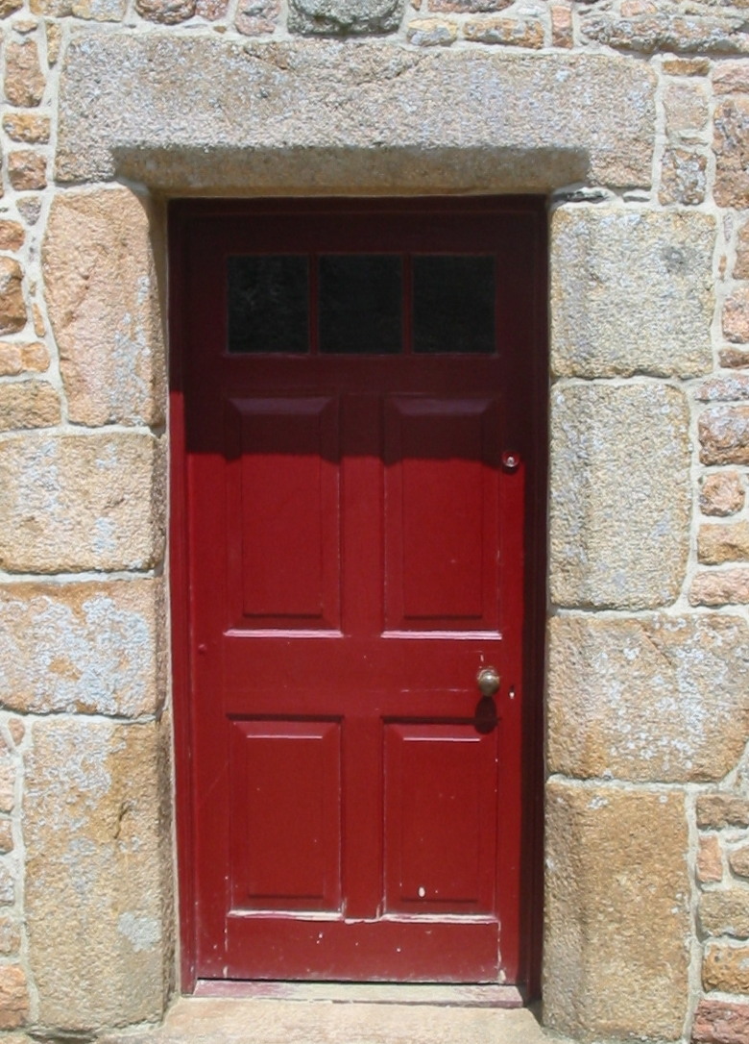
What do you see?
Well, duh …
It’s a door in a stone archway

Slide 3
What do you see?
Complexity & interdependence
History, culture, and the rule of law
Security, privacy and mathematics
Metallurgy and materials science
Environmental systems and fluid dynamics
Trade and economic specialization
Manufacturing and replication
Microbiology and cellular structure
Human social dynamics and structures
Art, design and esthetics
Paint, chemistry and polymers
Mechanical advantage and physics
… each through our own lens

Slide 4
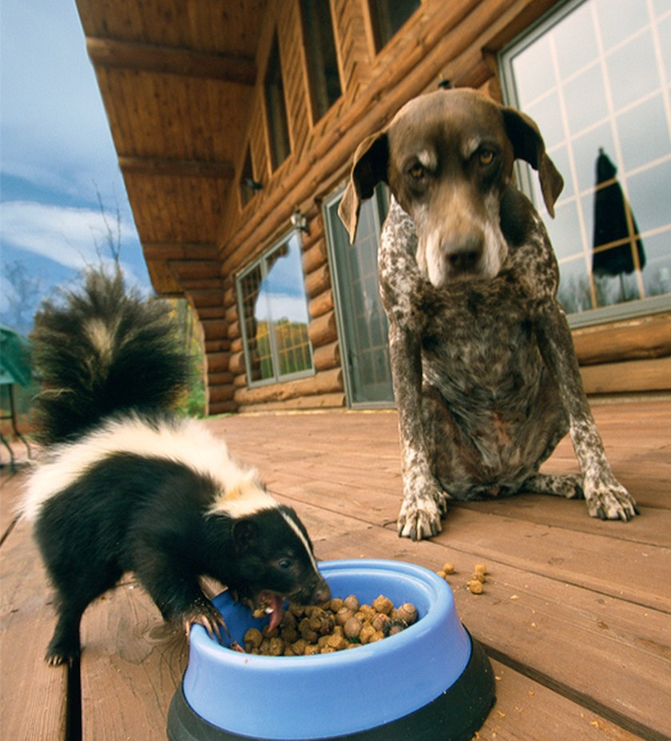
Humility – learning from others
Knowledge speciation
Trivium and quadrivium
Natural philosophy and the sciences
Lingua franca loss
Rebuilding an ontology of shared discourse
Embracing humility
Recognizing our own ignorance
Notes:
The speciation of knowledge
trivium and quadrivium (the original seven liberal arts)
From natural philosophy to sciences
Loss of a lingua franca – a common language
We are all both experts in our own domains and elementary students of others
DNA methylation to art contextualization
To build partnerships, whether internal or external, we must begin with humility
This means recognizing our own ignorance, for that is the beginning of true knowledge
People seek meaning and purpose
Ideas attract talent; talent drives change

Slide 5
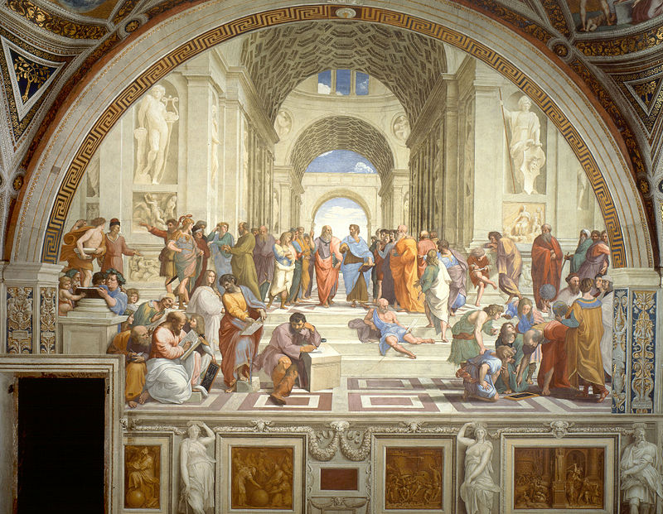
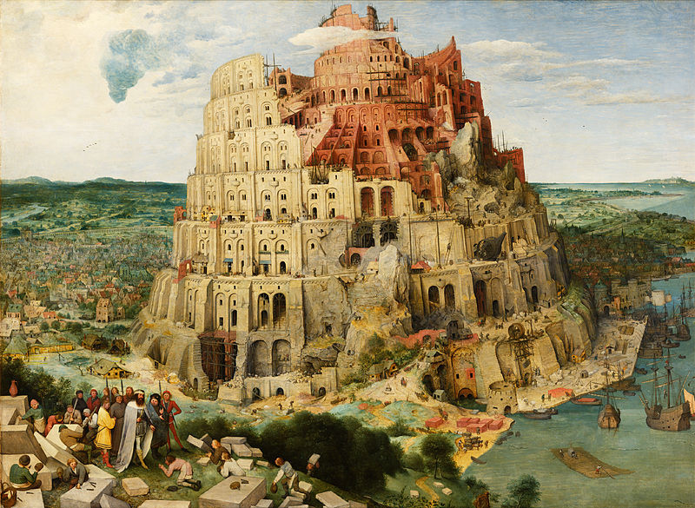
Consilience – shared commitment
Causarum Cognitio
Raphael’s The School of Athens
The Tower of Babel
Pieter Bruegel the Elder
Salon dinners, ideation summits, and Chautauqua redux
Seed funding for new ideas
SVPAA faculty fellows
An envisioning book
Notes:
At our best, we are the like the School at Athens, a community of scholars dedicated to knowing why, to understanding first causes – the Causarum Cognito (Raphael’s The School of Athens)
But there is another metaphor and cautionary tale, one drawn from the Judeo-Christian tradition, the Tower of Babel (Genesis 11:6-7) (Pieter Bruegel the Elder’s Tower of Babel)
Behold, the people is one, and they have all one language; and this they begin to do: and now nothing will be restrained from them, which they have imagined to do. Go to, let us go down, and there confound their language, that they may not understand one another's speech.
The story speaks to the power of unity and the danger of divergence.
We need an ontology of shared discourse, especially in a time of change
This is the One Utah message -- collaborative cross-campus and external partnerships

Slide 6
Reification – one Utah
Renaissance teams
Integrative collaborations/diverse expertise
Research, scholarship, education, & engagement
Potential areas
Strategic enrollment/student success
Global programs and international enrollment
Graduate mentoring and success
Lifelong relationships – the Utah Collaboration
One Utah research and scholarship
Applied R&D and informatics writ large
State and community partnerships
Humility
Consilience
Reification
Notes:
We must build collaborations – Renaissance teams – that integrate disparate expertise
Research, scholarship, education, and engagement
The TEP was a great start
Look for new cross-campus working groups and seed funding
UMETRICS/IRIS
Some things I am considering – I welcome ideas and/or alternatives
Strategic enrollment/student success – exceptional experience
Increase retention, grow enrollment, retain transfers
Ensure student success of an increasingly diverse population
Graduate success
Degree tracking, training, internships, communications,
Non-academic careers, communities
Global programs
Growing international enrollment, coordinating study abroad
Building cross-institutional partnerships
Lifelong relationships – the Utah Collaboration
Social cause partnerships, student & faculty advising, just in time (JIT) education
Modular degrees and certificates, skills refresh, and integration with colleges
Informatics writ large
Education, research, scholarship
One U research and scholarship
Transdisciplinary partnerships, centers/institutes, TEP, collaborative ventures
Applied R&D
Corporate joint projects, defense and national laboratory partnerships
State and regional economic impact
State and community partnerships
Building relationships, extending collaborations, engaging new communities
Remember, there are three levels of intellectual leadership
Follower in addressing questions
Leading peer in shaping the response
Framer of the big questions and agenda
Big, Hairy, Audacious Goals
Strategically and emotionally compelling
Externally viewed as difficult
Not internally regarded as impossible
Clear success criteria

Slide 7
Step one: IMAGINE
Step two: THEN DO
Notes:
Flammarion engraving

