Slide 2
9%
19%
20%
25%
30%

Slide 3
University of Utah Advancement
2015 - 2016
Oregon State
Virginia Tech
University of Rochester
Indiana University
Iowa State University
Texas A&M University
University of Arizona
University of Iowa

Slide 4
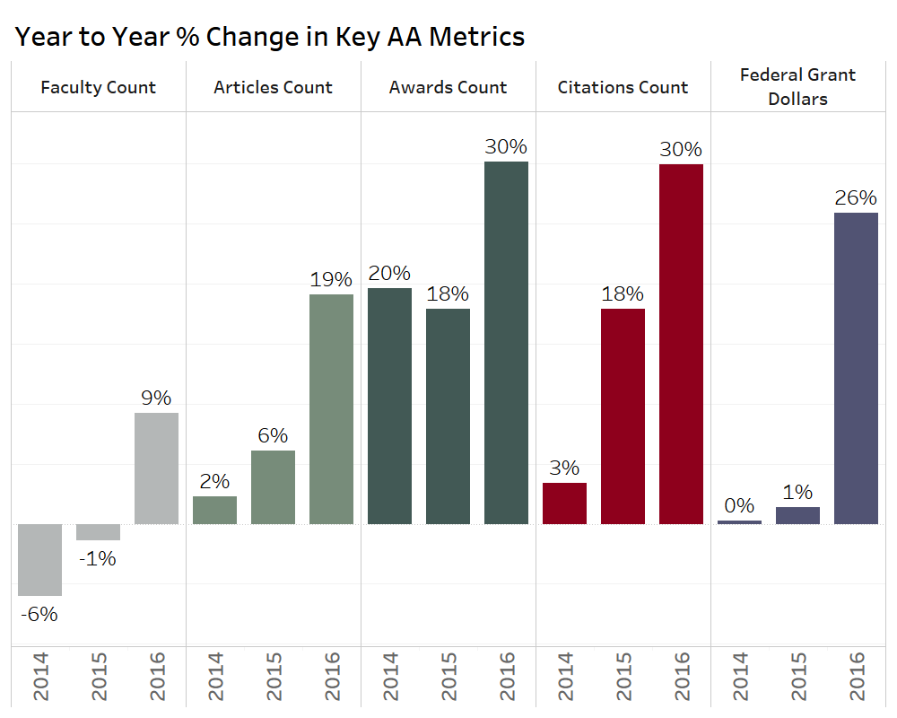

Slide 5
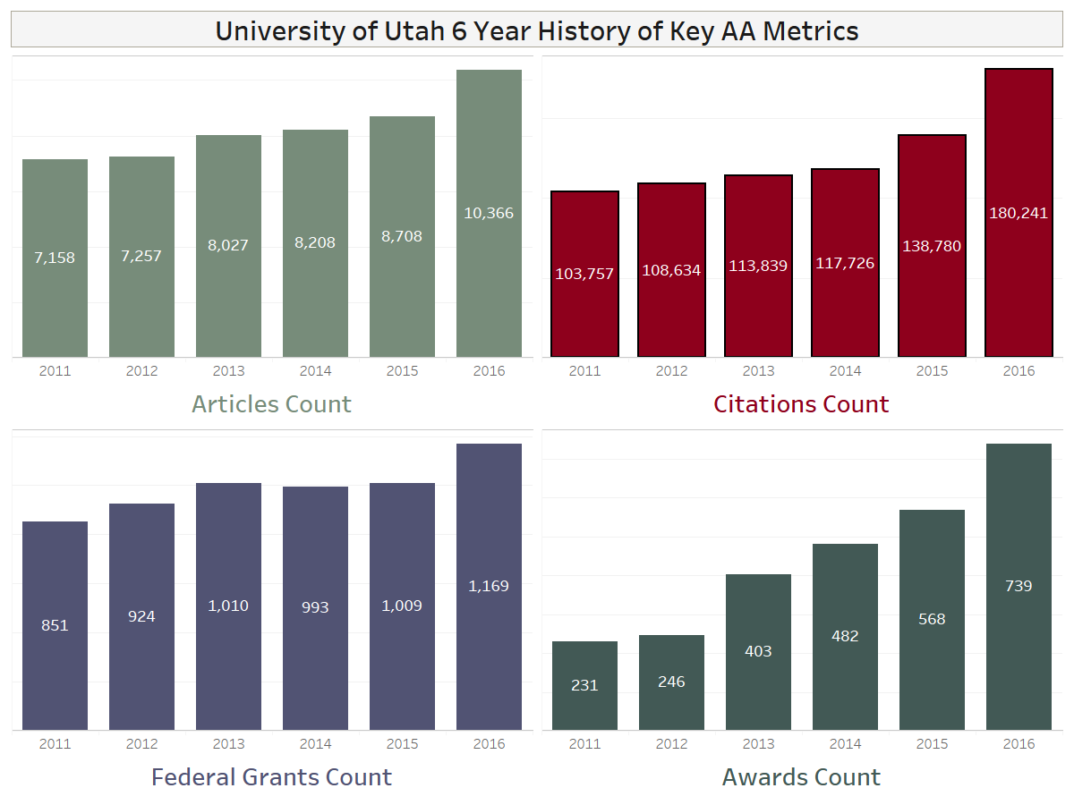

Slide 6
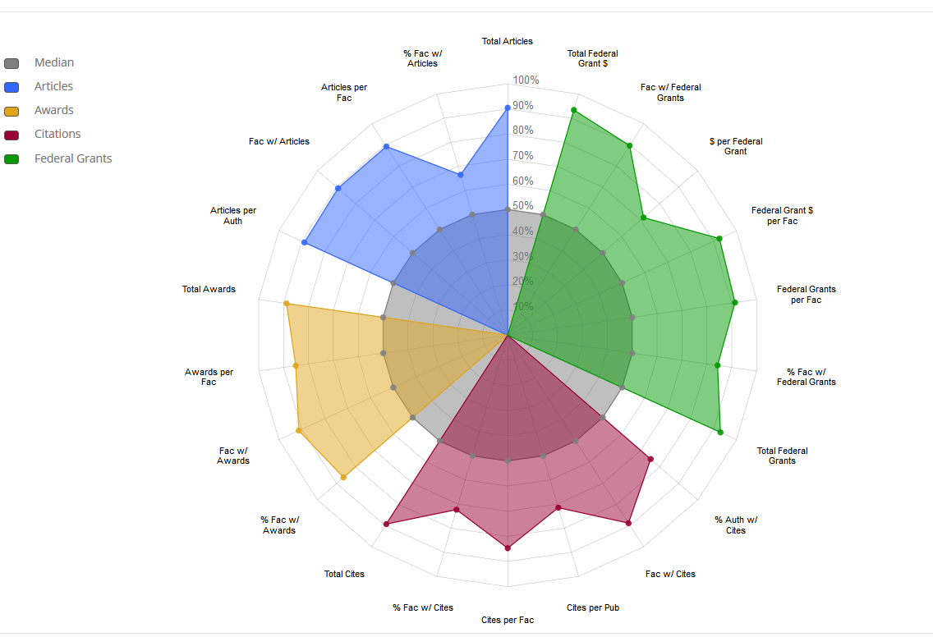
Peer Comparisons (General and Custom Groups)

Slide 7
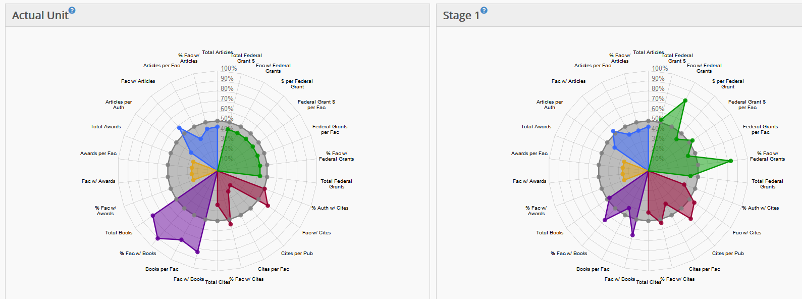
Model Department Changes in Faculty

Slide 8
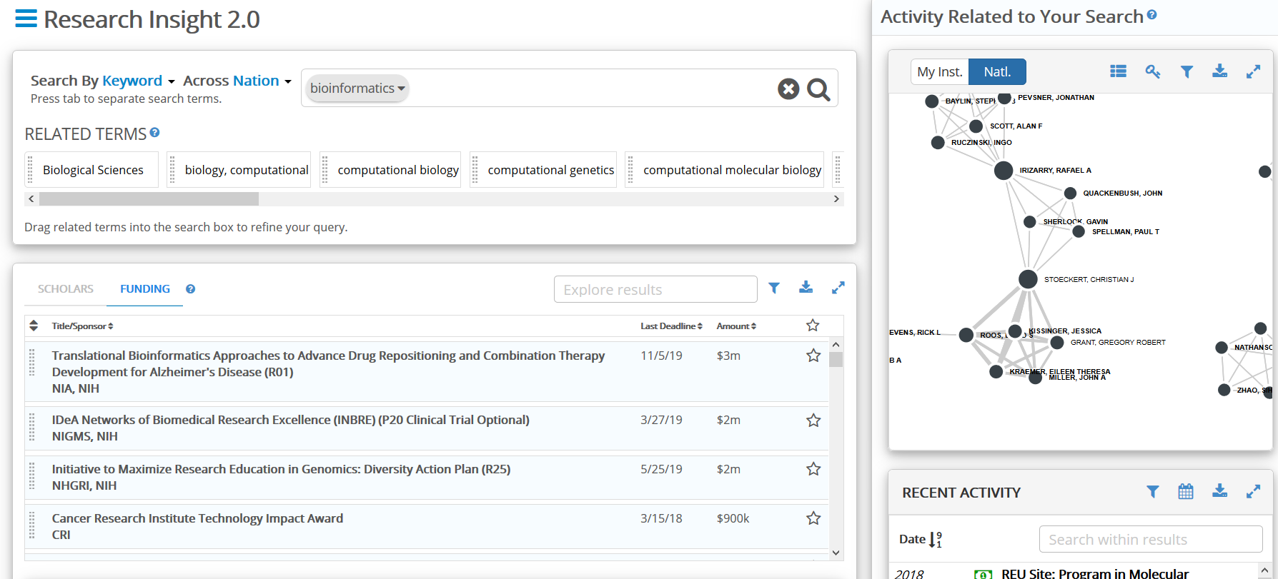
Identify Research and Collaboration Opportunities

Slide 9
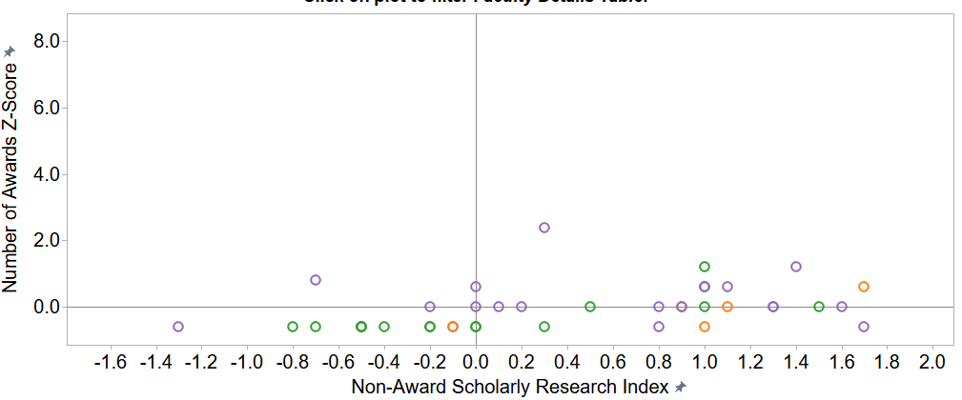
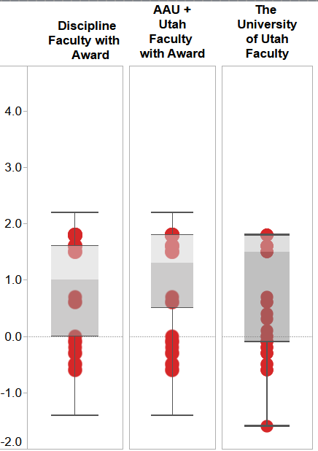
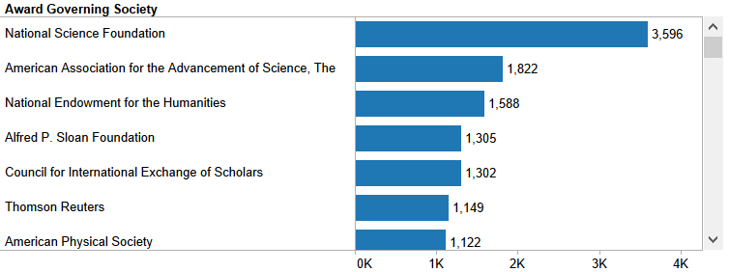
Awards and Recognition Opportunities

