Slide 1
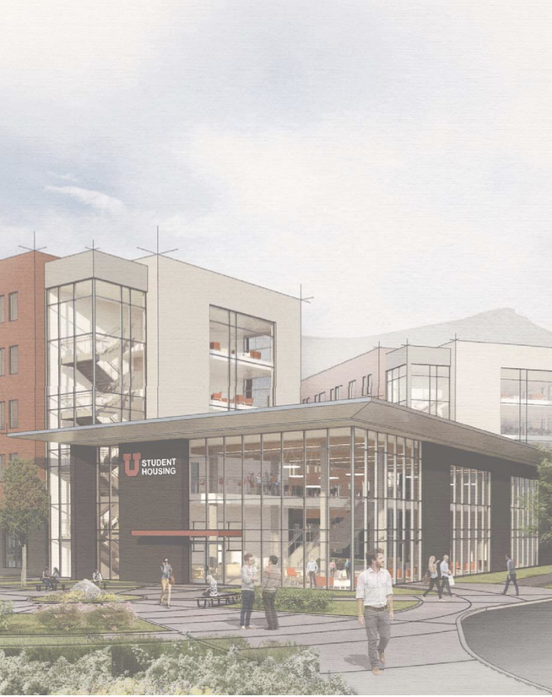
Transforming the U South Campus Student Housing & Dining Project
Academic Senate Executive Committee
November 20, 2017

Slide 2
South Campus Student Housing & Dining Project Overview
1. First Year Student Housing: A University Priority
Academic Impact
Housing Demand
Community
2. Space & Site Planning
Program
Site & Plan Approach
Room and Community Types
3. Budget & Schedule

Slide 3
South Campus Student Housing & Dining Project Academic Impact
Students that live on campus have a higher GPA in their first year and beyond, compared to their first year peers who do not live on campus.

Slide 4
South Campus Student Housing & Dining Project Academic Impact

Slide 5
South Campus Student Housing & Dining Project
Academic Impact
6 year graduation rate
Adjusted for allowable exclusions using same methodology as official rates

Slide 6
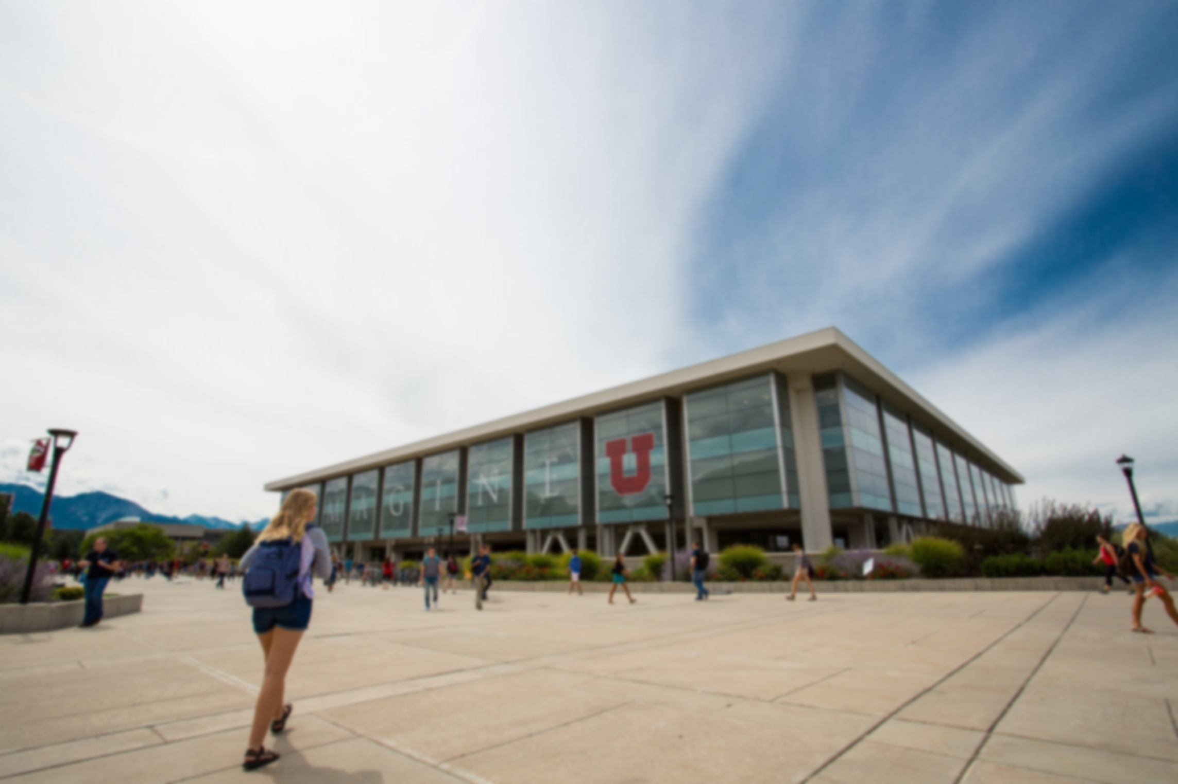
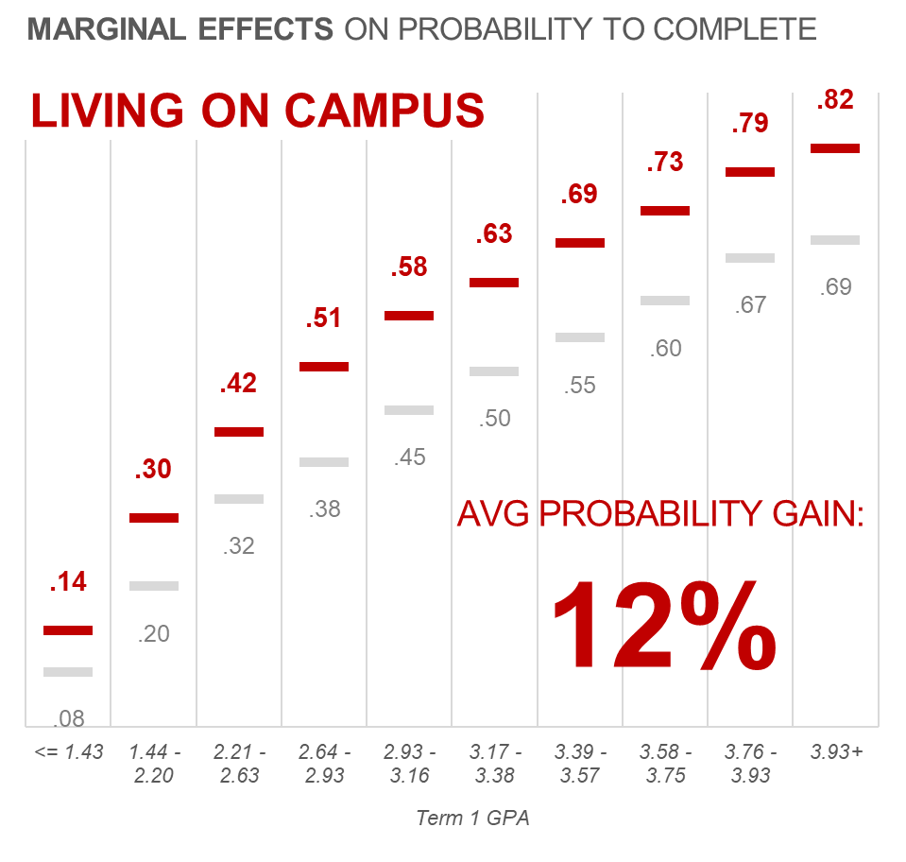
South Campus Student Housing & Dining Project
Academic Impact
On average, students who live on campus are
12% more likely
to complete a degree than similar students not living on campus

Slide 7
South Campus Student Housing & Dining Project Housing Demand: First-Year Students Want to Live on Campus

Slide 8
South Campus Student Housing & Dining Project Housing Demand
Fall 2017 Occupancy Strategies
Increased four person suites to five person suites | FA 17 | 180 beds
Transition beds in apartments from housing upper-class to housing First Year residents | FA 18 | 307 beds
 | FA 19 | 193 beds
Construct bedrooms out of in-suite living rooms | FA 18 | 89 beds

Slide 9
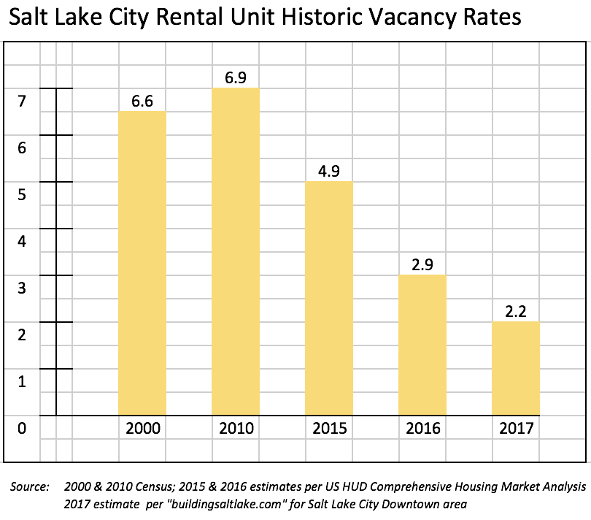
South Campus Student Housing & Dining Project Community
The apartment rental market in Salt Lake City is tight
Vacancy rates have been below 3% since 2015

Slide 10
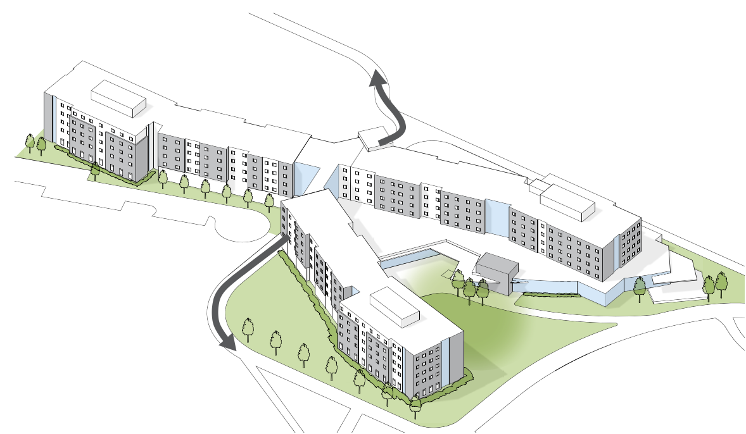
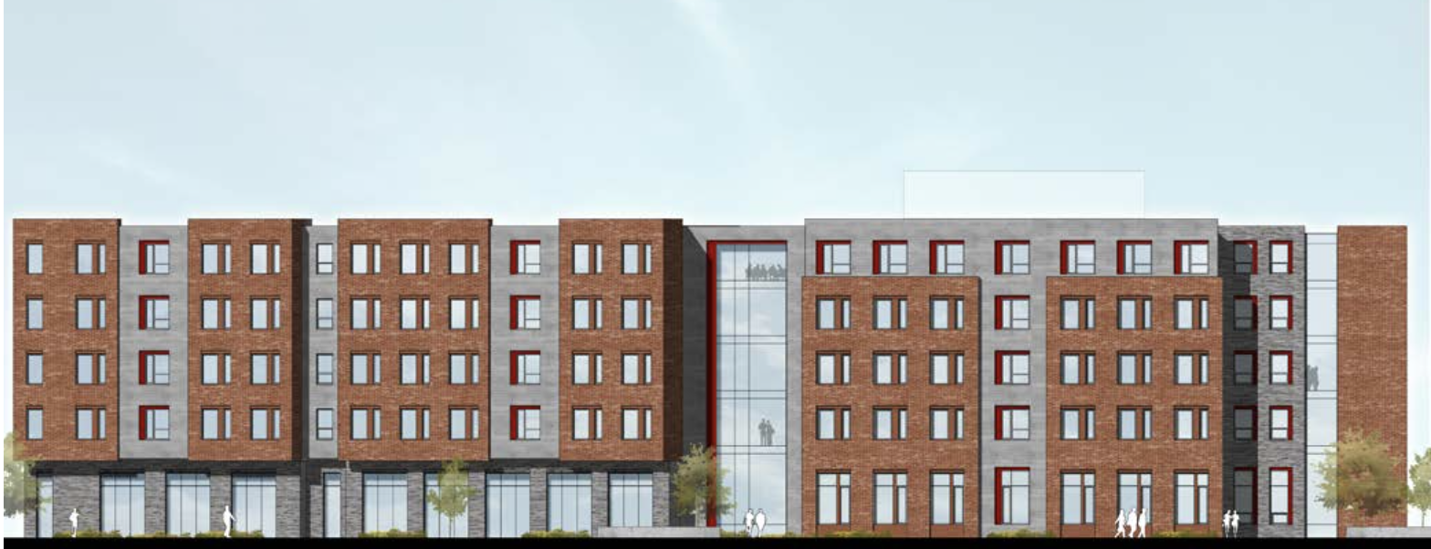
South Campus Student Housing & Dining Project Program: 992 Beds; 650 seat Dining Service; Community space
Building massing, viewed from Student Life Center, looking south west

Slide 11
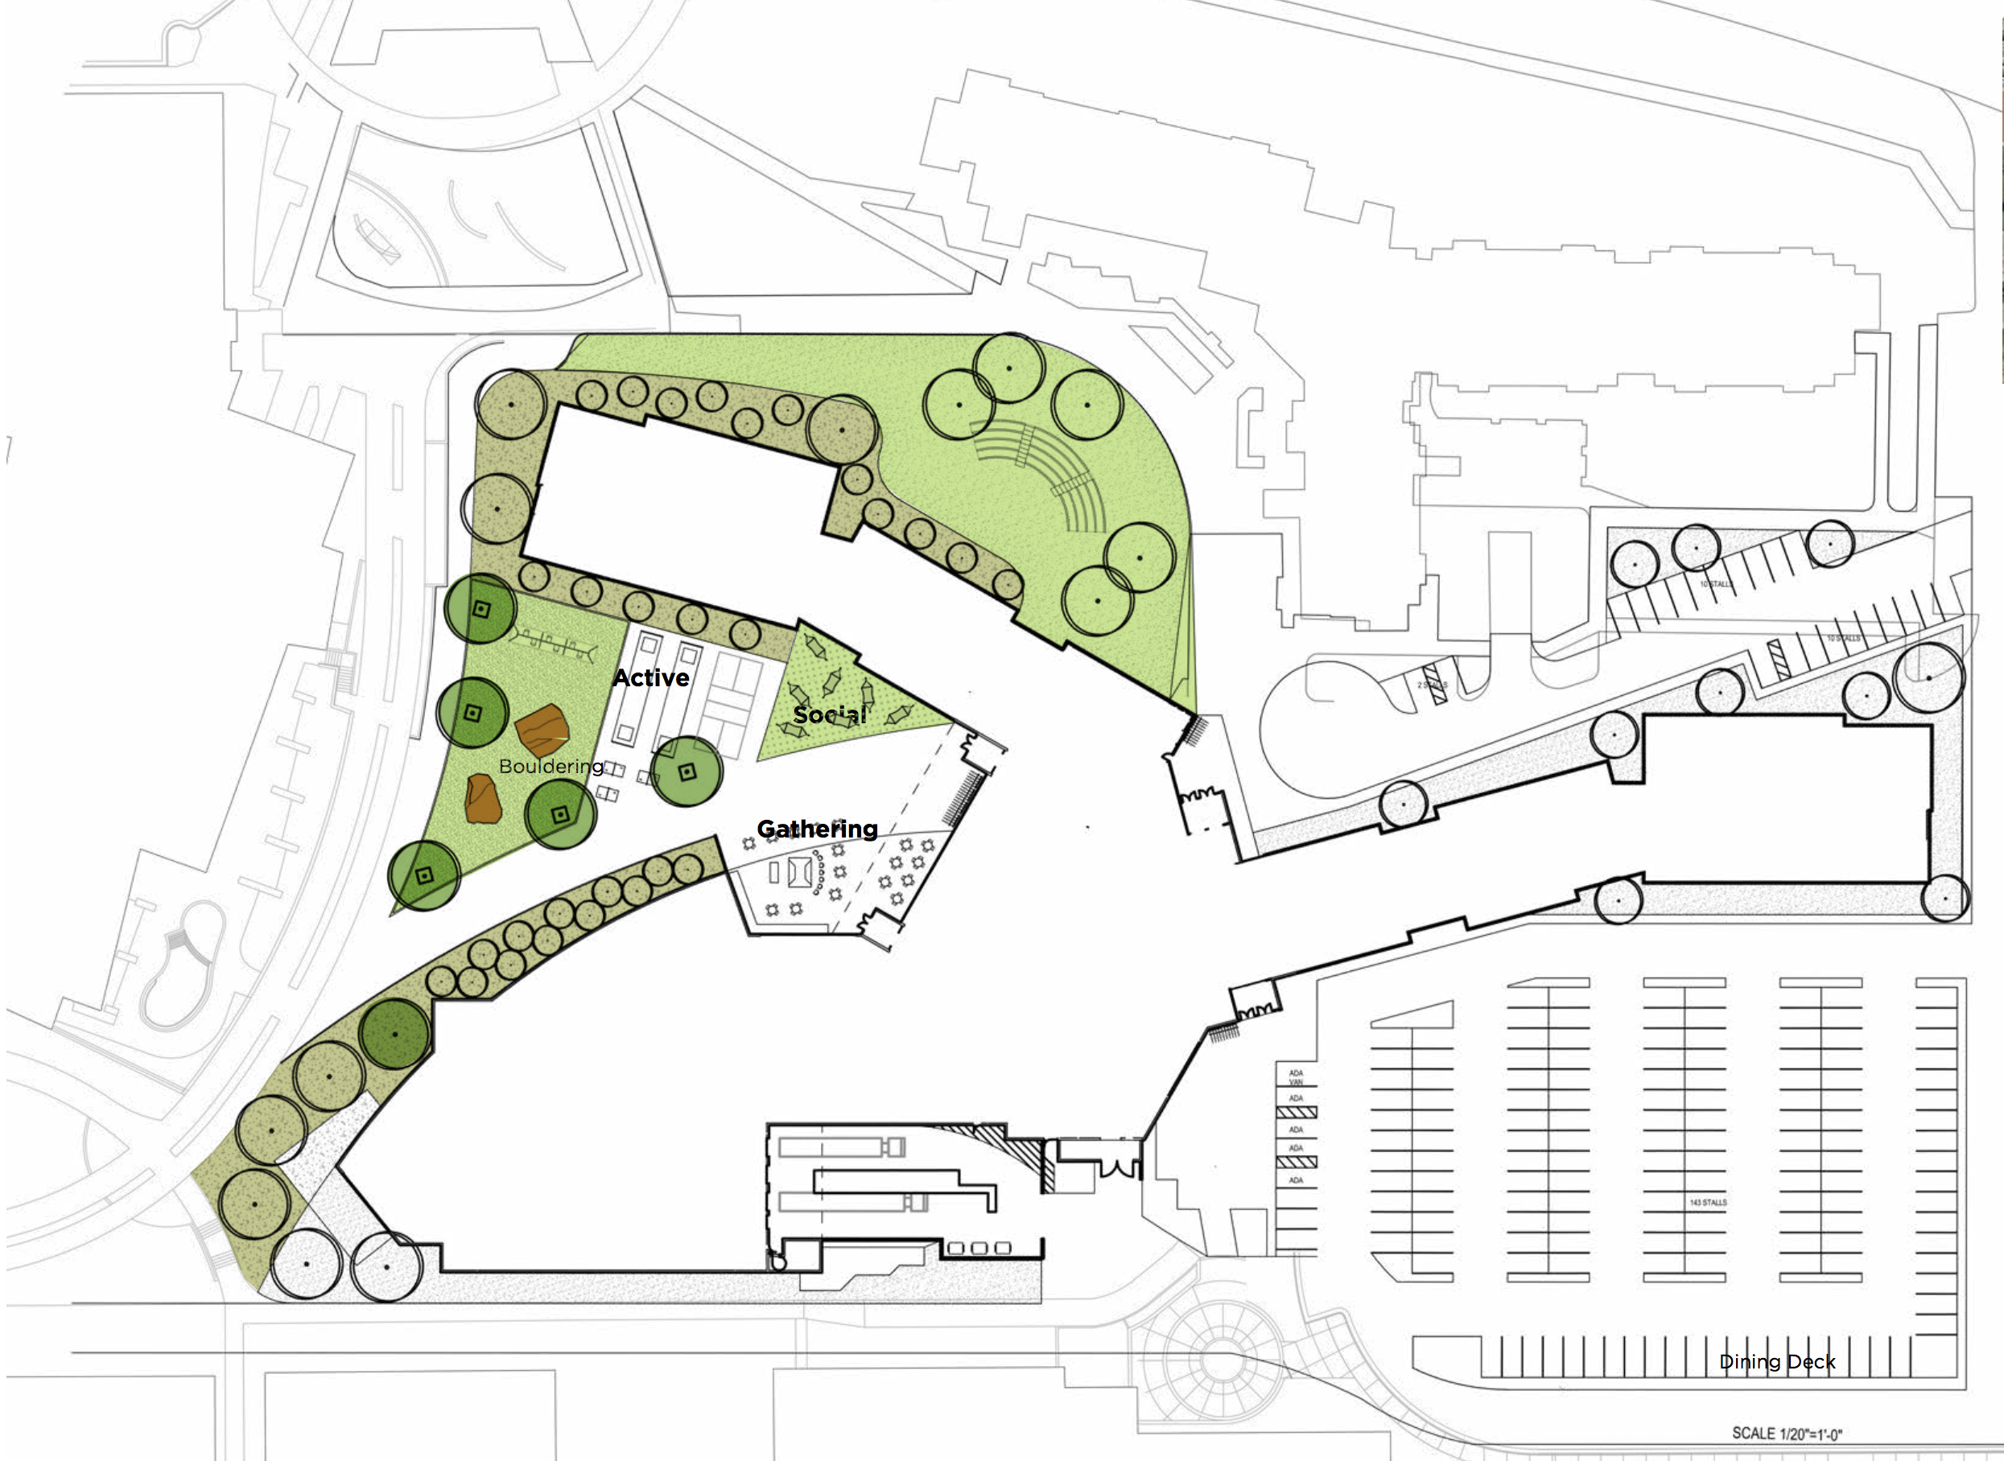
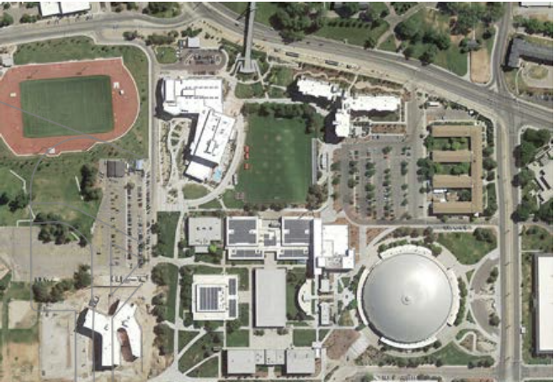
South Campus Student Housing & Dining Project Site: Current Soccer Field, adjacent existing Housing & Amenities

Slide 12
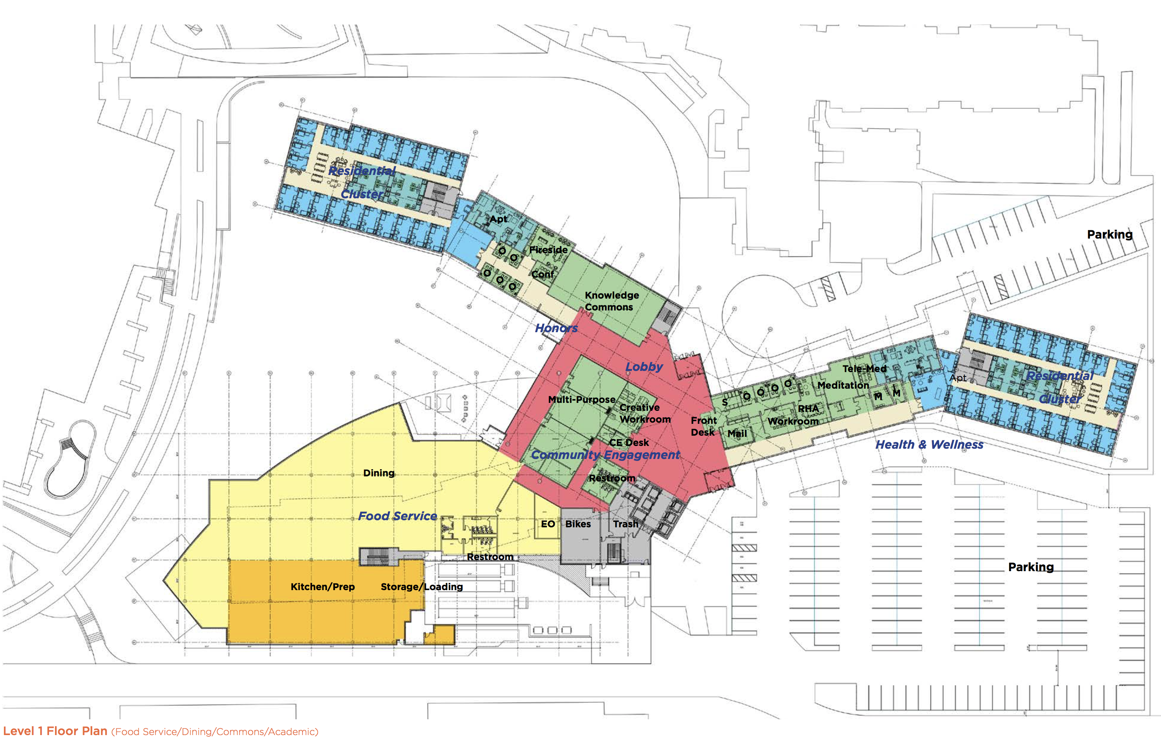
South Campus Student Housing & Dining Project Ground Floor Plan
Project Scope

Slide 13
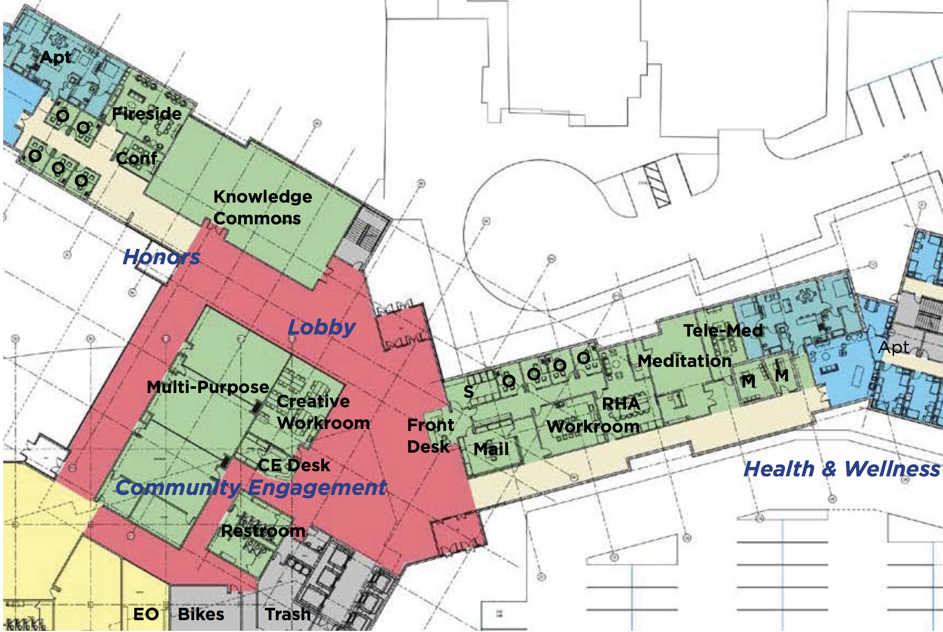
South Campus Student Housing & Dining Project Community Space: Community Learning, Classrooms, Administration
Project Scope

Slide 14
South Campus Student Housing & Dining Project 650 Seat Dining, sized to additionally serve Lassonde Studios & MHC
Project Scope

Slide 15
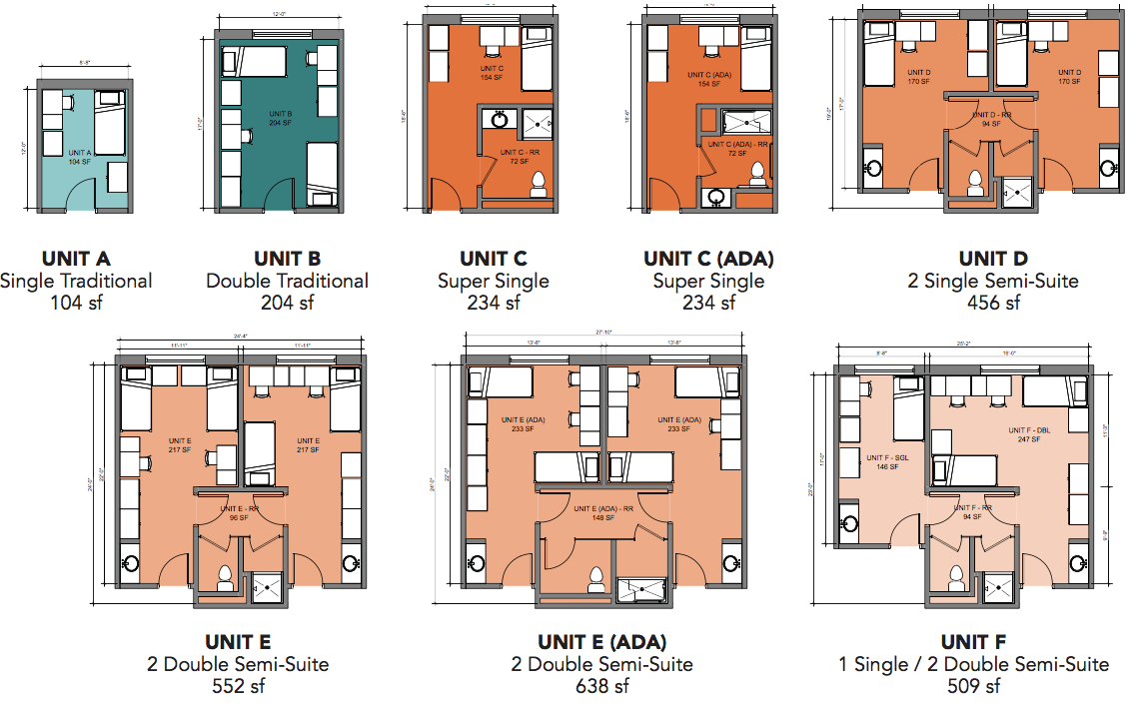
South Campus Student Housing & Dining Project Room types

Slide 16
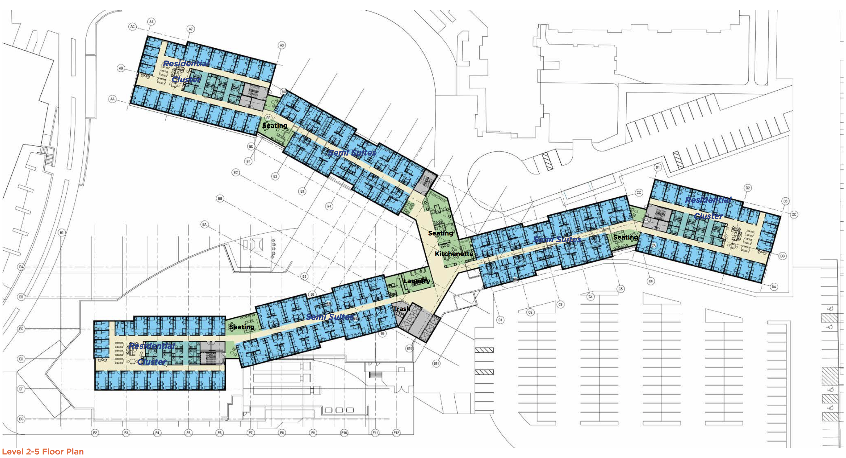
South Campus Student Housing & Dining Project Upper Floors 2-5 Plan
Project Scope

Slide 17
South Campus Student Housing & Dining Project Budget & Schedule
Number of Beds 992
Dining Size (Seats) 650
Total Size (GSF) 344,500
Construction Cost $83,343,000 ($241.92/GSF)
Soft Cost $21,874,000
Total Project Cost $105,217,000 ($305.42/GSF)
Funding:
Revenue Bond $77,717,000
Donations $15,000,000
Food Vendor $12,500,000
Total Funding $105,217,000
Expected Opening Fall 2020

Slide 18
South Campus Student Housing & Dining Project Levers to Sustain Housing Occupancy
Re-integrate the living rooms back into Sage Point suites | 89 beds
Support housing for English Language Institute students | 100 beds
Re-integrate Sophomores into Sage Point suite housing | 800 beds
Re-integrate Graduate students into apartments | 300 beds
Notes:
BoT
If enrollment projections are lower than expected, the concern re. overbuilding can be addressed through adjusting the levers identified above.

Slide 19
South Campus Student Housing & Dining Project
Questions?

