Slide 1
Fall 2017 enrollment update
Ruth Watkins, Sr. Vice President
Academic Affairs
Mary Parker, Associate Vice President
Enrollment Management

Slide 2
FIRST- TO SECOND-YEAR RETENTION
Based on first-time, full-time freshmen, fall cohorts adjusted for allowable exclusions

Slide 3
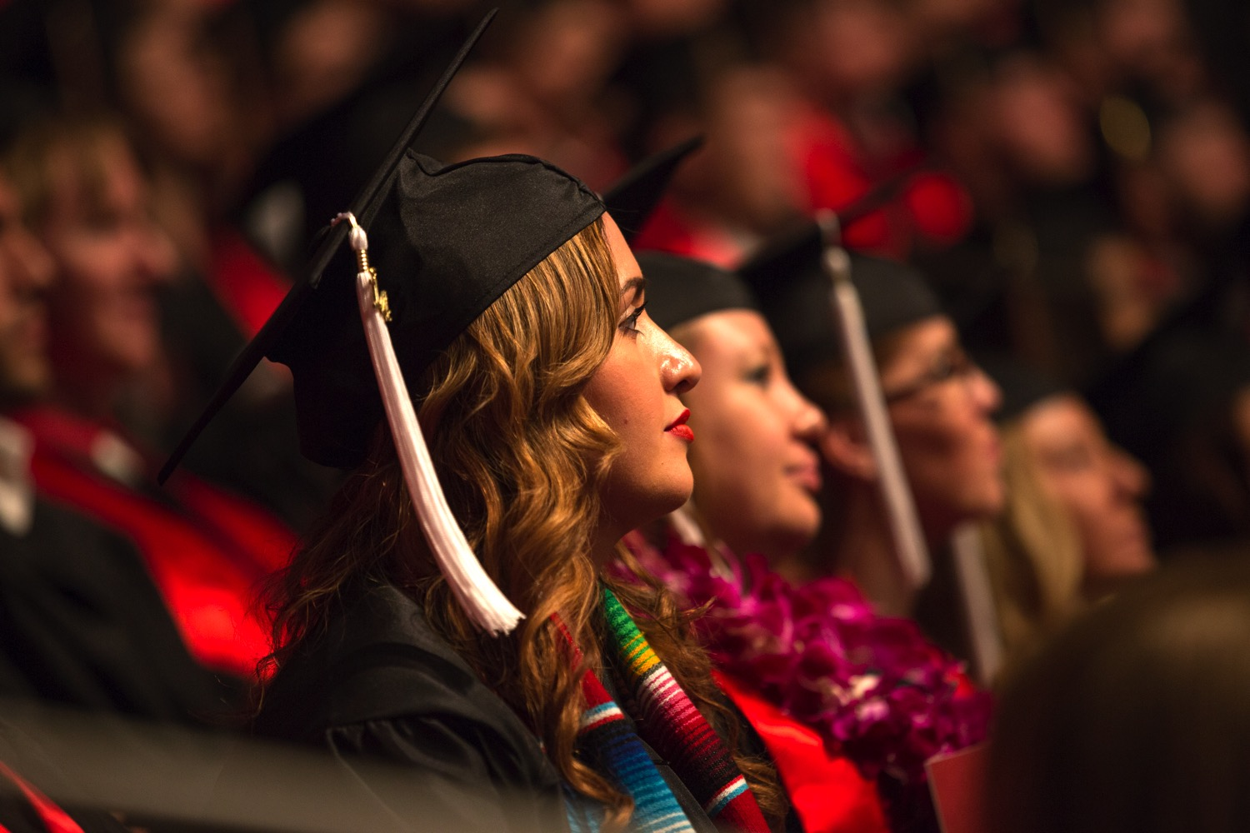
SIX-YEAR GRADUATION RATE
Based on first-time, full-time freshmen, fall cohorts adjusted for allowable exclusions

Slide 4
Six & Eight-Year Graduation Rates
GOAL
6-year rate = 8-year rate

Slide 5
Total Headcount
Total University headcount increased by 2.2% in Fall 2017.

Slide 6
graduate Headcount
Graduate-level headcount continued to rise.
Figures include Masters, Doctoral, and Professional enrollment.

Slide 7
undergraduate Headcount
Undergraduate headcount increased 2.7%

Slide 8
Freshmen Headcount
Overall freshmen headcount increased by 14.6%.

Slide 9
Under-represented freshmen
The number of domestic freshmen who are students of color increased 15.1%.

Slide 10
Freshmen ACT scores
The fall 2017 average Freshmen ACT is the highest on record.

Slide 11
Freshmen HS GPA
The average Freshmen HS GPA remained the same as last year.

