Slide 1
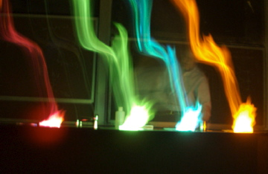
Subject to the approval of the Board of Trustees, the “university faculty shall have the authority . . . to legislate on matters of educational policy. . . .
The faculty has a right to a meaningful role in the governance of the university; . . . it has a right to participate in decisions relating to the general academic operations of the university including budget decisions and administrative appointments.”
The legislative power of the faculty is “normally. . . exercised by the faculty in conjunction with duly elected student representatives and administrators in the Academic Senate . . . .

Slide 2
A Brief History of the Richmond Group
Graduate Students | Undergraduate Students | MSSST Students | Institutions($)
Carolyn Kelley Dr. Margaret King Gregg P. Oakes (MS) Anne Pazos (MS) Patrick Pinson (MS) Mitch Poss Robert Barmore (MS) Julie Pleva (MS) Jill Grantham (MS) Steve Looman Roger Harrison Amy Parr (MS) Jaqueline Kiplinger Brian Bennett Jennie Lenig (MS) Dr. David Bauman | Eric Kelson Brett Lucht Lars Heumann Eric Kawamoto Greg Owens Andreas Fechtenkötter Steve Brown Chris Kareis Joseph Pergler Soren Giese Jeremy Riley Paul Oblad Matt Weinstock Stephen Oblad Reid Huefner Carlos Parrago William Hewitt Neira Acevedo Ramos Safia Ahmed Brandon Bacon Amelia Goldberg Nathan Odendahl Florence Fernandez Anastasia Borodai | Jeff Statler Sidney Gines Lisa Goff Nannette Gunty Bruce Illum Doug Sill Nancy Treasure Rob Wagner Scott Wihong Julie Taylor Jana Barrow Shea Wickleson Vicky Mayall Janette Duffin | University of Utah NSF ACS-PRF FIPSE (USDOE) Dreyfus Foundation Sloan Foundation US Army Collaborators Atta Arif (X-Ray) Carl Hoff Anita Orendt Rudi van Eldik Gary Wulfsberg J.F. Nixon Utah Colleagues Stan Pons Ron Ragsdale

Slide 3
Research | Teaching | Service
Organometallic Chemistry & Catalysis | Elementary ➔Graduate | Semester Transition U Teaching Committee Academic Senate EC
Making “Unreactive” Molecules REACT ! | Making Chemistry Exciting and Accessible | Guiding Students to Achieve Their Goals
Camille & Henry Dreyfus New Faculty Award | ASUU Student’s Choice Teaching Awards | Perlman Award for Excellence in Student Counseling
NSF Presidential Young Investigator | UU Presidential Teaching Scholar | College of Science ACCESS Program
Alfred P. Sloan Foundation Fellow | Robert W. Parry & WW Epstein Awards | MSSST Program Director Undergraduate Council
ACS Nobel Laureate Signature Award in Graduate Education |  | Associate Dean, Honors College
FIPSE Grant | NSF & EPA Graduate Fellowship Panels
DoEd JRC Nuclear Medicine Technology | American Chemical Society – Salt Lake Section Faraday Chemistry Lectures

Slide 4
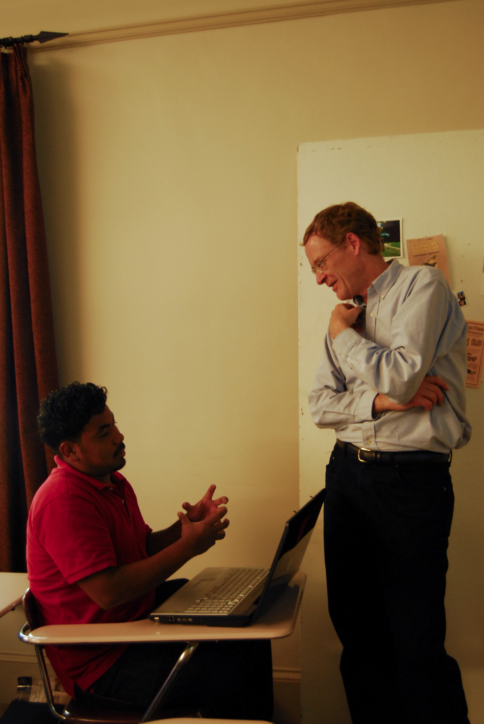
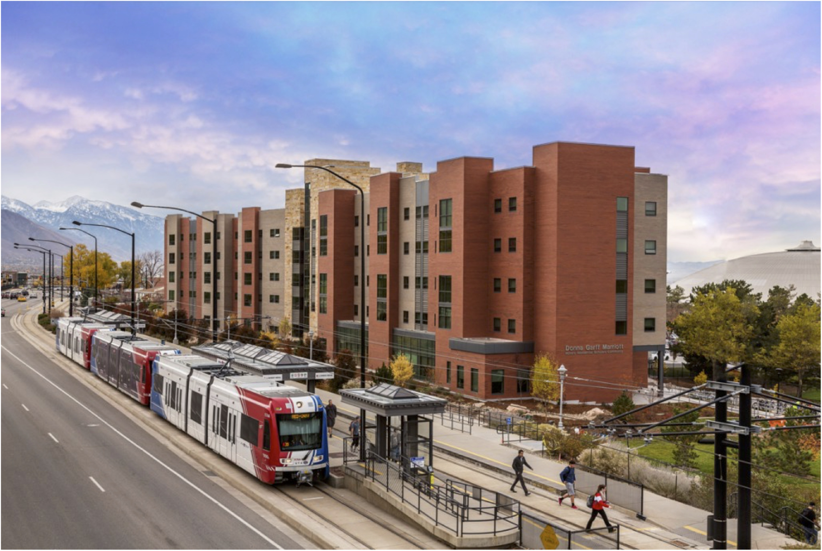
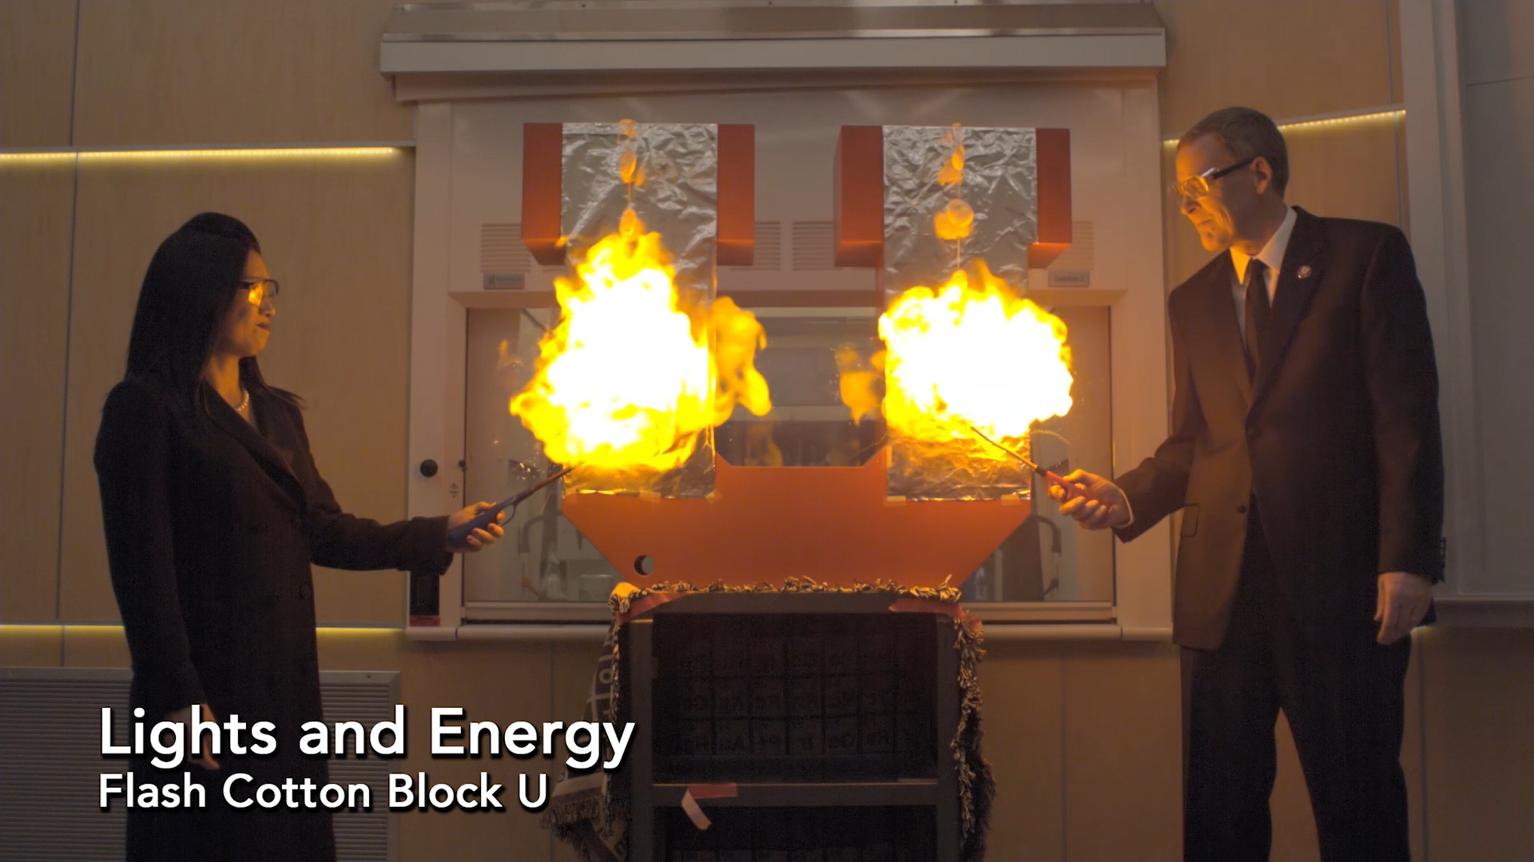
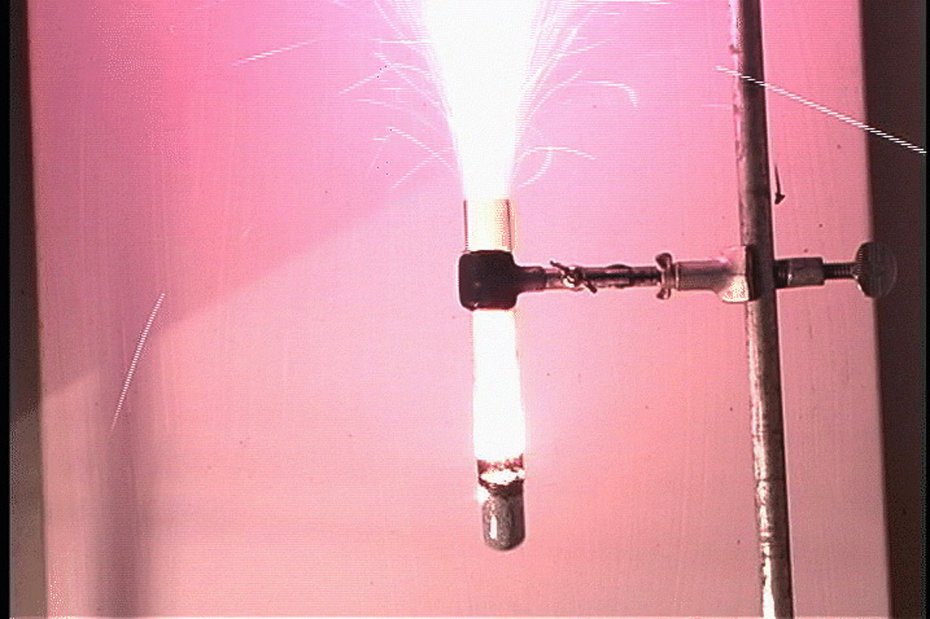
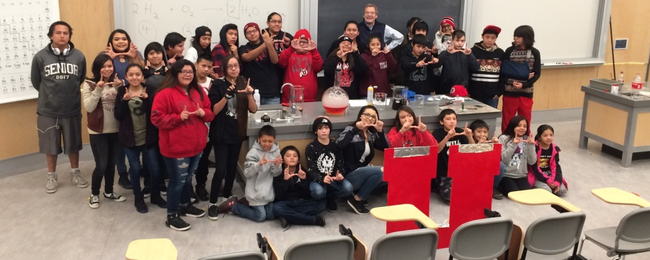
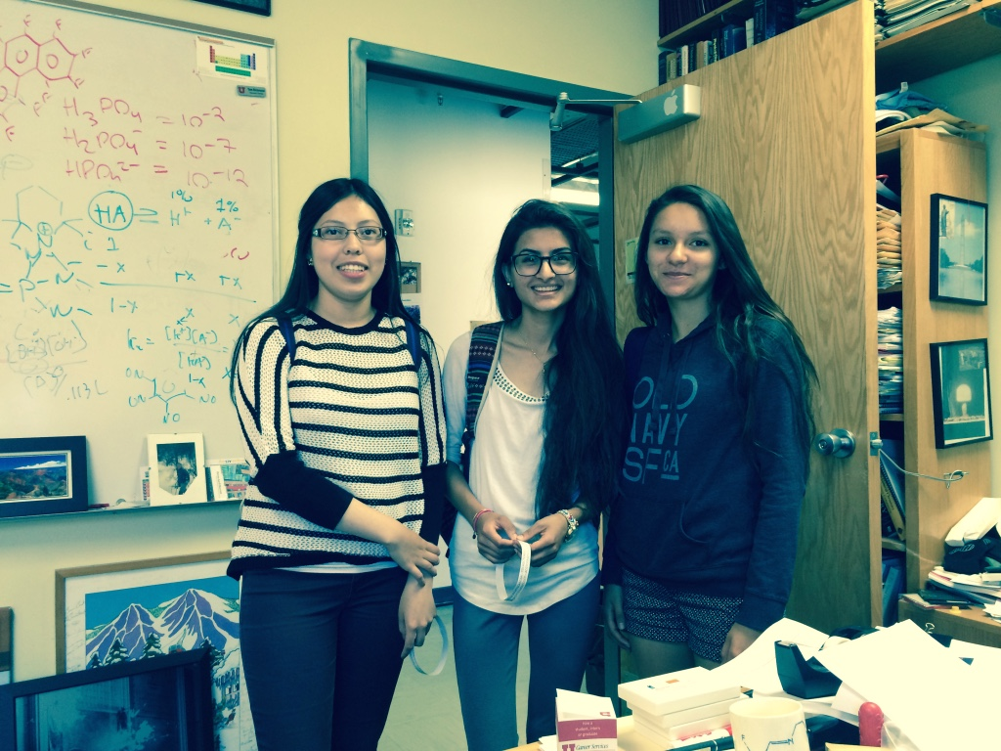
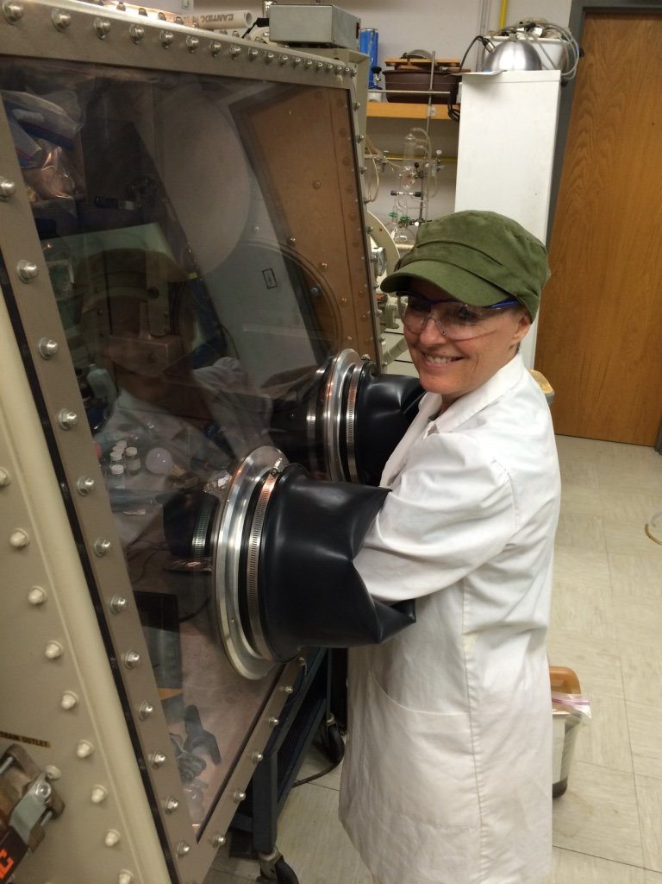
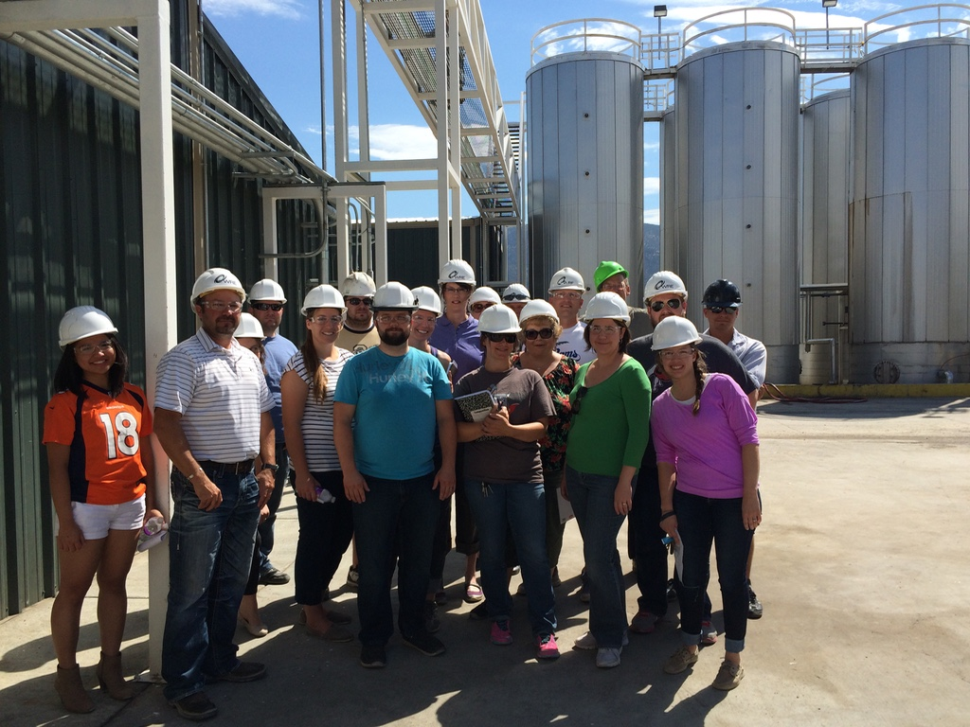
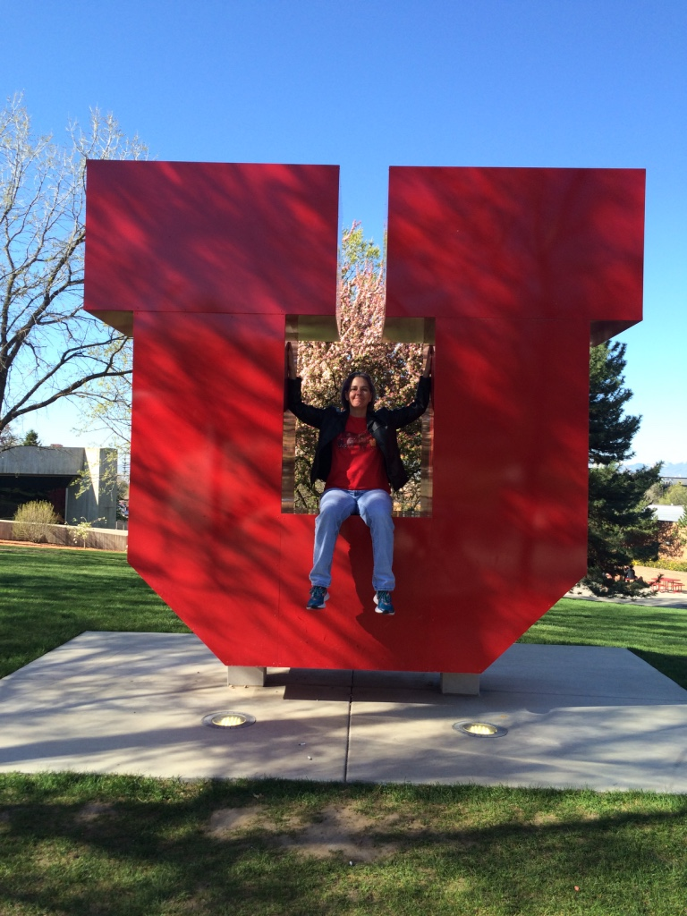
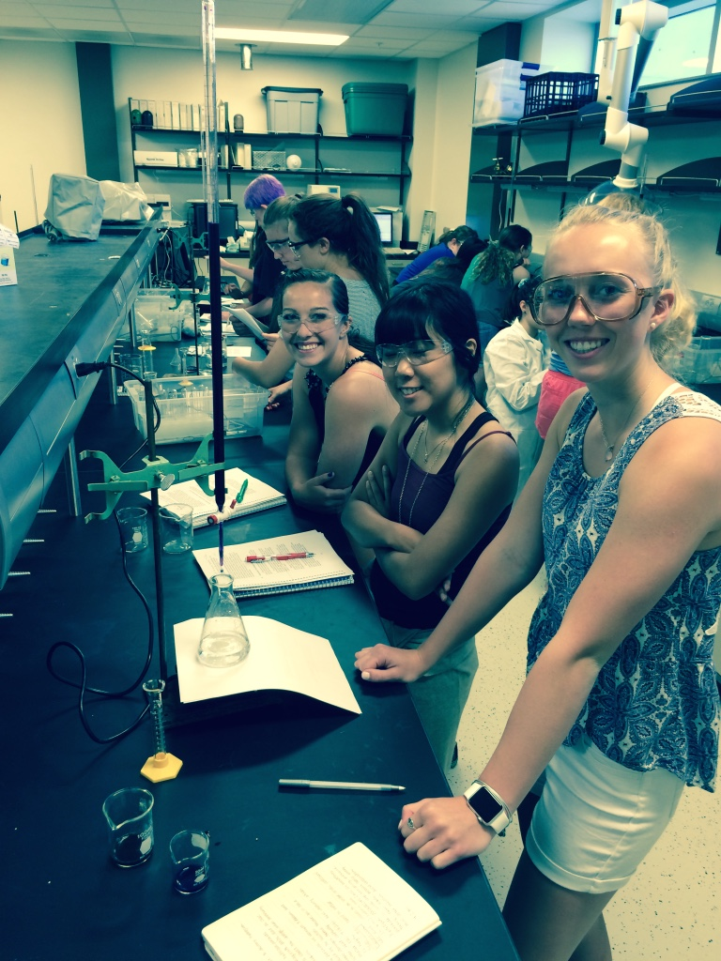

Slide 5
