Slide 1
Dr. Z’s Top Five Strategies to be a More Efficient Researcher
Donna Harp Ziegenfuss, Ed.D.
Associate Librarian, Marriott Library
donna.ziegenfuss@utah.edu
801-585-0542
Office: 2110B

Slide 2
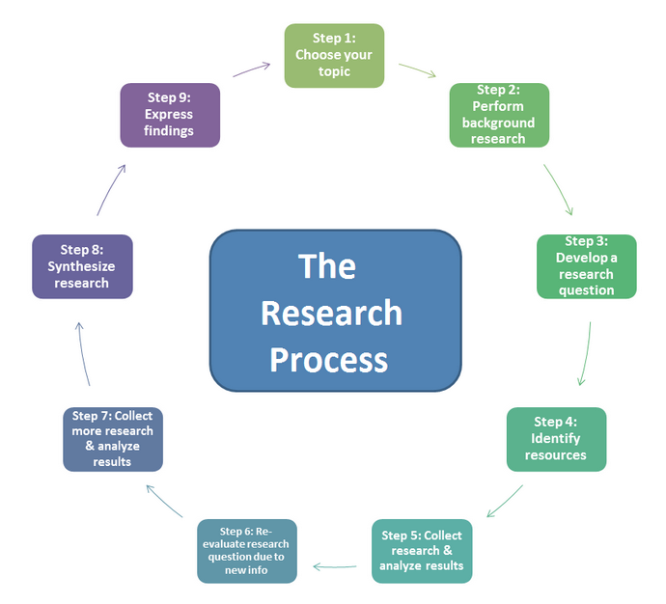
The Research Process
Library

Slide 3
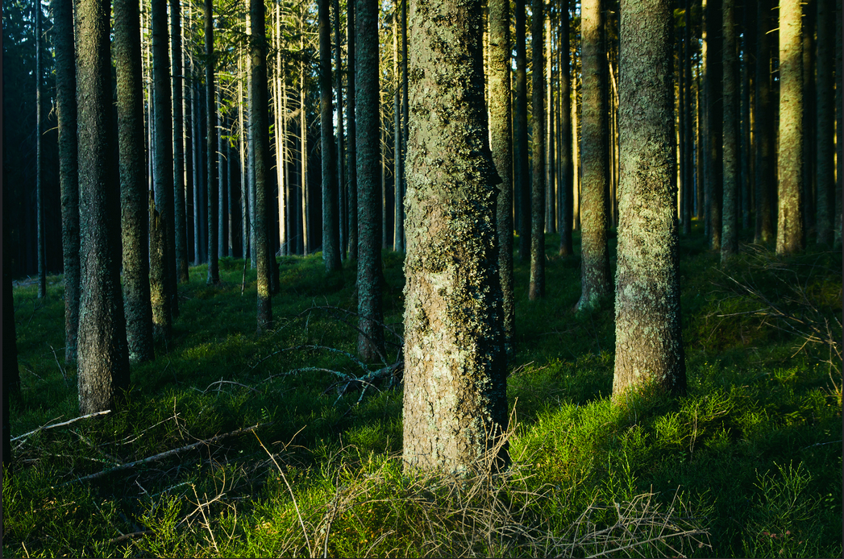
Start Broadly then Focus In
1
https://www.flickr.com/photos/pawel_pacholec/14079218372/in/photolist-ns8wVk-ns8GX5-naVAM5-ns8F7m

Slide 4
Start Broadly then Focus In
Advice
Browse scholarly conversations around your topic
Get a sense of how your topic is situated in the bigger picture
Take an interdisciplinary approach
Tools to find keywords, sub-topics
Google – use advanced search features
Blogs and popular magazines – what is being debated
Google Scholar – to see a broad picture of topic
Concept Mapping Subtopics (free CMap)

Slide 5
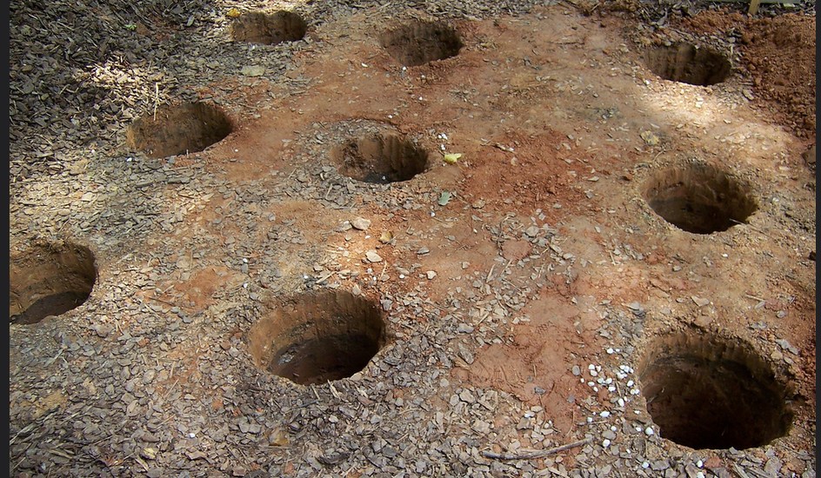
Then Dig Deeper into the Good Stuff
2
https://www.flickr.com/photos/barelyfitz/195076148

Slide 6
Then Dig Deeper into Good Stuff
Start with Search Field on the homepage
Faceted searching to limit your search
Narrow your search into specific scholarly Databases organized by discipline or general databases such as Academic Search Ultimate, Scopus, Web of Science
Online Journals link to find specific journals
Collections for digital primary sources

Slide 7
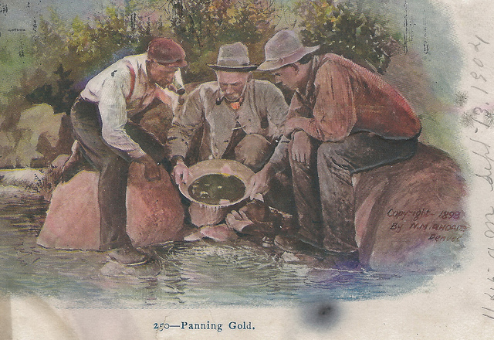
Mine What You Find
3
https://www.flickr.com/photos/upnorthmemories/6819551991/

Slide 8
Mine What You Find
If you find a really good article or book:
Look at the abstract or introduction – is this an article or book relevant to your topic?
Mine the references for more leads
Mine keywords so you can further search
What journal is this article published in? What journals are in the references? Go directly to that journal and search

Slide 9
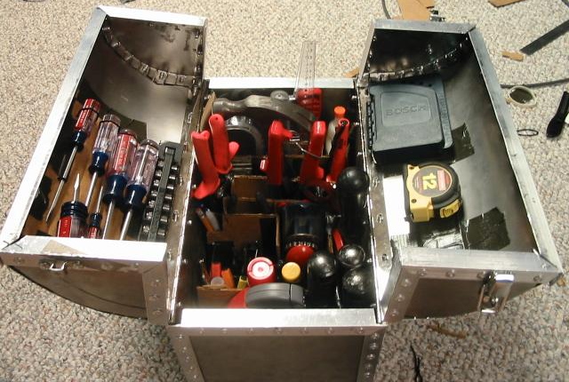
Develop a Research Toolbox to Be More Efficient!
4
https://www.flickr.com/photos/zakh/337938459

Slide 10
Set Up and Learn Free Research Tools to Be More Efficient!
Use free EndNote Basic for managing citations
Zotero, Mendeley, EndNote Desktop
Save PDFs to BOX! You have 1 TB of space http://box.utah.edu
Use the UofU Google Cloud Space http://gcloud.utah.edu
Link Google Scholar to the Marriott Library Catalog http://scholar.google.com
Dragon Dictation phone app for brain dumps

Slide 11
Get Organized & Stay Organized
Come up with a naming convention for files and folders
Track timelines and deadlines using Excel or Trello or other time management products
Chunk your research and writing tasks
Set short-term task deadlines so you can see progress
Additional templates at: https://utah.instructure.com/courses/353729/pages/details-research-organization

Slide 12
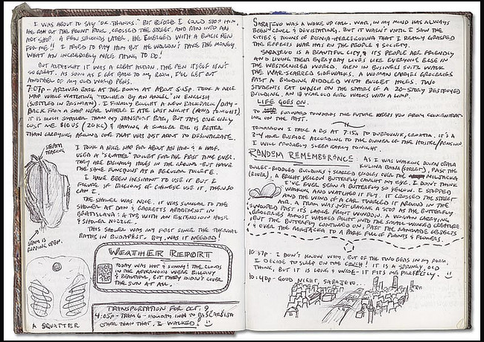
Keep a Research Journal
https://www.flickr.com/photos/kahunna/360229654/in/album-72157594171653541/

Slide 13
Keep a Research Journal https://anujacabraal.wordpress.com/2013/07/03/keep-a-research-journal-it-is-important/
Keep track of keywords you use
Journals that keep popping up in your searches
Recurring authors to check out further
Topics and connections – do some drawings
Record A-HA moments and questions that arise Is a record of what you have done
Writing in your journal helps you ease into the writing process

Slide 14
Scope Out Useful Resources Ask Questions!
5
https://www.flickr.com/photos/gerlos/3119891607

Slide 15
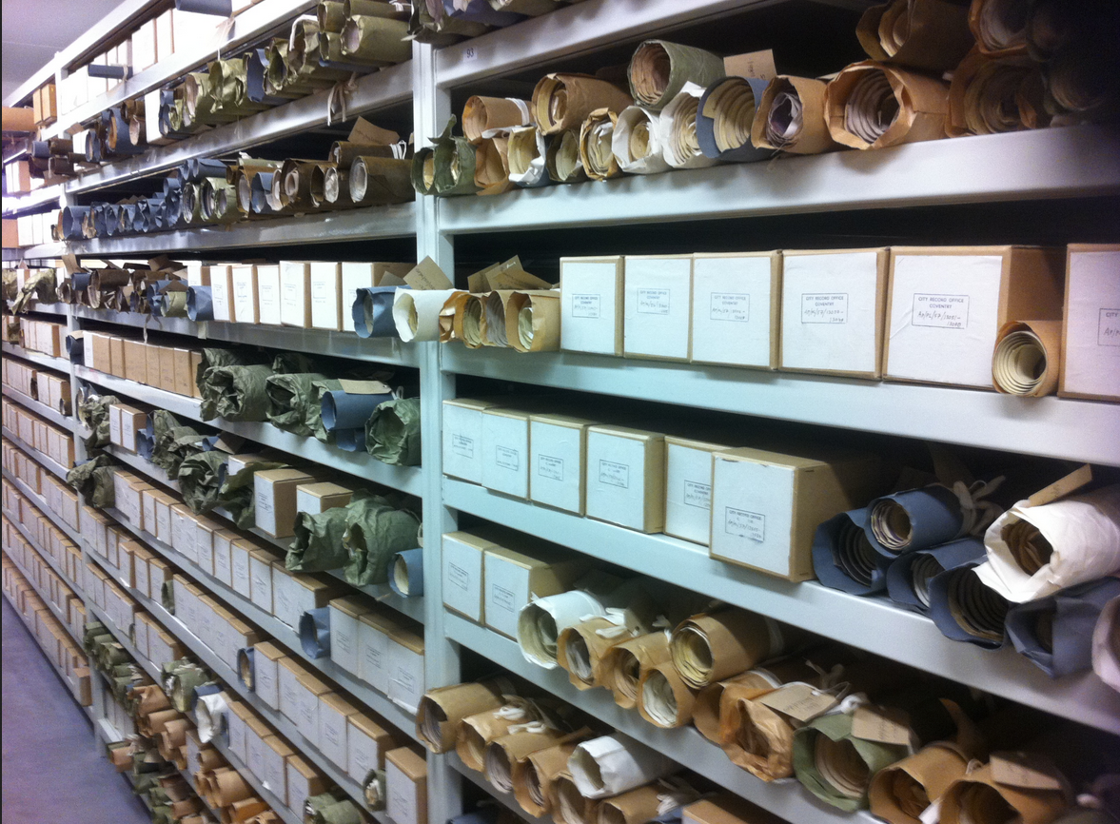
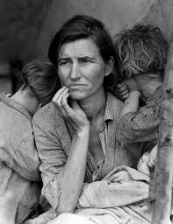
Don’t Forget Other Sources
https://en.wikipedia.org/wiki/Image_editing ; https://en.wikipedia.org/wiki/E-book
https://upload.wikimedia.org/wikipedia/commons/9/93/Video_icon2.png
https://upload.wikimedia.org/wikipedia/commons/e/e0/Documents_on_shelves_in_the_archive_store_%28History_Centre%29_at_the_Herbert.jpg

Slide 16
Don’t Forget Other Sources
Ebooks – you can read online without coming to the library
The ARC – you can request and pick up at the Reserves desk
The Stacks – find a call number and go browse
Special collections – might have collections around your topic
Government Documents – if you are researching policies and laws
Dissertations
Subject Guides – for every imaginable topic

Slide 17
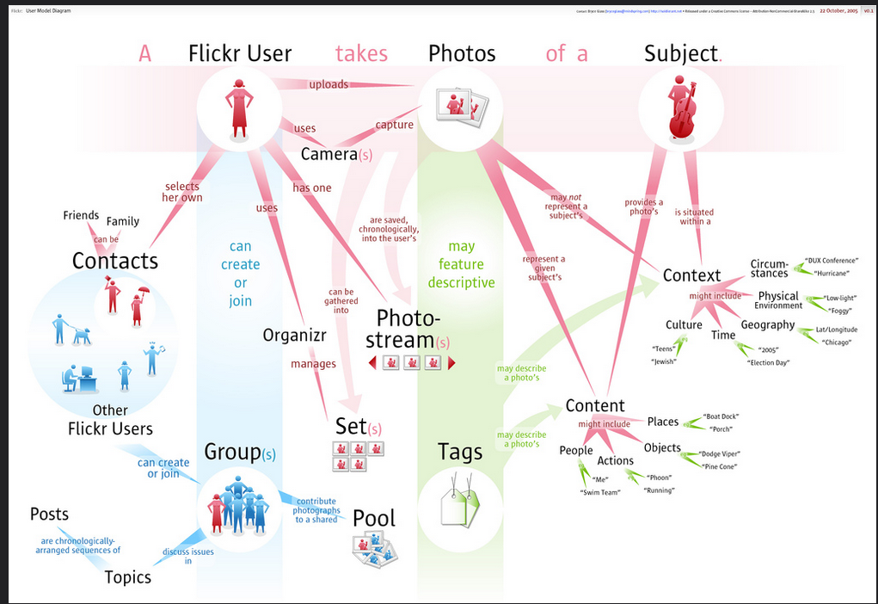
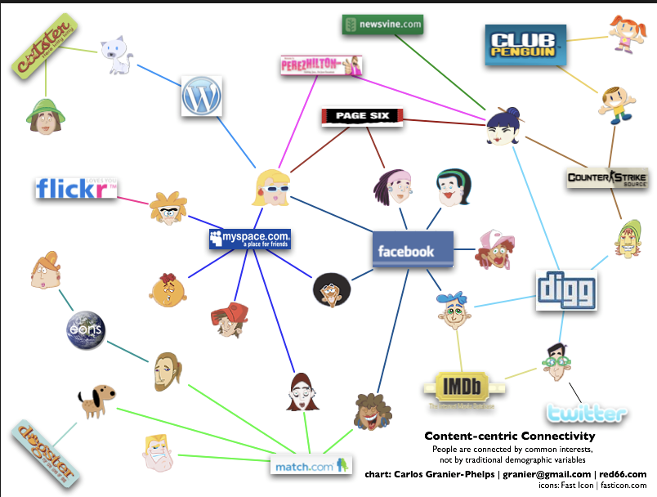
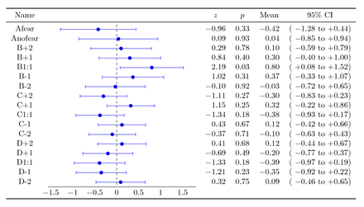
Think Visually
https://www.flickr.com/photos/bryce/55749985 ; http://pgfplots.net/tikz/examples/graph-in-table/; https://www.flickr.com/photos/anonymonk/1403378488

Slide 18
Voyant-tools.orgThink Visually
Use Concept Mapping to help you organize topics, look at relationships to visualize your research
Matrices or Tables to organize data
Diagrams to show conceptual frameworks or concepts
Word clouds -upload docs (word or pdf) and get a word cloud (https://voyant-tools.org/)
Images to demonstrate

Slide 19
Scope Out Useful Resources to Support or Refute Findings
You have a Subject Specialist Librarian
If we don’t have what you need we can get it for you!
Interlibrary Loan
Suggest a purchase

Slide 20
Get Help with Writing or Presenting your Findings
The Writing Center on the 2nd floor of the Marriott Library (by the reserves desk)
Help with creating a poster (templates available at: http://campusguides.lib.utah.edu/c.php?g=160626&p=1051599
Qualitative & Quantitative research analysis support (Library Guides)
Nvivo, Atlas.ti, Stats TA (mlib-statistics@lists.utah.edu )

Slide 21
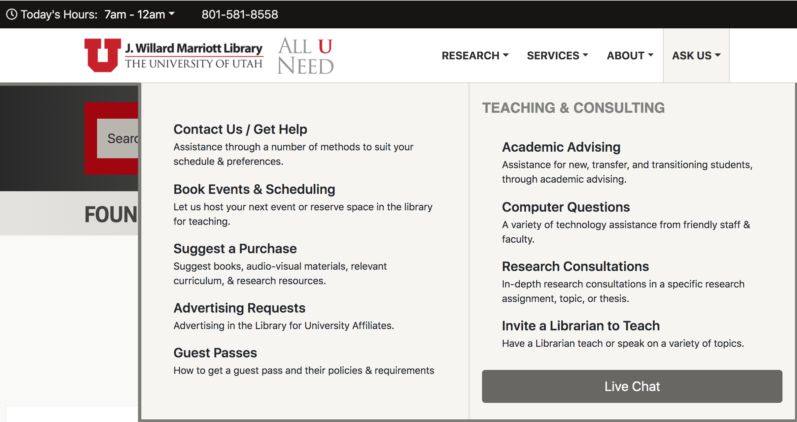
Ask for Help!!!!!!
On the Library homepage (top right) (http://lib.utah.edu/help

Slide 22
Ask for Help!!!!!!
This is what we are here for
We can meet one-on-one to discuss your topic and recommend databases
We can refer to you to experts
We can help you troubleshoot tools like Endnote basic
Chat and email

Slide 23
Additional Resources
Library Workshops (during fall & spring semesters)
Writing a literature review, doing qualitative research, advanced library research
Library Guides
How to use research tools, how to do literature reviews and research
One-on-one Discipline Specific Consultations
Subject specialists
donna.ziegenfuss@utah.edu I can connect you to what you need

Slide 24
The Research Process
Ask we print posters & have how-to guides
#1 Tip
Start Broad
#5 Tip
Scope out resources and ask questions
#2 Tip
Dig deep and use keywords to articulate
#4 Tip
You need to be organized, use tools
#3 Tip
Mine Articles & Books

