Slide 1
Obstacles to the Diffusion of Knowledge: The Hazards of Haphazard Reviews
Julia H. Littell, Ph.D., Professor
Graduate School of Social Work and Social Research
Bryn Mawr College, USA
Roundtable Discussion at the
Society for Social Work and Research conference
16 January 2011
Tampa, FL

Slide 2
Overview
Purposes and types of research reviews
Why review methods matter
Common sources of bias and error in reviews
Consequences of bias and error
Why haphazard reviews are hazardous to public health and well-being
Implications for
The design and conduct of research reviews
The organization and conduct of social science
Notes:
E&E not the only question, but effects matter. Could also use research synth for other questions.

Slide 3
Purpose of research reviews
Summarize and synthesize results of multiple studies on a given topic
Notes:
E&E not the only question, but effects matter. Could also use research synth for other questions.

Slide 4
Diffusion of knowledge in the professional literature: The ideal
Reviews
Reports
Studies (all data collected)
Publications
Negative results
Positive results

Slide 5
Rationale for reviews
Provide more compelling evidence than results of any single study
Provide opportunities to investigate
Consistency of results across studies
Why results may vary across studies
Potential moderators: populations, interventions, comparisons measures, study designs, contexts, etc.
Increasingly important, as means to cope with information glut
Notes:
E&E not the only question, but effects matter. Could also use research synth for other questions.

Slide 6
The problem: Studies pile up
“What can you build with thousands of bricks?”
Combining results of studies can lead to better intervention theories needed to guide effective program development and evaluation design (Lipsey, 1997, 2009)

Slide 7
How do we build evidence?
What are our blueprints?
What are the raw materials?
What methods are used to combine results across studies?

Slide 8
Types of reviews
Reviews vary in amount of planning, transparency, rigor
Different approaches:
Traditional, narrative literature reviews
Meta-analysis (quantitative synthesis)
Systematic reviews
Hybrids (e.g., rapid evidence assessments)

Slide 9
Haphazard reviews
Not systematic

Slide 10
Empirically-based criteria for systematic reviews (PRISMA and AMSTAR)
A priori design (protocol) provided
Explicit inclusion/exclusion criteria
Replicable search strategy, multiple databases, not limited to published sources
Duplicate study selection and data extraction
Provide list of excluded studies and reasons for exclusion
Methodological quality (risk of bias) assessed
Results presented as effect sizes, pooled if possible
Likelihood of publication bias assessed
Conflict of interest statement

Slide 11
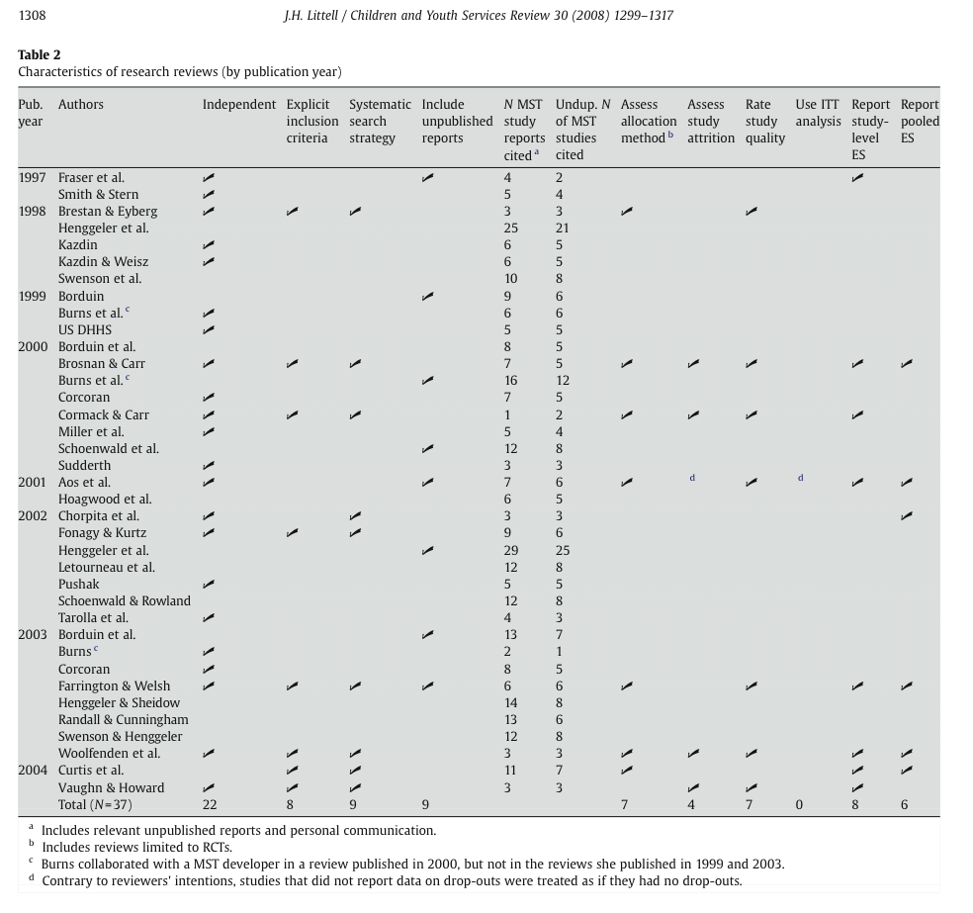
Haphazard reviews are common
37 published reviews
None met all criteria
Fewer than ¼ met any single quality criterion
Littell (2008)

Slide 12
Traditional (haphazard) reviews
Convenience samples of published studies
Narrative description of studies
Cognitive algebra or “vote counting” to synthesize results
Vulnerable to many sources of bias and error

Slide 13
Diffusion of knowledge in the professional literature: The ideal
Reviews
Reports
Studies (all data collected)
Publications
Negative results
Positive results

Slide 14
Diffusion of knowledge in the professional literature: The reality
Reviews
Reports
Studies (all data collected)
Publications
Negative results
Positive results

Slide 15
Diffusion of knowledge in the professional literature
Dissemination of research results is a biased process (Song et al., 2009, 2010)
Selective reporting of outcomes
Publication bias
Citation bias
Confirmation bias

Slide 16
Selective reporting of outcomes
Outcome reporting bias
Reporting of results influenced by their direction and/or statistical significance
“Cherry picking”

Slide 17
Outcome reporting bias (ORB)
Within studies with mixed results, significant results are more likely to be
reported (mentioned at all)
fully reported (i.e., data provided)
(Chan et al., 2004, 2005; Williamson et al., 2006)

Slide 18
Selective reporting of outcomes
BMJ (2010)
“The prevalence of incomplete reporting is high. Trialists seem generally unaware of the implications for the evidence base of not reporting all outcomes…”

Slide 19
BMJ (2010)
Of 42 meta-analyses with statistically significant results
8 (19%) became nonsignificant after adjusting for ORB
11 (26%) overestimated treatment effect by 20% or more
19/42 = 45% of meta-analyses with substantial errors due to ORB

Slide 20
Publication bias
Studies with statistically significant or positive results are more likely to be published than studies with non-significant (null) results
(Begg, 1994; Dickersin, 2005; Scherer et al., 2004; Song et al., 2009; Torgerson, 2006)

Slide 21
Extent of publication bias in different categories of research cohorts: A meta-analysis (Song et al., 2009)
Cohort Type (N) | Publication of Positive versus Other Results
 | Pooled OR | 95% CI
Inception cohorts (12) | 2.78 | 2.10 to 3.69
Registration cohorts (4) | 5.00 | 2.01 to 12.45
Abstract cohorts (28) | 1.70 | 1.44 to 2.02
Manuscript cohorts (4) | 1.06 | 0.80 to 1.39

Slide 22
Publication bias
Sources of publication bias are complex
Investigators don’t think null/negative results are worthwhile
Investigators don’t expect null results to be accepted for publication, so don’t submit them (Dickersin, 2005)
“Publication bias appears to occur early, mainly before the presentation of findings at conferences or submission of manuscripts to journals” (Song et al., 2009).

Slide 23
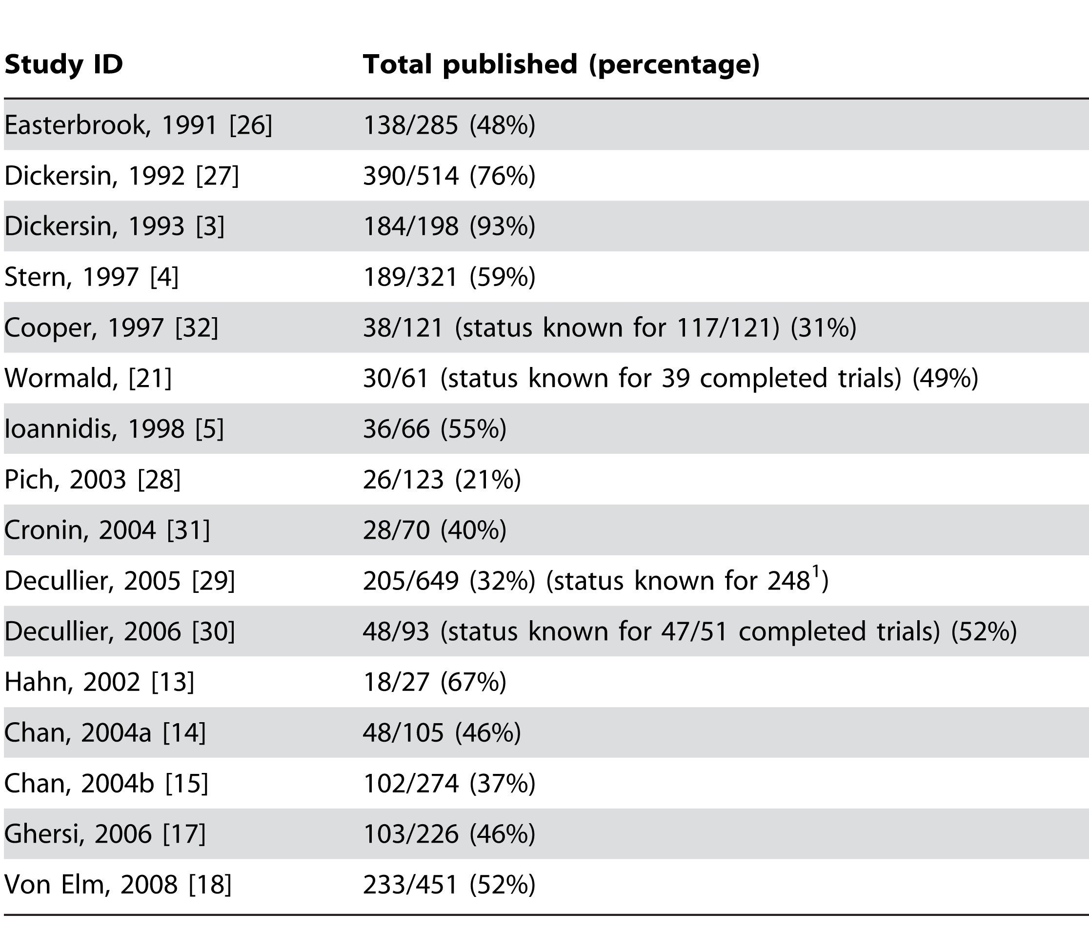
Publication rates
Average 51% of studies are published (16 cohorts)
Source: Dwan et al. (2008), Table 3

Slide 24
Publication rates
Average 51% of studies are published (16 cohorts)
Source: Dwan et al. (2008), Table 3

Slide 25
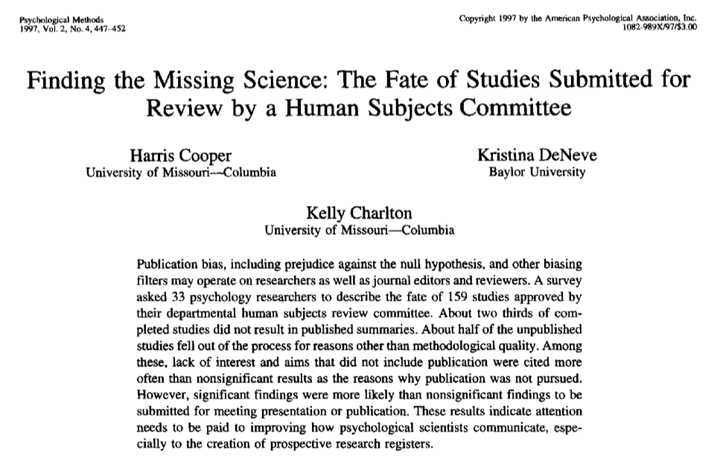
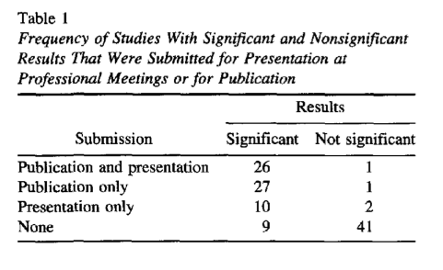
Publication bias in social sciences (few cohort studies)
Sig vs NS results:
Publication RR = 16.6 (OR = 60)
Presentation RR= 7.5 (OR = 14)

Slide 26
Dissemination biases
Studies with significant results are
Published faster (Hopewell et al., 2001)
Cited and reprinted more often (Egger & Smith, 1998)
More likely to be published in English than other languages (Egger, Zellweger-Zahner et al., 1997)
Easier to locate (esp. in English)

Slide 27
Reporting, publication and dissemination biases
Are ubiquitous
Are cumulative
Inflate effect size estimates
(Altman, 2006; Hopewell et al., 2005, 2007, 2009; Song et al., 2009)

Slide 28
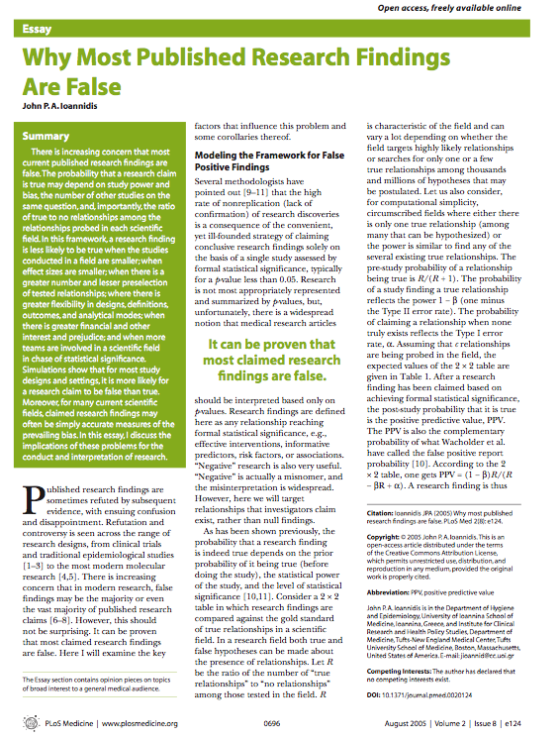
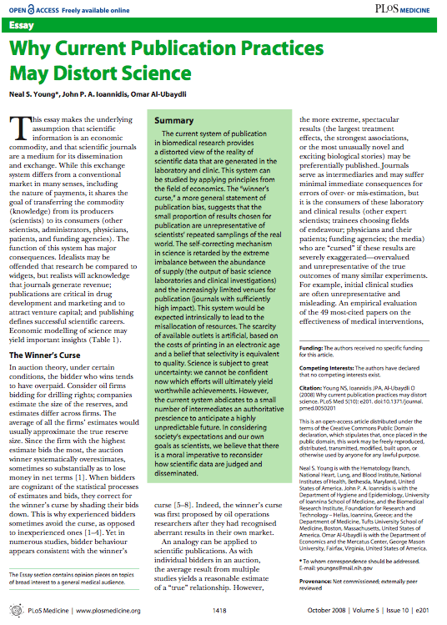
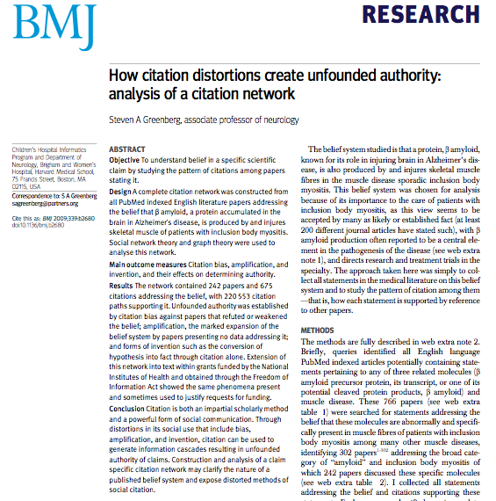

Slide 29
Really?
A real world example
One study published in 1987
How did investigators make use of data?
How did reviewers make use of data?
(Littell, 2008, CYSR)

Slide 30
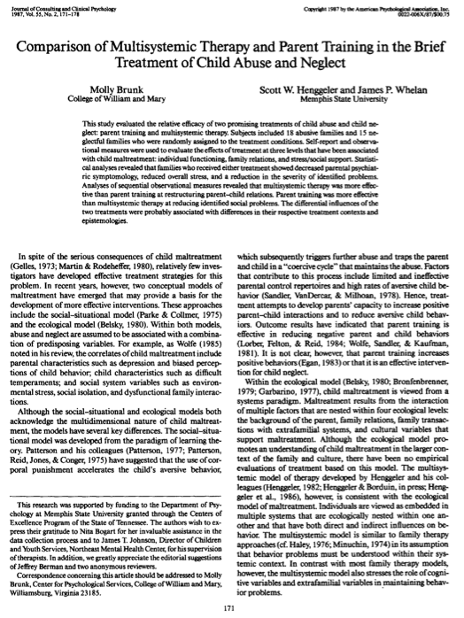
An Example
Parent Training vs Multisystemic Therapy (Brunk et al., 1987)
43 families of abused/neglected children randomly assigned to
Parent training (PT) groups or Multisystemic Therapy (MST)
33 /43 families completed treatment and provided data on outcomes immediately after treatment
30 outcomes (scales and subscales)

Slide 31
Results obtained (Brunk et al., 1987)
Parent Training vs Multisystemic Therapy
Outcome data

Slide 32
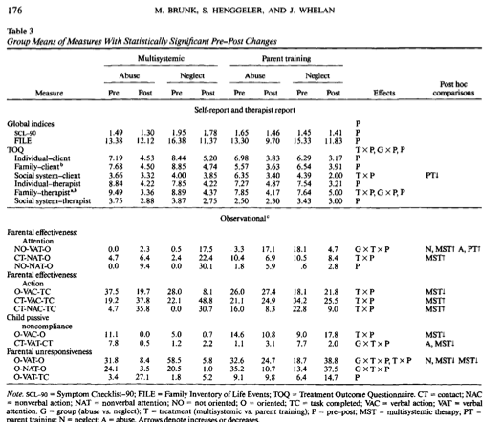
What did the investigators make of these results?
Data provided on
all (7) statistically significant results
12/22 non-significant results
Outcome reporting bias
Data provided
Outcome data
Notes:
Some outcome reporting bias 7/7 sig and 12/22 NS results fully reported

Slide 33
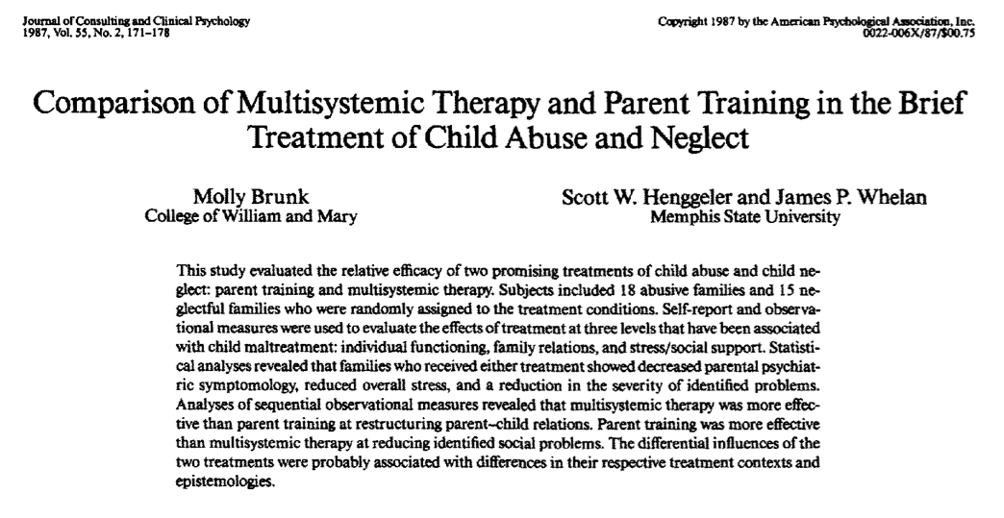
What did the investigators make of these results?
Both groups showed decreased psychiatric symptoms, reduced stress, and reduced severity of identified problems.
MST was more effective than PT at restructuring parent-child relations.
PT was more effective than MST at reducing identified social problems.
Abstract
Data provided
Outcome data

Slide 34
What did the investigators build?
A balanced report
(with some missing data)
Abstract
Data provided
Outcome data
Notes:
Return to what this means for policy and practice later

Slide 35
Content analysis of published reviews of Brunk et al.
Outcome data

Slide 36
Summary: Published reviews describing Brunk et al.
Most reviews used a single phrase to characterize results of this study, highlighting advantages of one approach (MST)
Ignoring valuable information on relative advantages, disadvantages, and equivalent results of different approaches
Outcome data

Slide 37
Next…
Brunk study cited as evidence that MST “works” in cases of child maltreatment (Kazdin & Weisz, Burns, Landsverk)
33/43 families, 1987, no follow-up
“Lite” reviews cite other narrative reviews
Conclusion is repeated
until readers mistake repetition for replication?

Slide 38
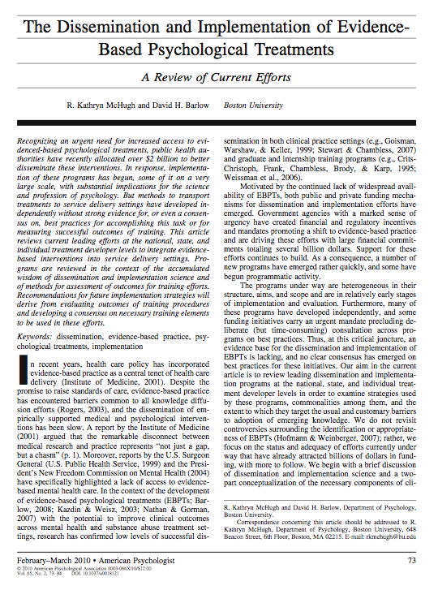
Example of a “lite” review
McHugh & Barlow (2010)
“Evidence-based psychological treatments” (EBPTs)
No assessment of the evidence for these treatments
Cites other reviews, uncontrolled studies

Slide 39
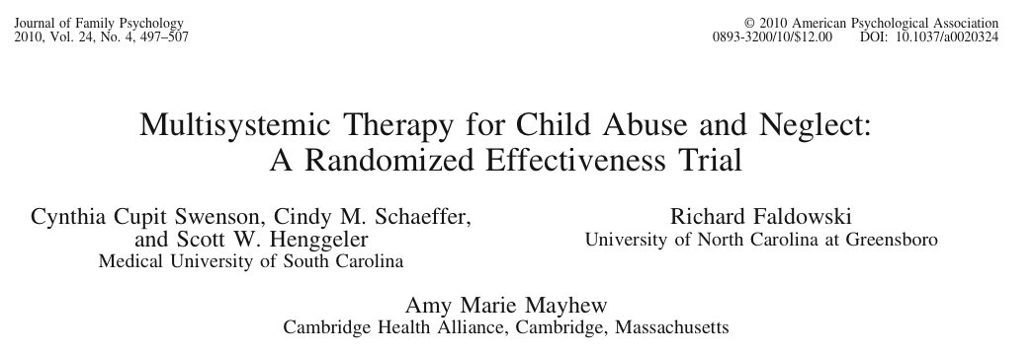
The only other RCT of MST for CAN

Slide 40
Outcome reporting bias Reports effect sizes for significant results ONLY

Slide 41
Diffusion of knowledge in the professional literature: The reality
Reviews
Reports
Studies (all data collected)
Publications
Negative results
Positive results

Slide 42
Why traditional reviews and well-meaning experts can be misleading
Rely on “natural” methods to filter and synthesize data
Human brain
Good at detecting patterns, maintaining homeostasis
Bad at vigilance, complex math, revising beliefs (Runciman, 2007)
Research synthesis is too complex for informal methods, “cognitive algebra”

Slide 43
Rely on heuristic devices, cognitive biases
Anchoring – relying too heavily on one piece of information. Once an anchor is set, there is bias toward it.
Availability/familiarity bias – over-reliance on information that is easily accessible, or easily recalled
Confirmation bias – Tendency to seek and accept information that confirms prior expectations (hypotheses) and ignore evidence to the contrary
Escalation of commitment

Slide 44
Haphazard reviews
Can be very misleading, even when conducted by experts (Petticrew & Roberts, 2006)
“If a review purports to be an authoritative summary of what ‘the evidence’ says, then the reader is entitled to demand that this is a comprehensive, objective, and reliable overview, and not a partial review of a convenience sample of the author’s favorite studies” (Petticrew & Roberts, 2006, p. 6).

Slide 45
Haphazard reviews are hazardous to health and well-being
Mislead readers
Over-estimate positive effects of interventions
Under-estimate or ignore potential harmful effects
Minimize or ignore viable alternatives
Promote ineffective and potentially harmful interventions

Slide 46
Meta-analyses of published studies: “the fine art of getting it wrong” (Ioannidis, 2010)
Meta-analyses
Reports
Studies (all data collected)
Publications
Negative results
Positive results

Slide 47
Systematic reviews must include unpublished reports & data
Systematic Reviews
Reports
Studies (all data collected)
Publications
Negative results
Positive results

Slide 48
Haphazard reviews are increasing (PsychINFO peer-reviewed journals only)

Slide 49
Reviews in ProQuest social sciences subject area (peer-reviewed journals only)

Slide 50
The way forward
To cope with reporting and publication bias:
Prospective registration of all research protocols/proposals by IRBs, as a condition of publication
Journals and reviewers check for potential outcome reporting bias
Raw data available on request for verification
Systematic reviews held to high standards (PRISMA, AMSTAR)

Slide 51
Conclusions: Ethical issues
If we believe that policy and practice should be informed by the best available evidence,
We must conduct evidence syntheses
in accordance with the best evidence on the accuracy of our review methods
Scholars must use evidence to inform our “practice”
Good evidence is available (methodology research) to inform the practice of reviewing research
We must use it

